Slide 1



Astroinformatics cooperation between Bulgarian and Serbian astronomers
Katya Tsvetkova¹, Milcho Tsvetkov¹, Vojislava Protic-Benishek²,
Vladimir Benishek², Milan Dimitrijevic²
¹Institute of Mathematics and Informatics, Bulgarian Academy of Sciences
²Astronomical Observatory of Belgrade

Slide 2
Abstract
The paper promotes the established collaboration in Astroinformatics between Bulgarian and Serbian astronomers. The topics of this collaboration are the discussed concepts for data processing, quantitative analyzing and data mining, data management and visualization. The priority task is to integrate the Serbian astronomical plate archives in the frames of the Wide-Field Plate Database (WFPDB) developed in Bulgaria on the basis of our experience and efforts in astronomical archives processing, data reduction, and implementation of the major protocols for fully featured Virtual Observatory service.

Slide 3
Introduction
The first contacts between Serbian and Bulgarian astronomers - during the annual meeting of the European Astronomical Society in Thessaloniki in 1997 (former Joint European and National Astronomical Meeting – JENAM, which has been renamed since 2009 as European Week of Astronomy and Space Science – EWASS).
The first initiative of this collaboration - organization of the first Bulgarian-Yugoslav (now Bulgarian-Serbian) astronomical meeting in Belogradchik (Bulgaria) in August 1998.
The decision for holding conferences every two years:
The first meeting in Belogradchik (August 1998), Zajecar (2000), Gjulechitsa (2002), Belgrade (2004), Sofia (2006), Belgrade (2008), Chepelare (2010), Leskovac (2012), Sofia (2014), Belgrade (May– June 2016).
The next meeting – to commemorate 20 years of intensive Bulgarian-Serbian cooperation in astronomy in Varna in June 2018.
Cooperation frameworks: variable stars, supernovae, extragalactic astrophysics, Astroinformatics, astronomical services provided by the Virtual Observatory, etc. The observations were conducted with the 2 m RCC telescope of Rozhen Observatory and the 60 cm Cassegrain telescope of the Astronomical Station Vidojevica.

Slide 4
Astroinformatics
Application of the new Information and Communications Technologies in astronomy and astrophysics and usage of the Informatics methods.
Astroinformatics - as data exploration oriented Astronomy and Astrophysics with disciplines as data-intensive computing, astrostatistics, data mining, knowledge extraction, information visualization, information retrieval methods, semantic science presented by semantic data integration, sky-based and catalogue-based indexing techniques, etc.
Astroinformatics - as a fourth paradigm of the astronomical research, which now unifies its historical used models of investigations and thinking - empirical, theoretical and computational ones.
The Astroinformatics collaboration projects - bilateral (as Bulgarian-Serbian one) and multi-lateral projects (as Virtual Observatory projects, COST action 1403 "Big Data in Sky and Earth Observations", the Serbian participation in the Large Synoptic Survey Telescope (LSST) project: 8.2 m telescope situated at Cerro Pachon in Chile, starting observations in six bands from optical to near infrared part of the spectrum in 2022).

Slide 5
Astroinformatics Collaboration
Astroinformatics - as a general topic of the Bulgarian-Serbian astronomical conference in Chepelare in 2010, and organization of special sessions devoted to Astroinformatics for the subsequent joint Serbian-Bulgarian conference in Leskovac in 2012, the Bulgarian-Serbian conference in Sofia in 2014, the Serbian-Bulgarian conference in Belgrade in 2016.
The results of this collaboration concern:
the enlargement and upgrading of the unique Wide-Field Plate Database (WFPDB) developed and managed in Sofia;
digitization of the plates from the Belgrade Astronomical Observatory archives;
organization of database for these plates and services according to certain standards;
the large databases mining;
organization and services for virtual astronomical observatories (European Virtual Observatory - EURO-VO; the German Astrophysical Virtual Observatory – GAVO; Serbian Virtual Observatory – SerVO, which provide access of all astronomical community to the available astronomical data with support of software tools.

Slide 6
Astroinformatics Collaboration Members
From Bulgarian side:
- Research group of Astroinformatics in the Institute of Mathematics and Informatics, Bulgarian Academy of Sciences;
- Department of Astroinformatics of the Institute of Astronomy, Bulgarian Academy of Sciences;
- Research group in the Department of Astronomy of Faculty of Physics, Sofia University;
- Research group in the Informatics Department, New Bulgarian University;
- Research group from "G. S. Rakovski" National Defense College.
From Serbian side:
- Research group of Astroinformatics in the Astronomical Observatory Belgrade;
- Research group of Astroinformatics in the Department of Astronomy, Faculty of Mathematics of the Belgrade University.

Slide 7
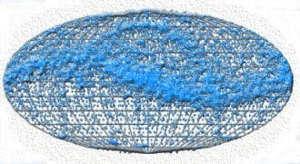
Astroinformatics Collaboration Metadata Provider
Wide-Field Plate Database (WFPDB, www.wfpdb.org) - with homogenized data for the existed astronomical plate observations and their plate archives and contents - (with assigned unique plate identifier, encoding an instrument identifier and a local plate number, for spatial-, temporal-, spectral-, and physical characteristics of the observed objects, semantic object classification, its digitization and availability, giving the person for further contact), as well as providing respective curation for plate digitization for the plate preservation as cultural and scientific heritage and re-use for astronomical research.
WFPDB is a wide-field unique telescope, giving access to the astronomical photographic observations, done systematically worldwide in the period 1880 ~ 2000 and stored worldwide;
The WFPDB project started in the Institute of Astronomy, Bulgarian Academy of Sciences, about 25 years ago. Its aim is to collect data from wide-field astronomical plates (> 1°). The project collects catalogue data (extracted from the log books), describing the plates, as well as digitized images, obtained from scanning the plates.
Currently the WFPDB system contains catalogue data for ~600 000 plates (or 24% of all known two millions and half wide-field plates), as well as ~3 TB of image data (plate previews with dominant 600 dpi resolution, in TIFF or JPG file format, scanned plate logbooks and plate envelopes).
All-sky distribution of plate centers in equatorial coordinates (J2000.0) using Molveide projection of the sky:

Slide 8
Astroinformatics Collaboration Metadata Provider
WFPDB is accessible via an online system, which provides powerful means for searching plates in the database.
Searching is possible by all original plate attributes, e.g. date of observation, plate number, filter, plate emulsion, etc. It is also possible to search for plates within a specified sky region by supplying a pre-defined radius of the region, or using the field of the instrument, to which the plates belongs. Also criteria about the magnitude limit of the desired plates can be specified. It means that the user can limit his search only to plates, which may contain objects as faint, as the specified magnitude.
The results of the query page contain data for the plates found, as well as links to the description of the archive, to which each plate belongs, where a graphical representation of the archive distribution can be seen.

Slide 9
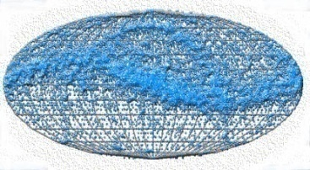
Wide-Field Plate Database: WFPDB meta-model

Slide 10
WFPDB integration to VO and development to Astroinformatics:
The increasing volume of data – reason that the WFPDB underwent transformation to a featured VO service with interoperating data archives and software tools through Table Access Protocol as a VO standard for querying astronomical databases.
Steps:
Development of the equal criteria and parameters for plate digitization according to the VO standards (using FITS format files);
Preprocessing and photometry of digitized plates by the VO tools;
Free access to the files of digitized photographic plates by the VO instruments.
Creating closer links between scientific papers published in Information Bulletin on Variable Stars and the data - included in the WFPDB, on which the papers are based upon gave a possibility of re-use of the plates, which is one of the goals of VO.
Integration of the WFPDB into the German Astrophysical Virtual Observatory as a VO structure.

Slide 11
WFPDB integration to VO and development to Astroinformatics
Processing of large amount of data from the running plate digitization – necessity of usage of methods of Astroinformatics.
Steps:
Visualization of some WFPDB data - AstroWeb on the base of the same data-set as the WFPDB search system;
Pipeline software tools for time conversion and coordinates conversion (usually equatorial coordinates to J2000). The software https://github.com/nkirov/timetool and https://github.com/nkirov/epochtool is written in C++ using Qt cross-platform application and UI development framework (http://qt.digia.com/).
Development of software tools for image processing of the flare star search monitoring multi-exposure plates, as well as for Carte du Ciel triple images plates;
Accurate World Coordinate Systems (WCS) fits of the plates using ASTROMETRY.NET (http://nova.astrometry.net/);

Slide 12
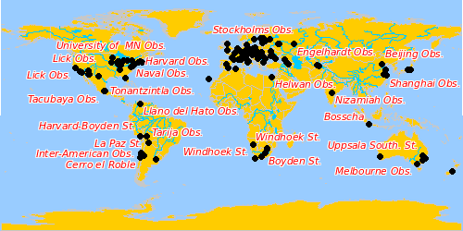
Wide-Field Plate Database: Data Visualization
Through AstroWeb (Alexander Kolev) using the exact data-set as the WFPDB search system.
Visualization: Observatory geographical location, plate archives, content, plate preview.
(http://wfpdb.org:8000/chameleon/astroweb/astroweb.phtml)
Notes:
AstroPlate 2016

Slide 13


Wide-Field Plate Database: Astroinformatics
Standard WFPDB requirements for content and data structure:
WFPDB Software tools:
Time Conversion: Local sidereal time (LST) or local time (local daylight saving time DST) to universal time (UT);
Coordinates Conversion: Equatorial coordinates to J2000.
Conversion Diagram

Slide 14
Wide-Field Plate Database: Present Status and Future Plans
International collaboration for plate archives inventory and their upgrading (only about 25% from all existing plates are visible via WFPDB) - the main aim of the project Humboldt_Astroinformatics.net
Need for collaboration
For plate collections inventory and exchange of experience an international collaboration is strongly desired. It is the main aim of the running project Humboldt Astroinformatics Networking and of the established Humboldt Astroinformatics Network Web Portal, which to be a starting point at any searches, presentations, retrievals, publishing preservation and dissemination of information concerning Astroinformatics in Bulgaria and Germany; to give computational education; to facilitate the historical and cultural heritage research in both countries; to active a social networking, combining Science Portal and Public Portal, as well as the Citizen Science (done by voluntary contributors together with professional scientists); to link to other existed already scientific organizations portals, self-referential portals and some astronomical image processing home pages and wikispaces (e.g. Astroplate Wiki at: https://www.plate-archive.org/wiki/index.php/Main_Page) for further exchange of knowledge, software and archival procedures, as well as for improving the standardization of metadata, catalogue data and scientific tools.

Slide 15
Wide-Field Plate Database: Astroinformatics
Humboldt Astroinformatics Networking
To enable and maintain the contacts between Bulgarian and German scientists and scholars from astronomical institutes, centres, observatories and scientific groups, where Astroinformatics is developed as a single topic.
The benefit: -
In providing data for the plate archives worldwide; computational services; user-based research tools. Except exchange of available data for operations and tools for analyzing and/or storing very large datasets, as well as for standards and protocols development, it will helps also for data preservations and curation through innovative use of information technology.
Optional contacts with countries from the Southeast Europe: – the neighboring Balkan countries – Serbia, Romania, Greece, Turkey, as well as Armenia and Ukraine,
To serve as regional node for Astroinformatics establishing in such way innovative multilateral academic cooperation.
Establishment of a web portal (Humboldt Astroinformatics Web Portal) - the starting point at any searches, presentations, retrievals publishing preservation and dissemination of information concerning Astroinformatics in Bulgaria and Germany.

Slide 16
Wide-Field Plate Database: Astroinformatics
Humboldt Astroinformatics Networking
Establishment of a web portal - Humboldt Astroinformatics Web Portal
Aims:
Starting point at any searches, presentations, retrievals publishing preservation and dissemination of information concerning Astroinformatics in Bulgaria and Germany;
Computational education ;
To facilitate the historical and cultural heritage research in both countries;
Social networking, combining Science Portal and Public Portal;
Citizen Science (done by voluntary contributors together with professional scientists) ;
Links to other existed portals on Astroinformatics –
- by scientific organizations (e.g. with Astrostatistics and Astroinformatics Portal at http://asaip.psu.edu at Penn State University, USA, established in 2012; with South African Astroinformatics Alliance or SA3 at http://www.sa3.ac.za/, established in 2013)
- or to self-referential portals which are rather personal home pages (e.g. astroinformatics.de - a personal astronomical image processing home page
- to wikispaces (e.g. Astroplate Wiki at https://www.plate-archive.org/wiki/index.php/Main_Page – a space to further the exchange of knowledge, software and archival procedures, as well as to improve the standardization of metadata, catalogue data, and scientific tools).
- to other web-portals (e.g. “Alumniportal Deutschland”).

Slide 17
Wide-Field Plate Database: Astroinformatics
Humboldt Astroinformatics Networking
Humboldt Astroinformatics Web Portal – Structure
Introduction to the topic – overview of the status in Bulgaria and Germany;
Presentation of the basic articles on the topics developed in Bulgaria and Germany;
Links to the running projects;
Links to other similar portals and wikispaces;
Information about the participants including Emails for contacts and user support; Interactive blog for discussions and comments with functions as a social networking service, which except in communication mode could be used for education, e.g. for giving instructional resources;
Dictionary of the used terms;
News;
Events.

Slide 18
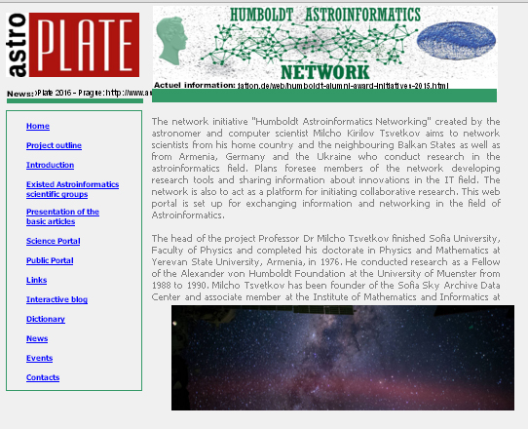
Humboldt Astroinformatics Network web site

Slide 19
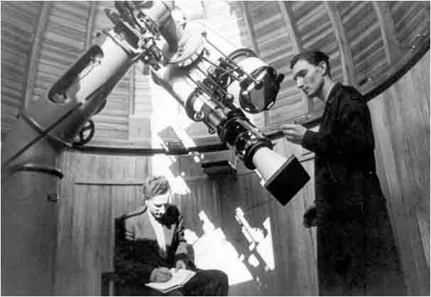
Incorporation of the Belgrade Zeiss Astrograph Plate Catalogue in the WFPDB
The 16 cm Belgrade Zeiss Astrograph with the main observers M. Protić and C. Chepinać

Slide 20
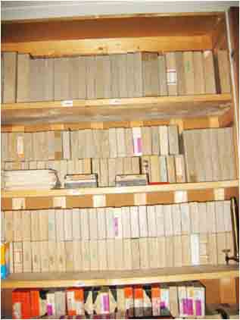

Analysis of the incorporated into WFPDB Belgrade BEL016A plate catalogue
The plate catalogue is available online in WFPDB-Sofia
Box with plates with French high-speed emulsion Guilleminot used predominantly for the Belgrade Zeiss astrograph plate observations
Belgrade Zeiss astrograph
plate storage

Slide 21
Incorporation of the Belgrade Zeiss Astrograph Plate Catalogue in the WFPDB
The first photographs of the Belgrade Observatory collection were taken with the Zeiss astrograph in 1935: open cluster Pleiades and four minor planets - 11 Parthenope, 27 Eutherpe, 569 Misa and 889 Erinia with exposure time of whole 3 hours! (Protic 1935). However, the photographic observations started systematically in 1936 when a detailed rectification of Zeiss astrograph was performed, optical characteristics of its objectives were examined and limiting magnitudes as function of exposure time were determined, as well as the methods of observation.
The historical plate archive of the 16 cm Zeiss Astrograph of the Belgrade Observatory contains 1939 plates taken in the period 1936-1973 mainly by M. Protić and C. Cepinać. The limiting magnitude is 14-15 mag. The metadata is published on the web site of the Serbian Virtual Observatory (SerVO)
http://servo.aob.rs/photo_plates_archive/).

Slide 22
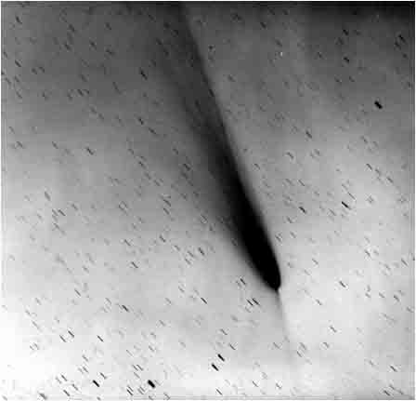
Incorporation of the Belgrade Zeiss Astrograph Plate Catalogue in the WFPDB
Reproduction of the BEL016A57025 plate with the comet Arend-Roland (1956h) observed in1957

Slide 23
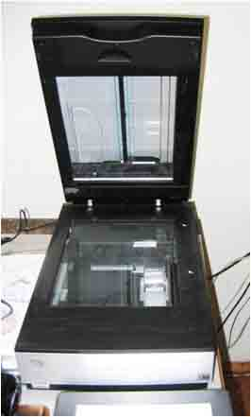
Incorporation of the Belgrade Zeiss Astrograph Plate Catalogue in the WFPDB
EPSON V700 Perfection flatbed scanner of the Astronomical Observatory of Belgrade used for the digitization of the Zeiss Astrograph (BEL016A) plates

Slide 24

Incorporation of the Belgrade Zeiss Astrograph Plate Catalogue in the WFPDB
The Zeiss Astrograph plate archive (BEL016A) - the first of the Belgrade observatory plate archives with:
a complete inventory;
accessibility of the electronic metadata catalogue through the Serbian Virtual Observatory web page.
The WFPDB incorporation became possible after:
assigning a unique WFPDB identifier: Observatory + Aperture + original plate number
BEL016A 570025

Slide 25
Incorporation of the Belgrade Zeiss Astrograph Plate Catalogue in the WFPDB
The WFPDB incorporation (continuation)
In January 1949 up to December 1949 the serial plate numbering had dropped and began again from 1, following the model "year-plate number“, e.g. BEL016A 490001. The serial numbering from continued up to December 1955. Since January 1956 for every year there is a separate plate numbering according to the model "year-plate number“ (last two digits of the year plus the consecutive plate number for this year). It makes the plate number unique.
Period Plate Serial Number
Feb 1936 – Dec 1948 000001 – 001013
Jan 1949 – Dec 1949 490001 – 490036
Jan 1950 – Dec 1955 001014 – 001588
Jan 1956 – Dec 1956 560001 – 560147
………..
………..
Jan 1973 – Dec 1973 730001 – 730026
metadata reduction to the required WFPDB format (for coordinates and time).
errors corrections (e.g. BEL016A000967, BEL016A000968 with date 1928).
Information retrieval from the WFPDB - Sofia Search Page (http://www.wfpdb.org).
The notes, as well as the names of the objects, are given in Serbian language as they are in the original version.

Slide 26
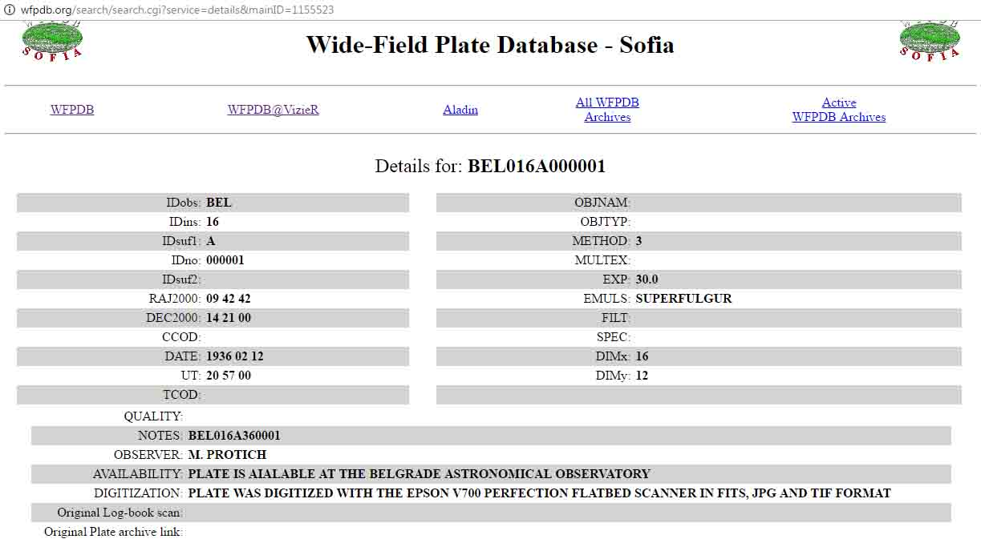
Incorporation of the Belgrade Zeiss Astrograph Plate Catalogue in the WFPDB
Wide-Field Plate Database - Sofia
Search Result

Slide 27
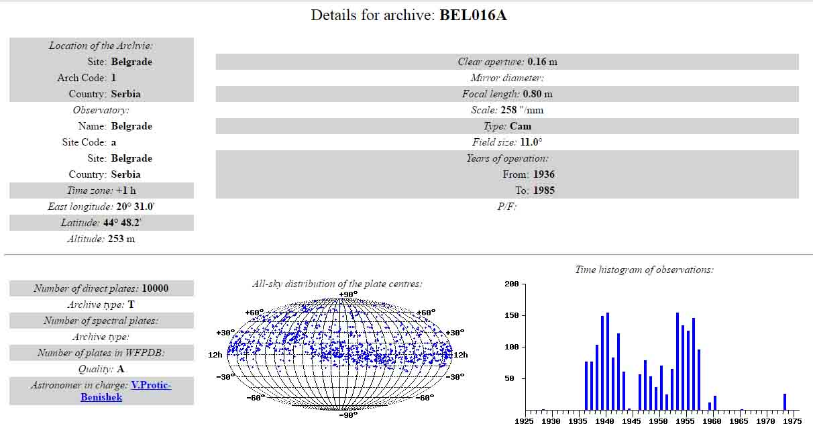
Incorporation of the Belgrade Zeiss Astrograph Plate Catalogue in the WFPDB
Wide-Field Plate Database – Sofia
Details for archive: BEL016A

Slide 28
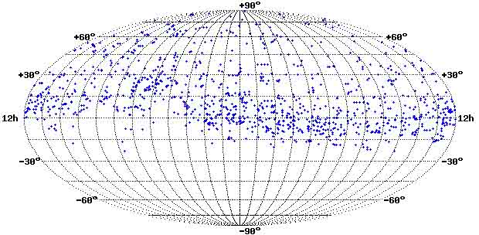
Analysis of the Belgrade Zeiss Astrograph Plate Catalogue in the WFPDB
All-sky distribution of the BEL016A plate centers
(http://wfpdb.org/search/search.cgi)

Slide 29
Analysis of the Belgrade Zeiss Astrograph Plate Catalogue in the WFPDB
Time distribution of the BEL016A plates

Slide 30
Analysis of the Belgrade Zeiss Astrograph Plate Catalogue in the WFPDB
Object Distribution of the WFPDB BEL016A Plate Catalogue
There is information only for 86% of all 1936 plates or for 1674 plates.
Observations of :
Known minor planets as 10 HYGIEA, 11 PARTHENOPE, 2 PALLAS, 23 THALIA, 4 VESTA, 29 AMPHITRITE, 78 DIANA, as well as 33 new minor planets discovered at AOB on 1122 plates;
Comets on 268 plates;
Stellar regions, stellar clusters (Pleiades), variable stars, Moon, galaxies, etc. – 284 plates.

Slide 31
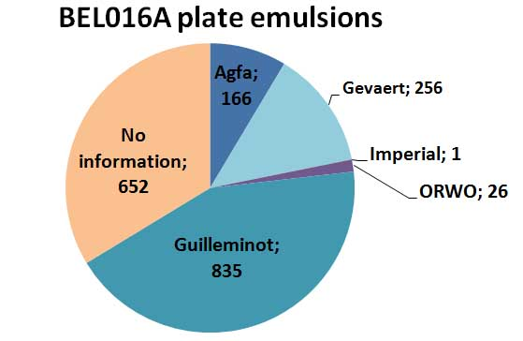
Analysis of the Belgrade Zeiss Astrograph Plate Catalogue in the WFPDB
Plate Emulsion Distribution of the WFPDB BEL016A Plate Catalogue

Slide 32
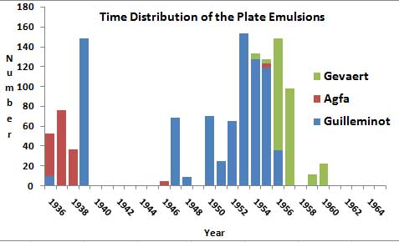
Analysis of the Belgrade Zeiss Astrograph Plate Catalogue in the WFPDB
Time Distribution of the WFPDB BEL016A Plate Emulsions

Slide 33
Хвала на пажњи
Захваљујем се организаторима конференције RAZVOJ ASTRONOMIJE KOD SRBA IX
за позивање учешће

