Slide 1


IONOSPHERIC DISTURBANCES DUE TO SOLAR FLARES
RECORDED BY VLF RECEIVER LOCATED IN TUNIS
Ahmed Ammar,
Hassen Ghalila
Laboratoire de Spectroscopie Atomique, Moléculaire et Applications
Faculté de Science de Tunis – Université Tunis El Manar
ammarahmed.ph@gmail.com

Slide 2
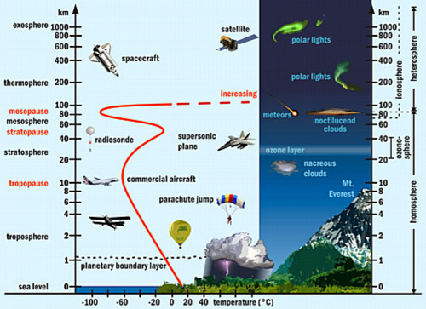
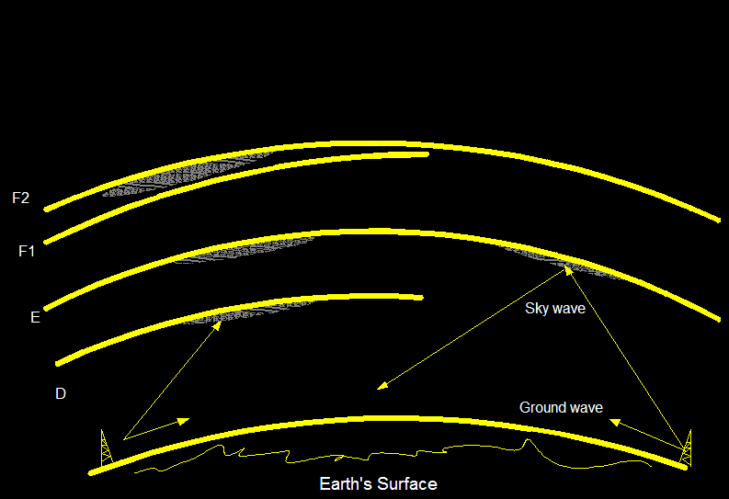
The terrestrial Ionosphere
Probing the IONOSPHER with
VLF-radio transmissions through the
Earth-Ionosphere waveguide
IONOSHERE
Daytime
Nighttime
D&E-REGION

Slide 3
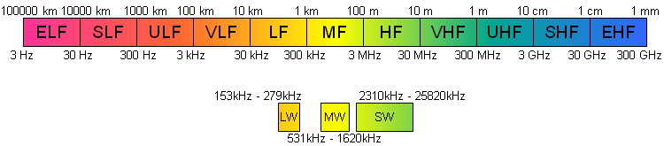
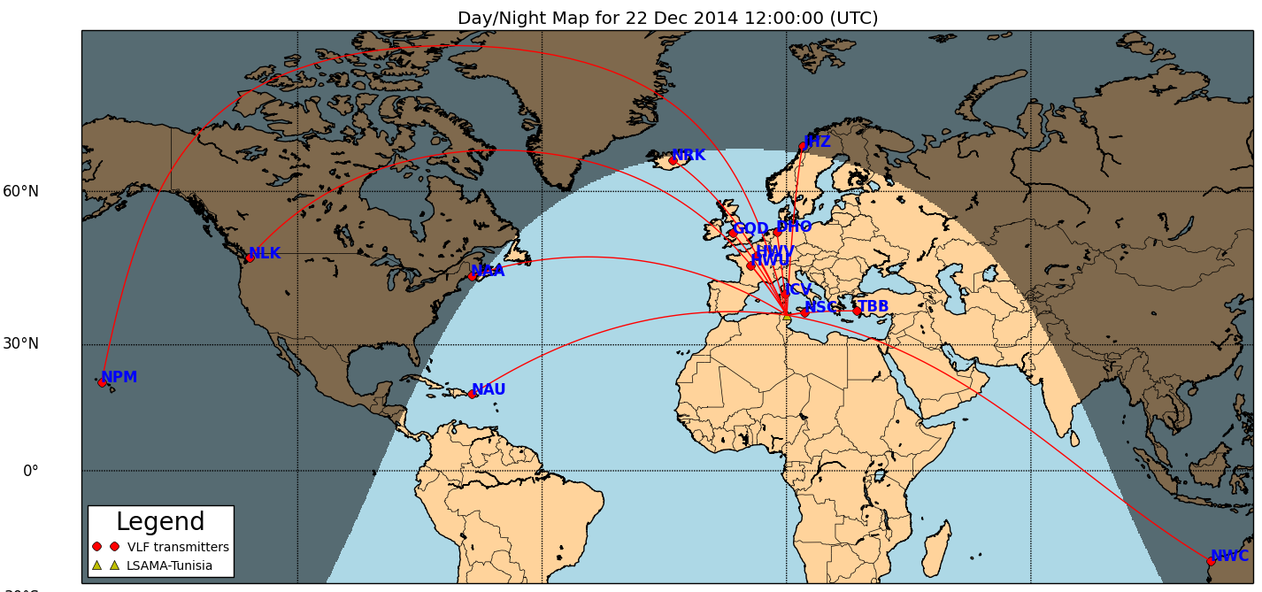
The Very Low Frequencies (VLF-radio)

Slide 4
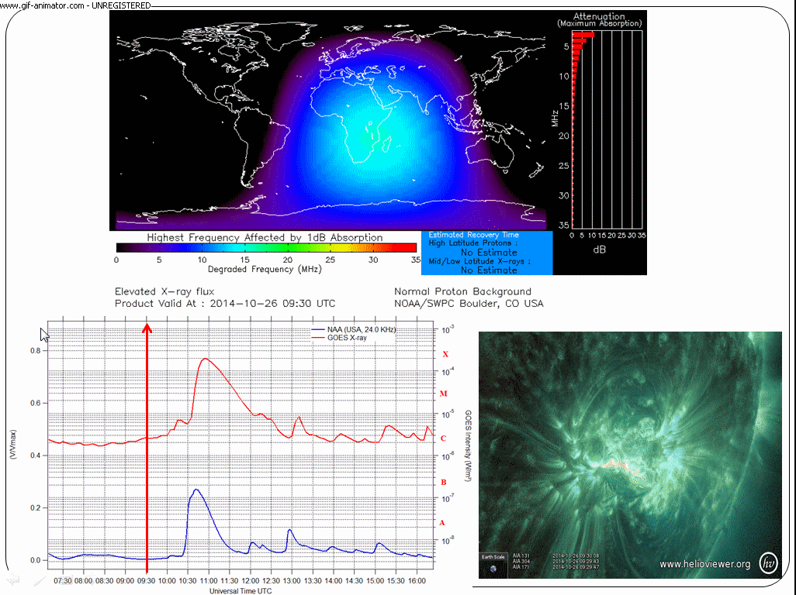
Perturbations of VLF/LF radio signals by solar X-ray flare
Flare X2.0
GOES X-ray satellite
SID event
SuperSID LSAMA-Tunisia

Slide 5
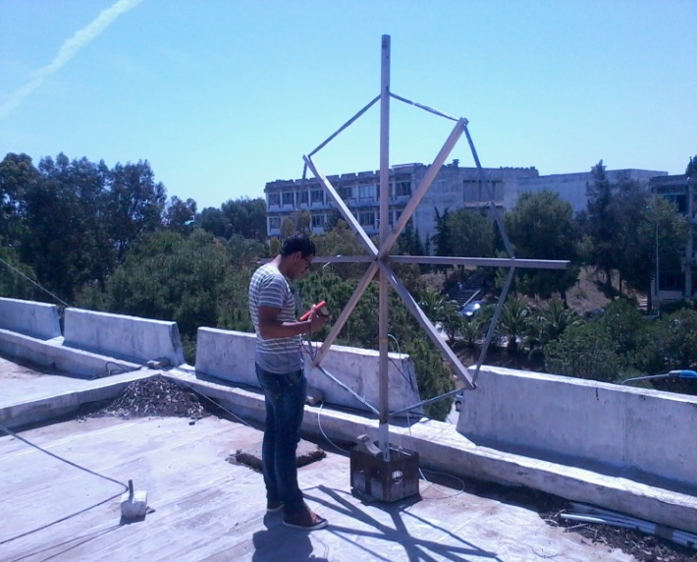
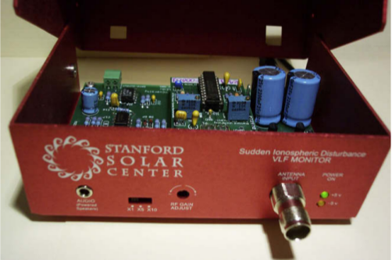
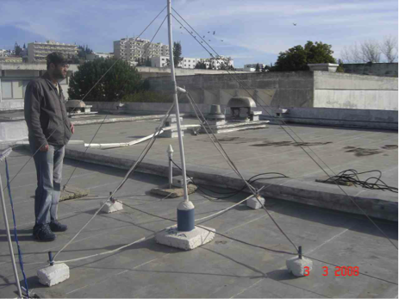
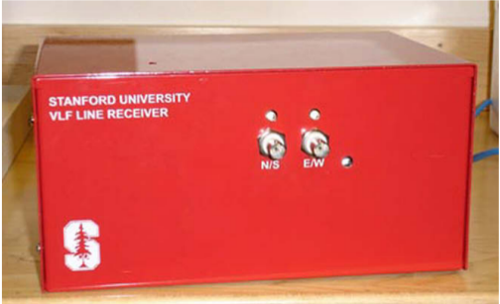
LSAMA’s ELF/VLF equipments
SID MONITOR
SuperSID MONITOR
SID/SuperSID antenna
AWESOME

Slide 6
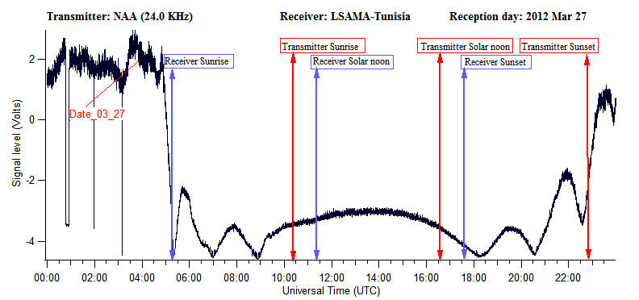
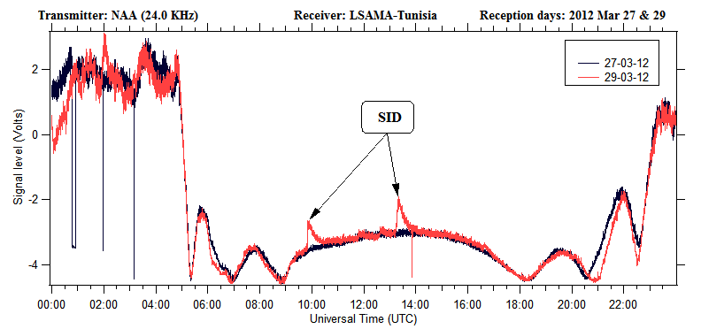
Signature of SIDs in the VLF signal
Path is completely in the dark
Path is partially in the dark
All the path is exposed to the sun
Path is partially in the dark
Path is completely in the dark
Path is partially in the dark
All the path is exposed to the sun
Path is partially in the dark

Slide 7
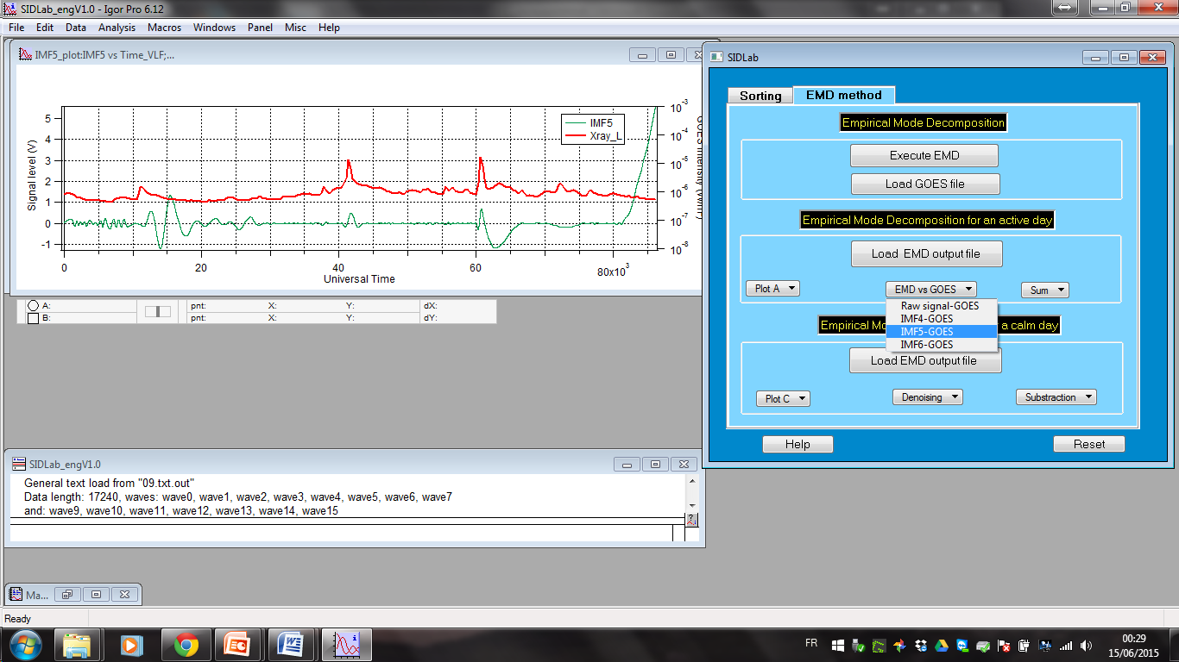
Numerical tool : SIDLab-V1.0

Slide 8
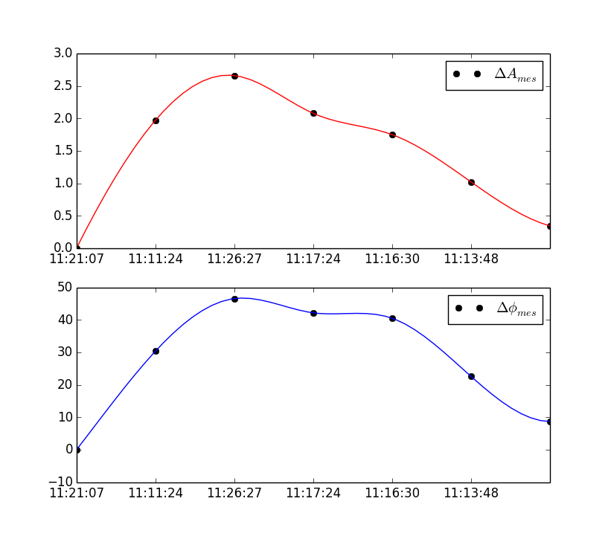
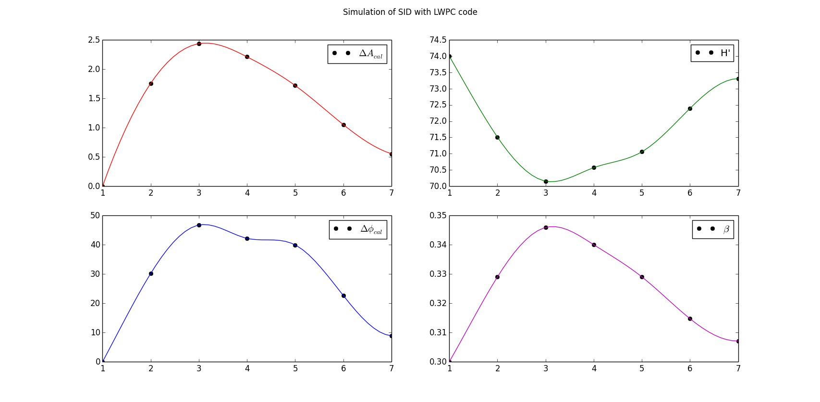

SIMULATION TECHNIQUE USING LWPC CODE
In our study, the Long Wave Propagation Capability (LWPC) code developed by the Naval Ocean Systems Center (NOSC), San Diego, USA for the propagation of VLF waves into the Earth Ionosphere Waveguide (EIWG) (Ferguson 98) has been used to model D-region ionosphere during solar flare conditions.
MESURED VLF AMPLITUDE AND PHASE DURING SOLAR FLARE RECORDE BY OUR AWESOME VLF RECEIVING STATION.
CALCULATED VLF AMPLITUDE AND PHASE from LWPC model during SOLAR FLARE.
Estimated values of change in Wait ionospheric parameters during SOLAR FLARE.
The upper boundary of this waveguide is the earth ionosphere that is characterized by the conductivity. In LWPC, we use Wait's exponential ionosphere (Wait and Spies, 1964) for the electron density profile valid up to 100 Km altitude.
h’ (Km) :The effective reflection height
β (Km⁻¹) : The sharpness
We perform numerical simulations in an effort to quantitatively understand the observed variations in the D-region and discuss the results in the light of current understanding on the effect of solar flares on this terrestrial ionospheric layer.

Slide 9
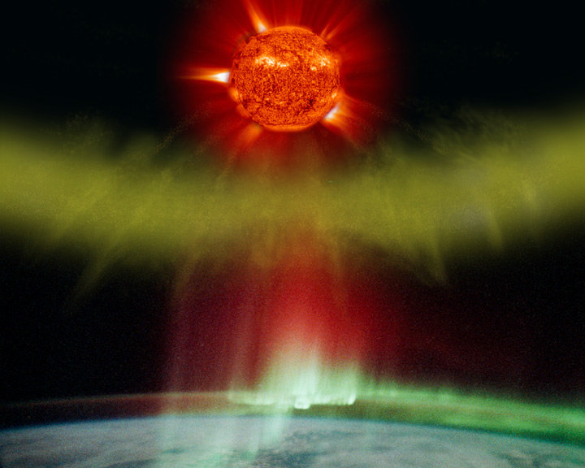
Thank you!

