Slide 1
The method for mapping electric field distribution in
cathode fall region of an abnormal glow discharge
using neutral neon spectral line shapes
N V Ivanović¹, G Lj Majstorović², N M Šišović³
¹University of Belgrade, Faculty of Agriculture, 11080 Belgrade, Serbia
²University of Defence, Military Academy, 11105 Belgrade, Serbia
³University of Belgrade, Faculty of Physics, 11001 Belgrade, Serbia

Slide 2
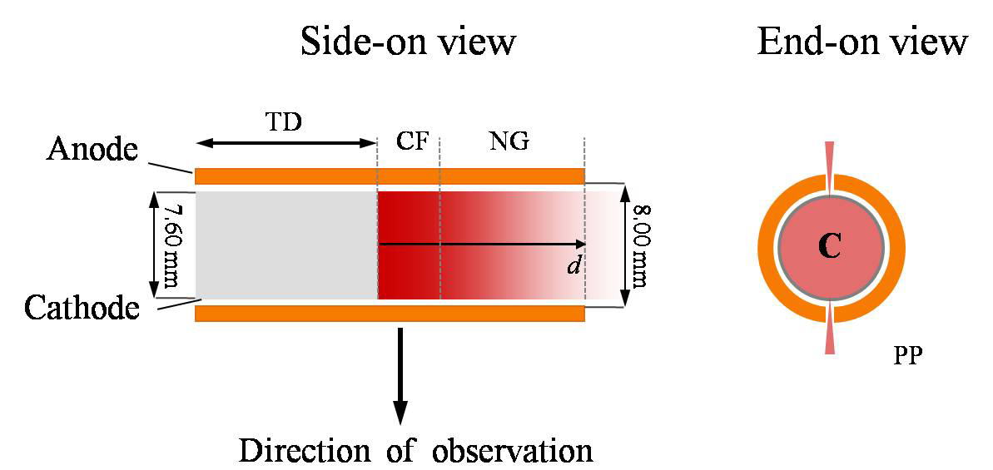
End – on view
Figure 1. Schematic diagram of the central part of the Grimm GD for side-on and end-on observations. Symbols: TD – translation direction, CF – cathode fall region, NG – negative glow region,PP – protruding plasma, C – cathode.
Side – on view

Slide 3
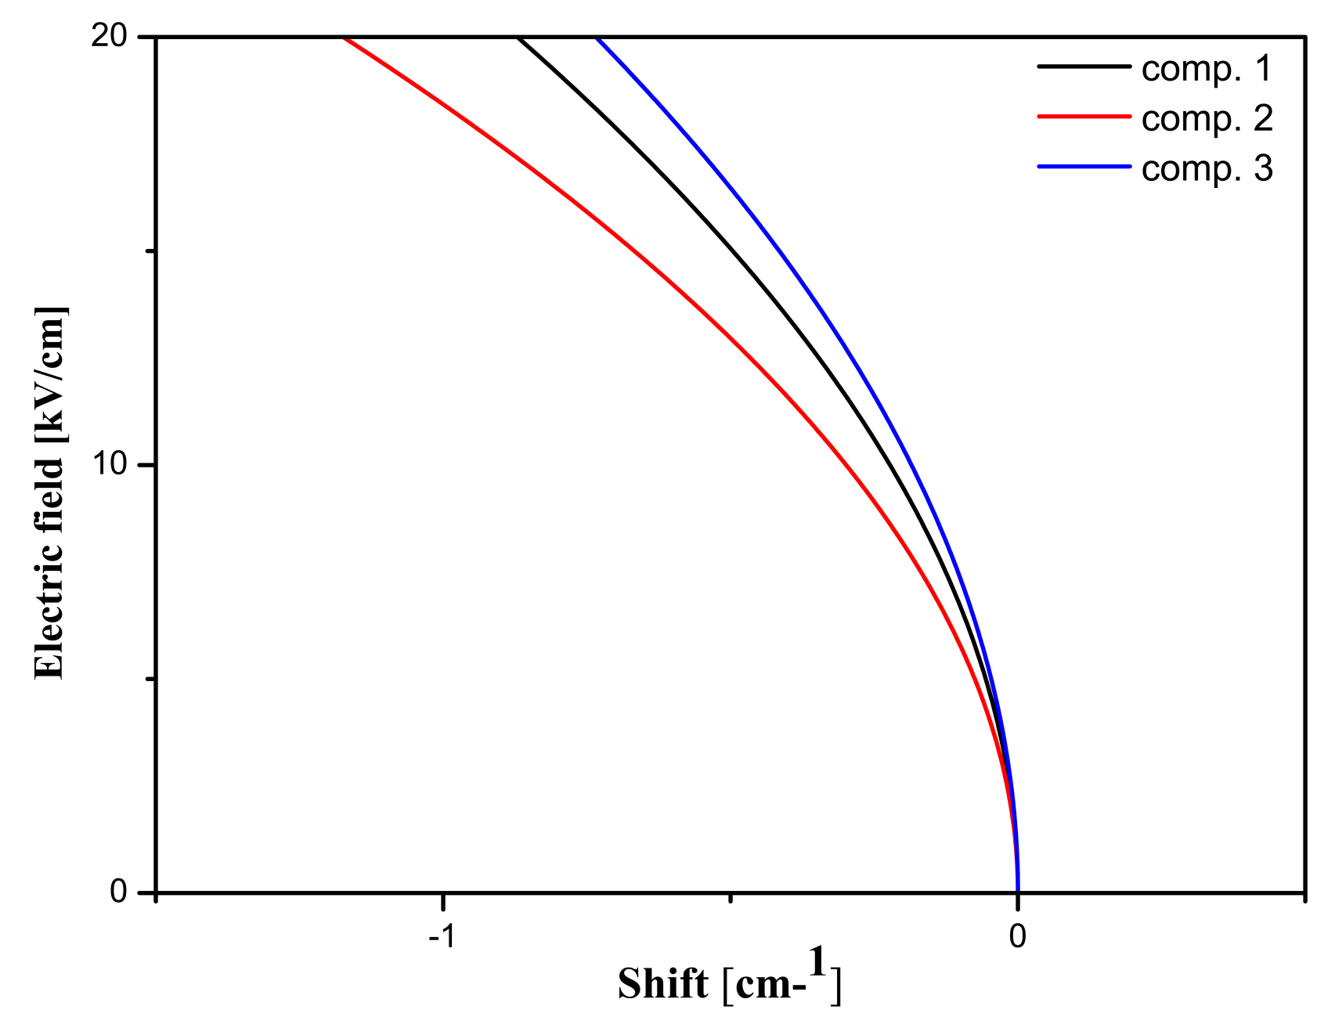
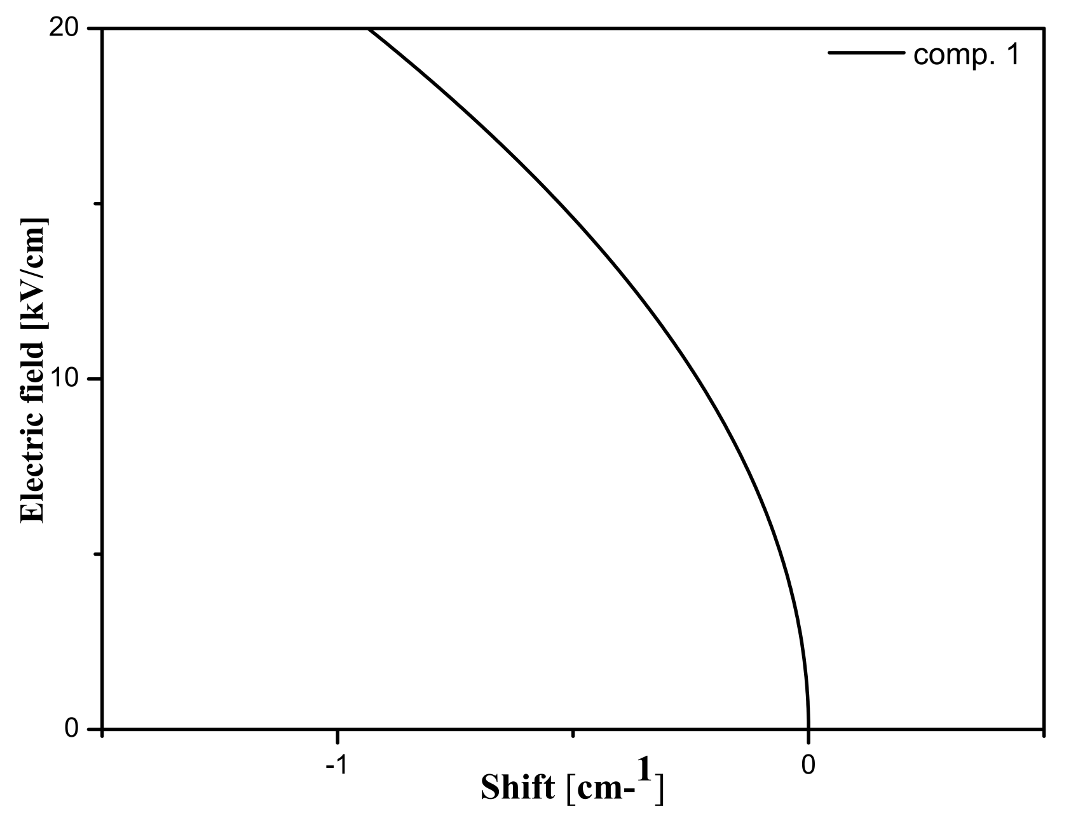
Figure 2. Behaviour of terms group 4d': Ne I 511.367 nm in a Stark field calculated from equation (1) using data from Table II in Ref. 3.
Figure 3. Behaviour of terms group 4d': (a) Ne I 511.650 nm in a Stark field calculated from equation (1) using data from Table II in Ref. 3.

Slide 4
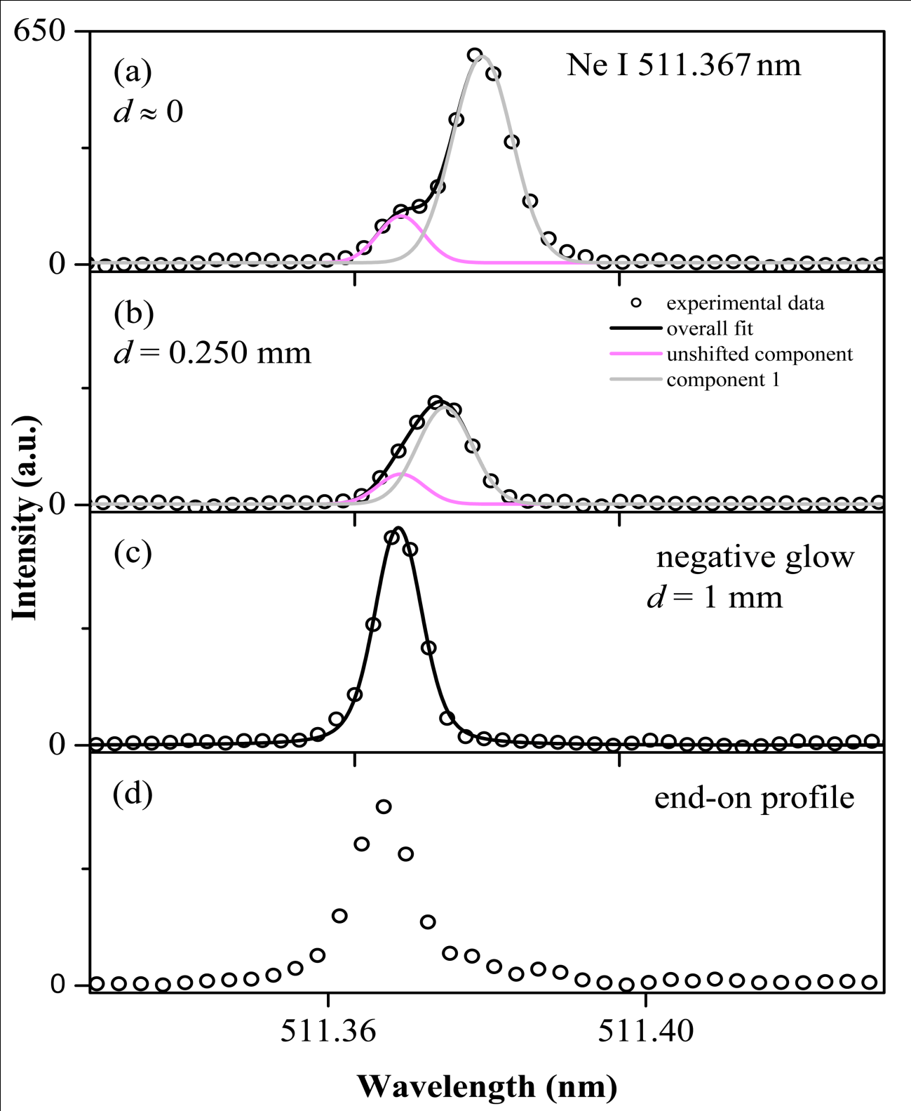
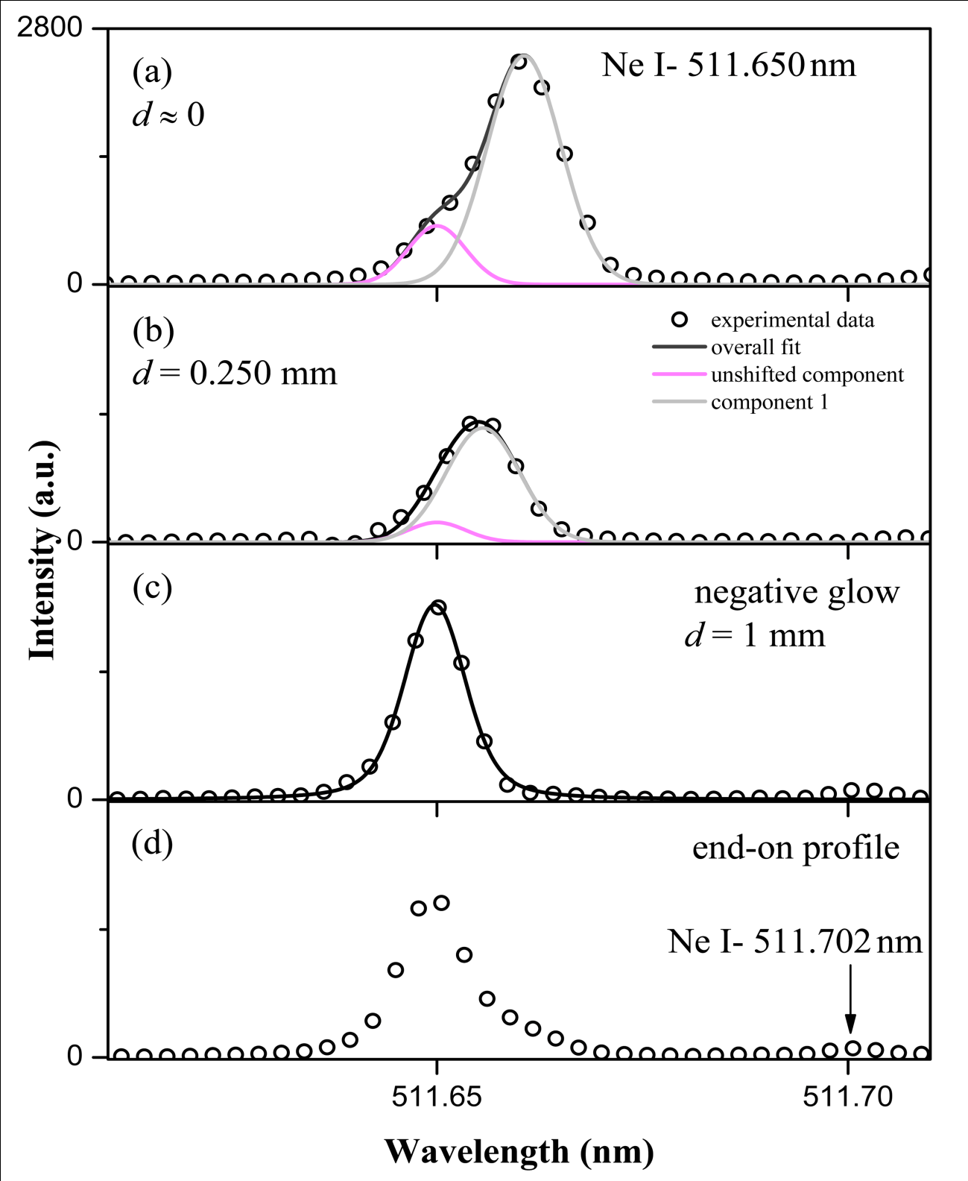
Figure 4. Spectral line shapes and best fits of Ne I 511.367 nm at different axial positions from cathode: (a), (b) and (c); and end-on experimental profile: (d) Discharge conditions: iron cathode,
p = 6.5mbar; I = 12 mA; U = 600 V.
Figure 5. Spectral line shapes and best fits of Ne I 511.650 nm line. at different axial positions from cathode: (a), (b) and (c); and end-on experimental profile: (d) Discharge conditions: iron cathode,
p =6.5mbar; I = 12 mA; U = 600 V.

Slide 5
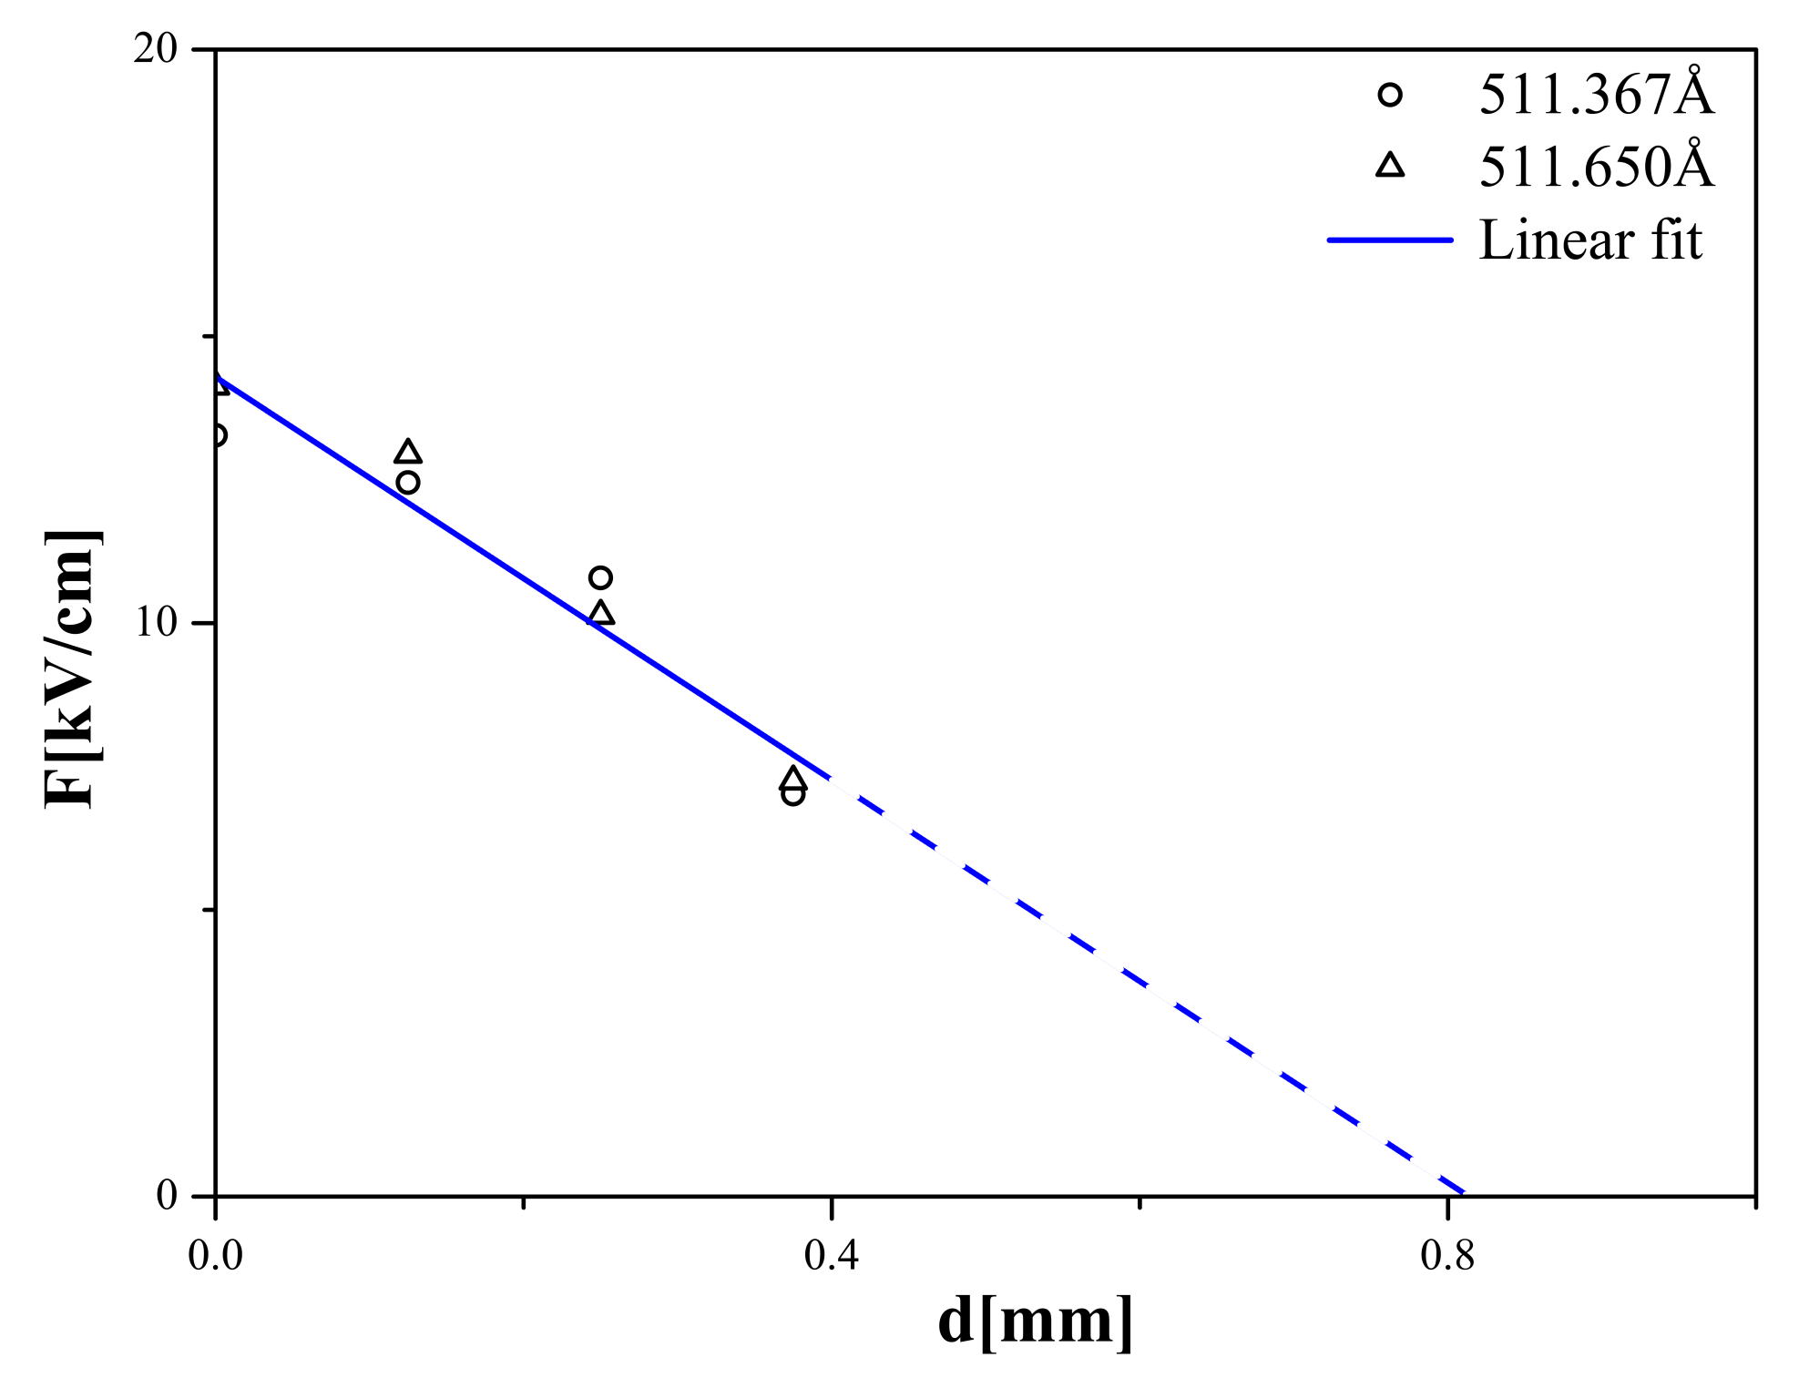
Figure 6. Calculated electric field strength in the CF region of GDS by using measured shifts for Ne I 511.367 nm and Ne I 511.650 nm line. Discharge conditions: iron cathode: p = 6.5 mbar; I = 12 mA; U = 600V .

Slide 6
Thank you for your attention!

