Slide 1
CRYOPLASMA IN HELIUM INDUCED BY CORONA DISCHARGE
N. Bonifaci, F. Aitken, G2Elab Grenoble, France
V Atrazhev, Joint Institute for High Temperatures, Russia
V.A. Shakhatov, Topchiev of Petrochemical Synthesis Institute, Russia
J. Eloranta Department of Chemistry,California State University, USA
K. von Haeften , Leicester University, Leicester, UK
G Vermeulen, Institut Néel Grenoble, France
1

Slide 2
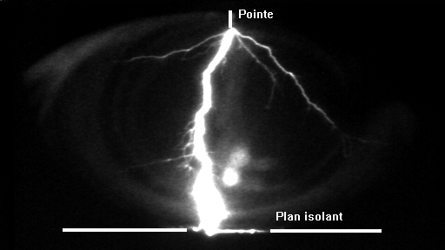
Motivation
Discharges in dense fluids (liquids or high-pressure gases :1-100 bar)
Filamentary Streamers in Liquid N₂
This process in dense fluids is very complex that involves
- electronic phenomena : electron injection, electron impact, excitation and ionization
thermal phenomena: phase change
- hydrodynamic phenomena : formation of pressures waves, propagation of discharge channel.
Modeling
2

Slide 3
Cryoplasma in Helium
Discharge model in liquid model
µ-discharge
Liquefied Helium
Gas liquid
300k
4.2k
Condensed ⁴He
Interaction of atoms He*, molecules He₂, and e⁻ with helium in various thermodynamic phases and states
nanoscopic probes
3

Slide 4
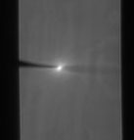
Corona discharge in dense helium
CCD Camera picture
Liquide
Transport zone : E ~ kV/cm µ_{e} and µ+
Ionization zone : E_{p}~ MV/cm
Light emission
I ~ 0.1-50µA, DC V ~ kV
Applied power : 0.5-100mW
gap distance~mm
R_{p} ~ 0.1-0.2µm
Gas pressure ~ 1-100 bar
  Densities of the plasma particles (N_{e} and N_{p}), Temperature, etc
Crucial importance for the modelling of plasmas produced by electric discharges
4
4

Slide 5
Electrons in condensed ⁴He
Electron bubbles are formed by excess electrons in condensed He
Electronic mobility
Free e-
e⁻ repulses surrounding atoms He
Repulsive interaction
Transition
e⁻ bubble
N_{tr}∼10²¹cm⁻³
5
5

Slide 6
Optical Spectroscopic Investigation
Discharge in helium supercritical at 300 K and 150 K | Discharge in helium liquid at 4.2 - 5.1K In helium supercritical T<12K
He* lines, He₂* excimers, Impurities N₂*, N₂⁺ ,H*, O*, OH Continuum emission (400-1000 nm) | He* lines, He₂*

Slide 7
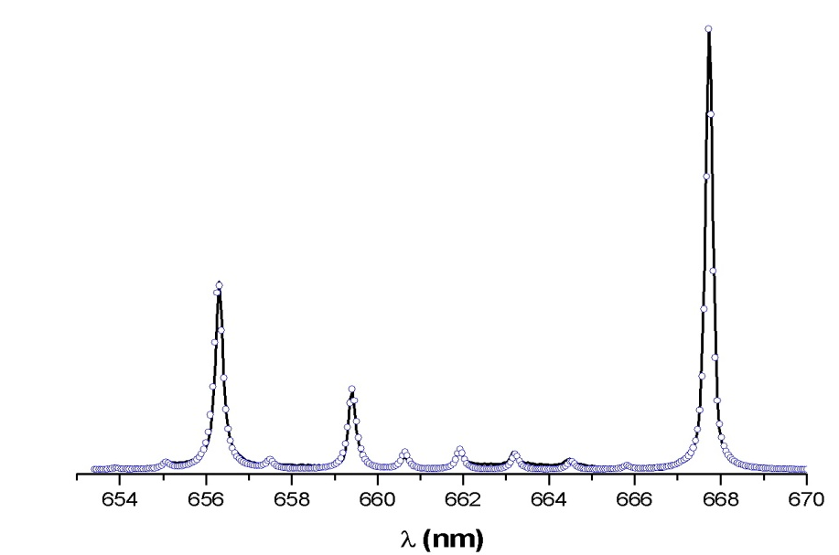
Kinetic temperature of Discharge at 300K
Rovibrational spectra of molecules
He₂
P=1-20bar
P=1-5 bar
T_{rotational} =300K-320k ≈ T_{k}
(P=1-20Bar)
T_{k}
Cold plasma

Slide 8
At 300K Hydrogen line : Electron density Ne
Hydrogen H_{β} 486.1nm
The lorentzian width of the H_{β} profile is ascribed to stark broadening
w
Stark width
w
N_{e}~10¹⁵-10¹⁶ cm⁻³
He I Δλ_{stark}=0,08-0,2nm
He I : Stark Broadening

Slide 9
At 300K Analysis of atomic He line 706.5 nm
“Blue” wing
P
Blue satellites
Main line disappears

Slide 10
Results for He line 706 nm (³S-³P) at 300K
Comparison between experiment and theory
ν
ν
ν
N_{p}=2.4 10²⁰ cm³
^{P=10 bar}
N_{p}=3.8 10²⁰ cm³
^{P= 16 bar}
N_{p}=4.8 10²⁰ cm³
^{P= 20 bar}
perturber density
N_{p} ≈ N
N ALLARD, et al EPL 88 (2009) 53002
N ALLARD, et al EPJ D 61 (2011) 365-372

Slide 11
Discharge in helium gas at 300 K
N_{plasma} and T_{kinetic} at T = 300 K
Transport zone
Ionization zone
N
T= 300 K
N_{Plasma}~ N
N_{e}∼ 10¹⁵-10¹⁶cm⁻³
T_{kinetic}~ 300-320K
11

Slide 12
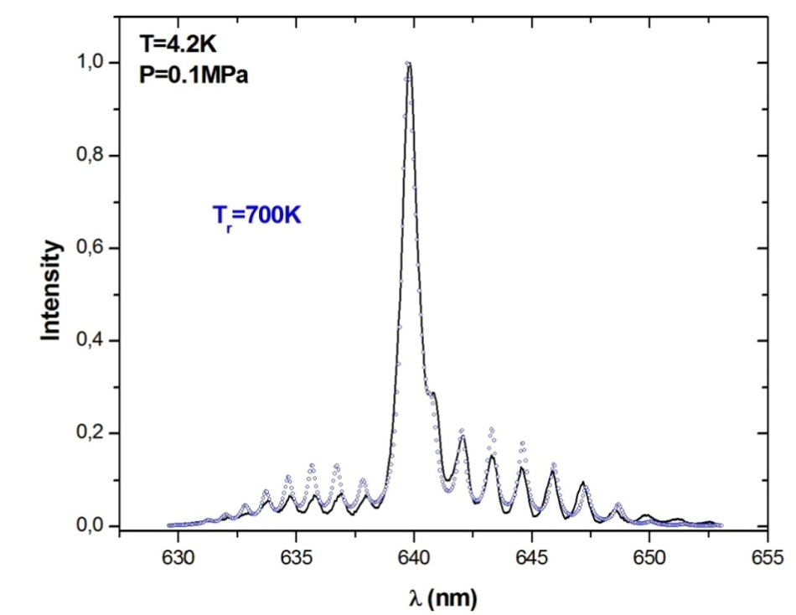
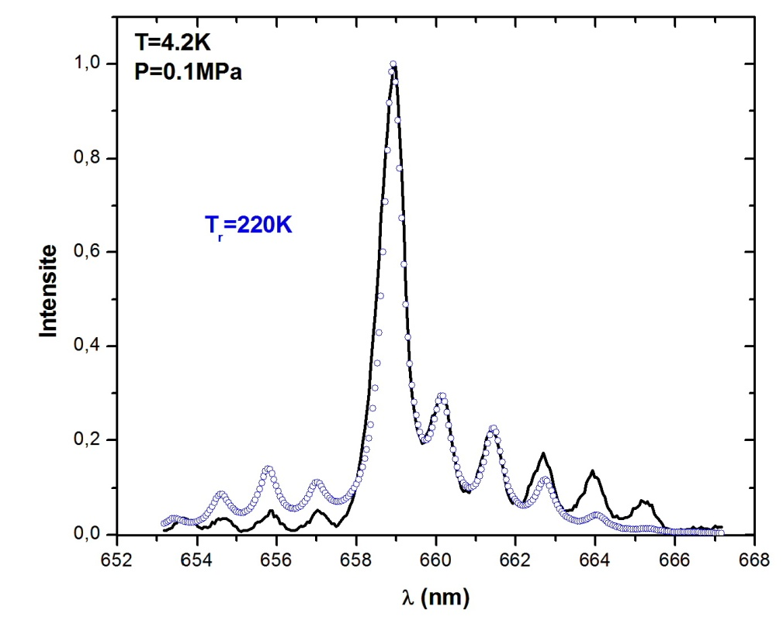
Discharge in liquid helium at 4.2 K
He₂(d³Σ_{u}⁺-b³Π_{g})
He₂(D¹Σ_{u}⁺- B¹Π_{g})
T_{r}=700K
T_{r}=220K
Discrepancy between the rotational temperature of He₂(d³Σ_{u}⁺-b³Π_{g})
and He₂(D¹Σ_{u}⁺- B¹Π_{g})
Tkinetic

Slide 13
Discharge in liquid helium at 4.2 K
Shape of Line 706 nm in Liquid He at 4.2K.
706 nm line (³S-³P)
observed
in liquid helium
Gas
300 K
Gas
150 K
Strongly Blueshifted
symmetrical Gaussian profile

Slide 14
New Autocorrelation function liquid helium
In Analogy to electron bubble
Repulsion between excited atom (Rydberg e⁻) and surrounding atoms in the ground state forms bubble
Atomic bubble
He*(3s)
He* fluorescence lines originate from outside the discharge region
Bulk helium
Ab initio potentials of the excited state He(3 ³S)-He
is the liquid density in the electronic ground state
around 3s calculated using Bosonic Density Functional Theory DFT

Slide 15
Liquid density around He*(3s)
Liquid density around 3s³S excited state calculated using Density Functional Theory (DFT)
35 bar
16 bar
6 bar
1 bar
Bubble Radius R_{b} depends on applied pressure P.
Bulk
liquid
Empty cavity around
excited atom (radiator).
3s
LHe

Slide 16
706.5 nm He* line (³S-³P)
Experimental (continuous) vs theoretical (dashed)
w_{th}≈w_{exp}
Electron impact excitation
e⁻+He ->He*+e⁻+heat
the increased local temperature
3s
« Local heating »

Slide 17
Shape of Line 706 nm in Fluid He at 11 K.
Fixed temperatures 11 K, different pressures, the increasing density.
the line has symmetrical Gaussian profile with shift and width dependent on Pressure

Slide 18
Line shift
the same slopes at 4.2 and 11 K
4.2-11K
150 K
300K
Empty cavity around excited atom (radiator).

Slide 19
Conclusions
Discharge in helium gas at 300 K | Discharge in helium at 4.2 K-T= 11K
N_{Plasma}~ N N_{e}∼ 10¹⁵-10¹⁶cm⁻³ Tkinetic~ 300-320K | He line 706,5nm Large blue shift Gaussian Line Shape The line profile have been interpreted in terms of « bubble model » over extended temperature range He* fluorescence lines originate from outside the discharge region inhomogeneous structure
He Line 706.5 nm
Small blue shift

Slide 20
CRYOPLASMA IN HELIUM INDUCED BY CORONA DISCHARGE
Thank you !

