Slide 1


Some new ideas to study the Quasar’s spectra
The example of C IV emission lines in the UV spectra of 21 HiBALQSOs
E. Danezis*, E. Lyratzi*, D. Stathopoulos*, L. Č. Popović **,
A. Antoniou*, M. S. Dimitrijević** , D. Tzimeas*.
* University of Athens, ** Astronomical Observatory of Belgrade

Slide 2

Active Galactic Nuclei
A.G.N.
Seyfert
Radio
galaxies
Blazars
ULIRGs
LINERs
Markarian
Quasars
BALQSOs
(Broad Absorption Line QSOs)
Non -BALQSOs
HiBALs
High Ionization BALs (CIV, SiIV, NV)
LoBALs
Low Ionization BALs (MgII)
FeLoBALs
(Absorption from Fe)
BAL Quasars is a category of Active Galactic Nuclei (AGN)
Notes:
Λεπτομερής ανάλυση αυτών παρουσιάζεται στην εισαγωγή της διπλωματικής. Στο σημείο αυτό καταδεικνύουμε τη

Slide 3
Spectral classification of BALQSOs
BALQSOs are classified in the following three subcategories based on the material producing the BAL profiles.
High-ionization BALQSOs (HiBALs) contain strong, broad absorption troughs short-ward of high-ionization emission lines (such as C IV, Si IV, N V) and are typically identified through the presence of C IV absorption resonance lines.
Low-ionization BALQSOs (LoBALs) contain HiBAL features but also have absorption from low-ionization lines such as Mg II.
LoBALs with excited-state Fe II or Fe III absorption are called FeLoBALs.

Slide 4
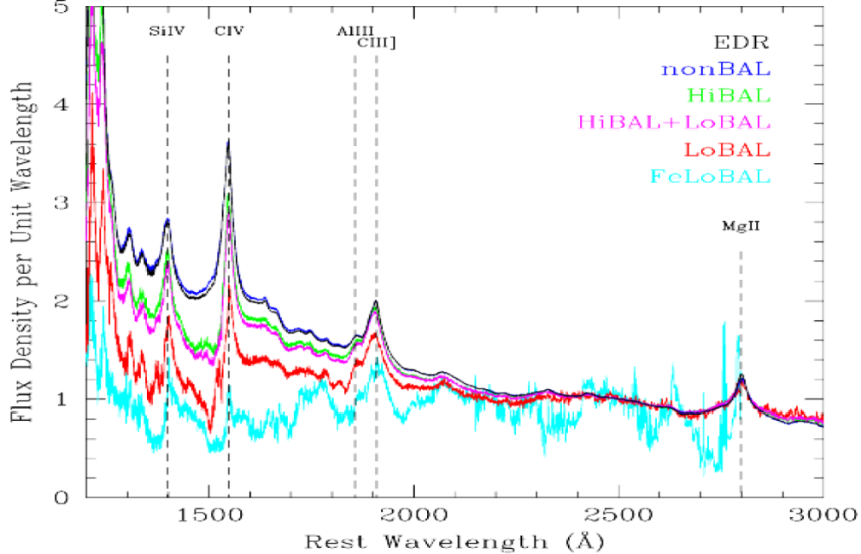
In this figure we can see some BALQSOs spectra of all the above categories

Slide 5
The HiBALQSOs absorption Spectral Lines
In the spectra of HiBAL QSOs we can detect absorption lines separated in the following subgroups.
Absorption lines
Broad Absorption Lines (BALs) with complex profiles and
Narrow Absorption Lines (NALs) with simple profiles

Slide 6
1. The broad absorption lines
The first subgroup of absorption lines includes lines that show very broad and complex profiles. It is known that BLRs include a large number of plasma clouds. As a result, the very broad lines represent a number of lines of the same ion and the same wavelength shifted at different Δλ. This effect occurs because these lines are created in different clouds that move radially and spin with different velocities (Danezis et al. 2007).

Slide 7
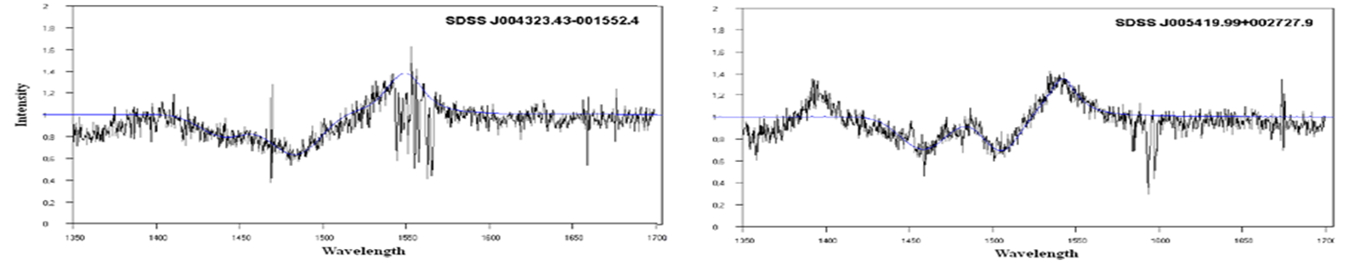


BAL
BALs profiles of C IV resonance lines with broad and complex profiles

Slide 8
2. Narrow Absorption lines (NALs) with simple profiles
The second subgroup of absorption lines includes spectral lines with simple profiles. One can fit these lines using classical distributions such as Gauss, Lorentz or Voigt. In these cases we may be able to understand the phenomena that take place in the regions which produce the simple lines, but we are not able to calculate the values of the physical parameters that describe the absorbing clouds.

Slide 9
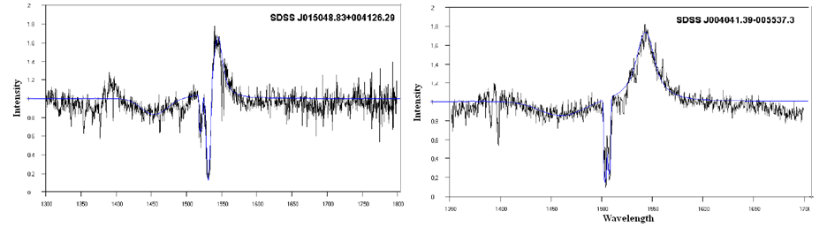
NAL
NAL
BAL
BAL
NAL profiles of C IV resonance lines (components)

Slide 10
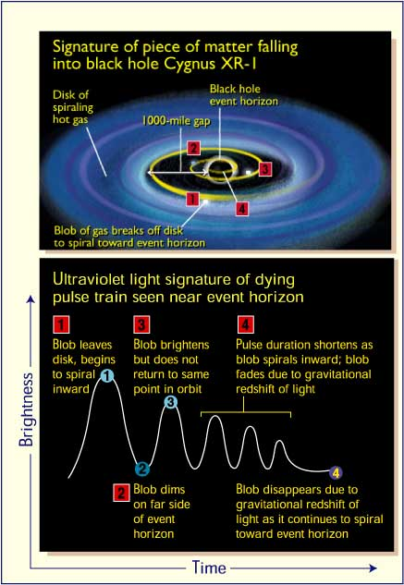
The HiBAL QSOs emission Spectral Lines
We can detect three regions as the origin of emitting radiation
1. Perhaps blobs in the inner accretion disc
Jian-Min Wang1, Ye-Fei Yuan2, MeiWu1, and Masaaki Kusunose3
The Astrophysical Journal Letters
Hideyuki kamaya1
The Astrophysical Journal, 510:862È866, 1999 January 10

Slide 11
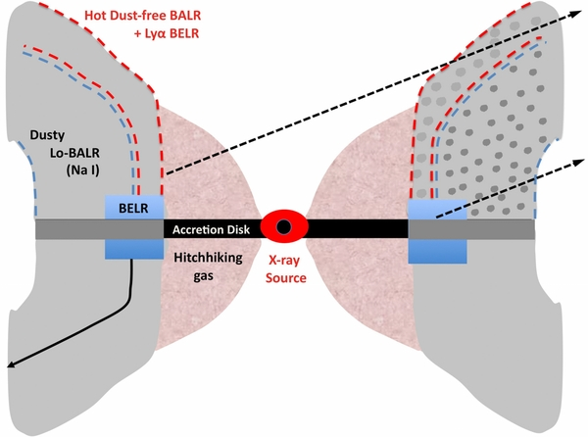
2. Emitting radiation layers in the external region of the accretion disc
S. Veilleux et al. 2013 ApJ 764 15

Slide 12
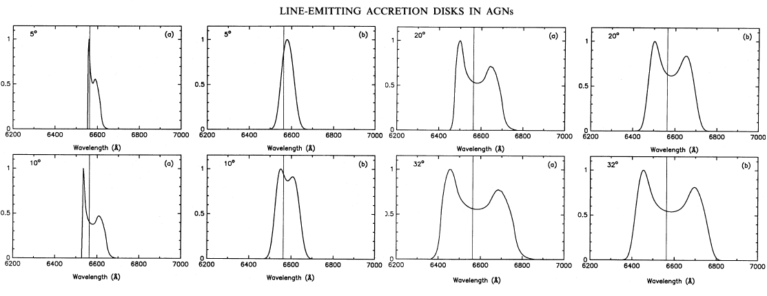
In this figure we can see the theoretical emission profiles that arise from the disc model as a function of the inclination angles (Chen, K. & Halpern, J. P. 1989)

Slide 13
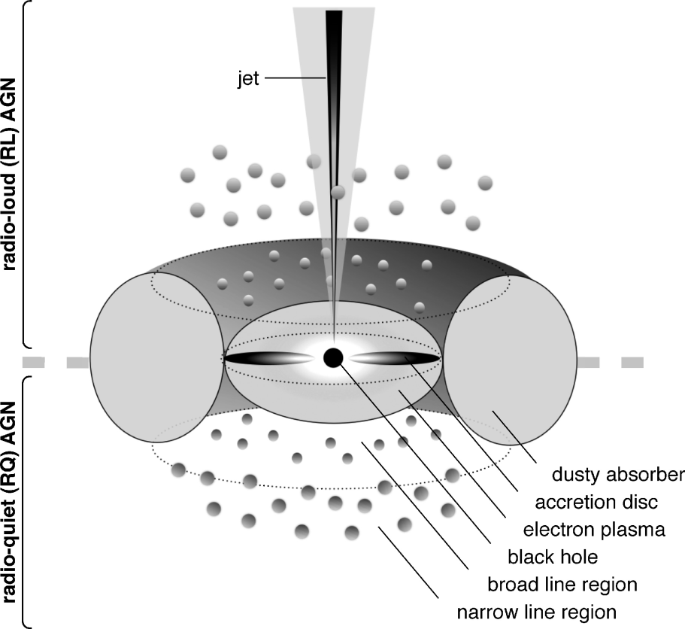
3. Broad and Narrow Line Region Clouds
Arav et al. 1997, Ferland 2004, Laor 2006, Laor et al. 2006

Slide 14
Emission line profiles
In the spectra of HiBAL QSOs we can detect emission line profiles separated in two subgroups.
Simple Emission lines
Multi-component emission lines

Slide 15
Simple Emission lines
The first subgroup of emission lines includes lines with simple profiles that we can fit using the accretion disk model or, a classical distribution as Gauss, Lorentz or Voigt.

Slide 16
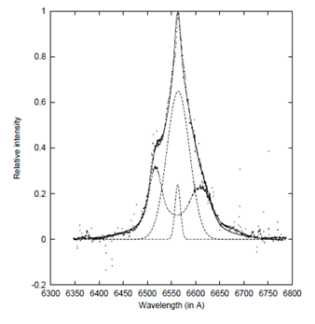
Multi-component Emission Lines
The second subgroup of emission lines includes complex lines that cannot be simulated using only the accretion disk model. This means that the line profiles are not due only to the accretion disk, but there are other regions (clouds, blobs) apart from the disk that play a significant role too.
The observed Hα line (dots) fitted with multi-component model (solid line) given by Popović et al. (2002). With dashed lines the disk, broad and narrow spherical components are presented.

Slide 17
Problems of
HiBAL QSOs spectra

Slide 18
The broad and very complex
Absorption Line profiles
BALR’s spectral line profiles appear to be rather complex in structure. This means that these spectral lines are not created in a single region but are the spectral synthesis of many discrete lines. These discrete lines are created in separate and independent regions (clouds or blobs) that have different spectral characteristics.
(Danezis 1984, 1986, Danezis et al. 1991, 2003 and Lyratzi & Danezis 2004, Boksenberg et al. 2003, Zheng et al. 2001, Dobrzycki et al. 2007).

Slide 19
To be more specific, each plasma cloud produces a classical absorption line. If these clouds rotate around their centers, with large velocities and move radially with small velocities, then the produced spectral lines have large widths and small shifts. As a result, these lines are blended among themselves producing a complex profile (Danezis 1984, 1986, Danezis et al. 1991, 2003 and Lyratzi & Danezis 2004).

Slide 20
Based on this complex structure, many researchers (Arav et al. 1997, Ferland 2004, Laor 2006, Laor et al. 2006) suggested that BALRs consist of a number of independent plasma clouds. Each cloud, supposing it is homogenous in its physical properties, should create a specific spectral line profile which is described by a specific mathematical distribution (known or not). However, in the bibliography we cannot find a mathematical distribution or a physical model that can fit these complex profiles. This lies in the fact that the radiative transfer equations, through a complex environment of many clouds, were not solved. As a result, until recently, we didn’t have the line function that could theoretically simulate a complex spectral line.

Slide 21
2. The classical distributions
The classical mathematical distributions used for fitting spectral lines in QSO’s spectra are Gauss, Lorentz and Voigt. These distributions describe the physical conditions of the plasma regions which create the studied spectral lines.
In more detail:
When we fit a spectral line with a Gaussian we accept that in the plasma region, which creates the spectral line, the random, thermal motions of the ions prevail.
A Lorentzian fit implies the existence of pressure in the region which produces the studied spectral line.
A Voigt fit (Gauss + Lorentz) tells us that in the plasma region we have a combination of thermal motions of the ions and pressure.

Slide 22
The problem is that the classical distributions, Gauss, Lorentz and Voigt are not efficient enough in describing the BALQSO’s spectra and as a result we need some new distributions, in order to give a more accurate description to the complex spectra.
However, what was missing, was a distribution able to describe the rotation of plasma clouds (around their centers) or a distribution that could describe the rotation of clouds as well as the thermal motions of the ions simultaneously.

Slide 23
3. The radiative transfer equations and the line function
In order to fit the BALQSO’s spectra we need a physical model, with a mathematical description, which solves the radiative transfer equations for a complex plasma environment and gives the line function that can describe accurately each complex spectral line. Furthermore, this model must include the mathematical description of the previously mentioned distributions.
This model must be able to calculate not only the physical parameters that describe the complex studied spectral line profile, but also the parameters of each one of the single spectral lines that compose the complex profile. As a consequence, by describing each spectral line separately, we describe the physical conditions of each absorbing plasma cloud.

Slide 24
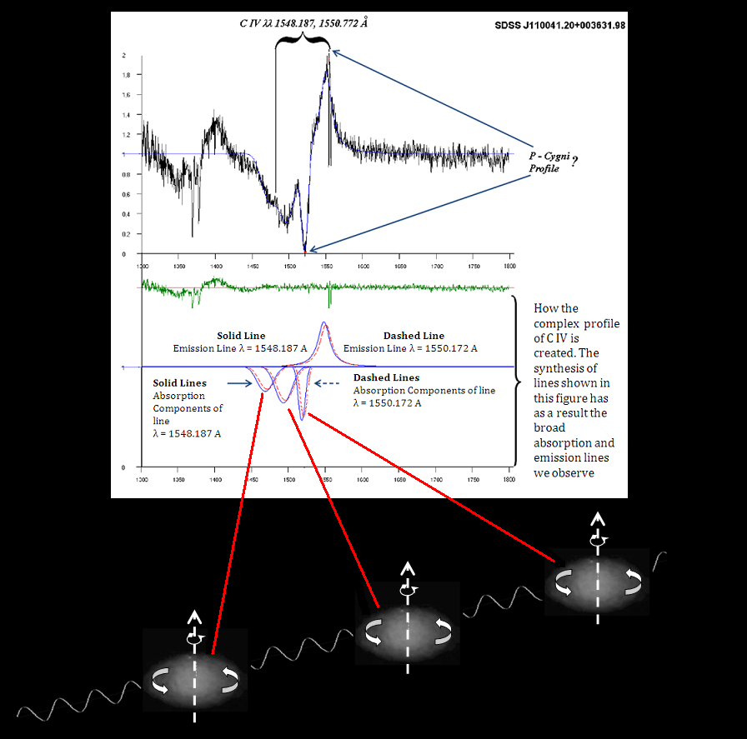

In this figure we can see the emission and the absorption components of the C IV resonance spectral lines that construct the C IV complex line profile

Slide 25
Finally, the model, in its mathematical description, should include the geometry of the regions that produce the studied spectral lines. The model must be self-consistent, and the theory that underlies the model must not go against the physical principles that we already know that apply in the broad line region.

Slide 26
The reasons for choosing GR Model
(Gauss-Rotation Model)
In our research we use the GR Model
for the following reasons:
(Danezis et al. 2007, PASJ, 59, 827 )

Slide 27
Solving the radiative transfer equation
The line function
In the context of GR Model, the radiative transfer equation for a complex atmosphere has been solved. By solving the equation (Danezis et al 2007), we calculated the final line function that can fit not only each one of the spectral lines (emission or absorption) but all the complex spectral regions of an ion line (e.g. C IV λλ 1548.187 Å, 1550.772 Å)

Slide 28
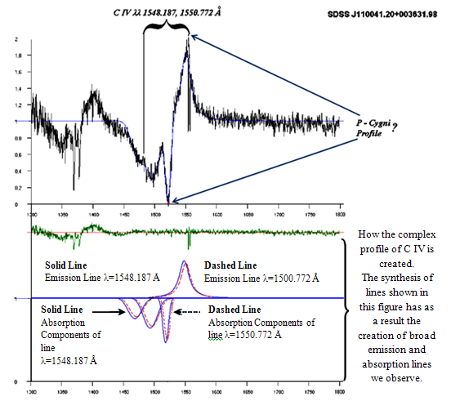
Example based on the problems
The final line function can fit not only each one of the spectral lines (emission or absorption) but all the complex spectral regions of an ion line (e.g. C IV λλ 1548.187 Å, 1550.772 Å)

Slide 29
In the line function
Ι_{λ0}: is the initial radiation intensity,
L_{i}, L_{ej}, L_{g}: are the distribution functions of the absorption coefficients k_{λi}, k_{λej}, k_{λg},
ξ: is the optical depth in the centre of the spectral line,
S_{λej}: is the source function, that is constant during one observation.

Slide 30
2. Creating two new distribution functions
GR Model includes the creation of two new distributions, the Rotation distribution (Danezis, E. et al. 2003) that describes the rotation of the plasma clouds and the Gauss-Rotation distribution (Danezis et al. 2006b, Danezis et al. 2007a, Lyratzi et al. 2009) which describes the combination of the random motions of the clouds’ ions and the self-rotation of the clouds.

Slide 31
Rotation Distribution
If then
if then
The L(λ) is a function of Δλ_{rotation} (from where we can calculate V_{rot}) and λ₀ = λlab + Δλradial (from where we can calculate V_{rad}).

Slide 32
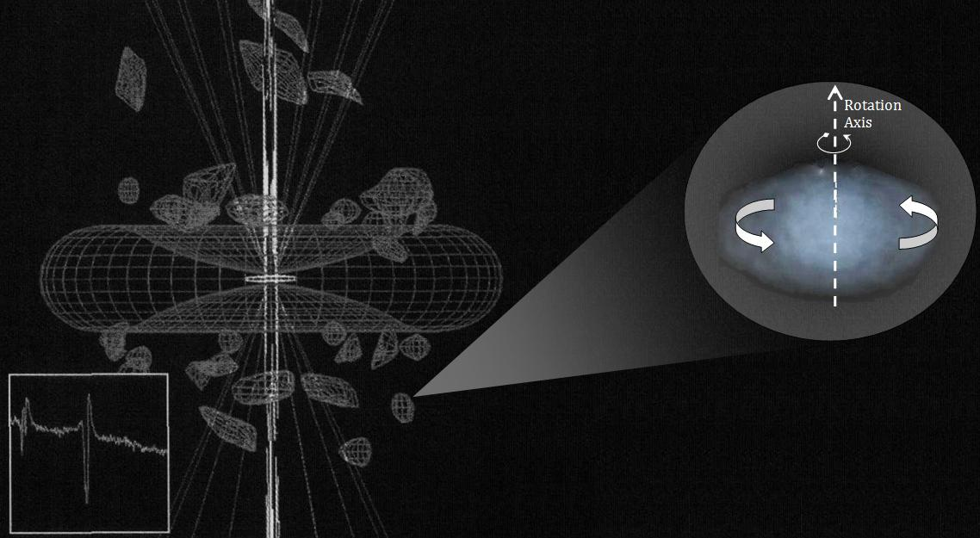
We want to point out that the Rotation distribution represents the rotation of plasma clouds around their centers and not around the galactic center.

Slide 33
The Gauss-Rotation distribution
V_{radial}
V_{rotation}
Gaussian typical deviation
V_{random}
Danezis et al. 2007 PASJ, Danezis et al. SPIG 2006

Slide 34
GR Model includes the physical expression of the mathematical distributions Gauss, Lorentz and Voigt

Slide 35
In the case of the following line function:
The and are the distribution functions of the absorption and the emission component, respectively.
The factor L must include the geometry and all the principle physical conditions of the region that produces the spectral line. These physical conditions indicate the exact distribution that we must use.

Slide 36
This means that
if we choose the right physical conditions in the calculations of the factor L, the functions and can have the form of a Gauss, Lorentz, Voigt, Rotation or GR distribution function.
In this case we do not use the pure mathematical distributions that do not include any physical parameter, but the physical expression of these distributions.

Slide 37
In the case of GR model for the classical distributions we use the physical expressions below:
For the Gauss distribution, L takes the form:
For the Lorentz distribution, L takes the form:
For the Voigt distribution, L takes the form:

Slide 38
Using the GR model
We can calculate some important parameters of the plasma clouds that construct the components of the observed spectral feature, such as:
Direct calculations
The apparent rotational velocities of absorbing or emitting density layers (V_{rot})
The apparent radial velocities of absorbing or emitting density layers (V_{rad})
The Gaussian typical deviation of the ions’ random motions (σ)
The optical depth in the center of the absorption or emission components (ξ_{i})
Indirect calculations
The random velocities of the ions (V_{random})
The FWHM
The absorbed or emitted energy (Εa, Ee)
The column density (CD)

Slide 39


We point out that…
In our study, we solved the radiative transfer equations (Danezis et al. 2003, Ap&SS, 284, 1119) and thus we have the final line function. Having the line function we proved that in the case of a group of absorption lines, the derived complex spectral line profile is described by a new function which is not the superposition of absorption components but the mathematical product of them ( ). This means that the final complex profile is not the sum of different functions ( ) but the mathematical product of them. Each individual function describes the absorption component of each cloud. The product of a series of functions ( ) is a new function and has nothing to do with the sum of functions ( ).

Slide 40
In contrary, in the case of a group of emission spectral lines the derived complex spectral line profile is described by the sum of different functions and not the product of them

Slide 41
Data and Spectral Analysis
In this work we study the emission resonance lines of C IV λλ 1548.187, 1550.772 Å in the spectra of 21 HiBAL QSOs. The spectra were obtained from the SDSS DR7 database and they cover the spectral range 3800 – 9200 Å.
For the UV continuum we used the 0.5 power law index.
During the fitting process we use the minimum required components which are necessary in order to get the best fit. The number of required components is tested using F-test while the best fit is checked using T-test.

Slide 42
Table I
Object Name (SDSS) | MJD-Plate-Fiber | Redshift | Date
J004323.43-001552.4 | 51794‐0393‐181 | 2,81671 | 7/9/2000, 8:10
J104109.86+001051.76 | 51913‐0274‐482 | 2,25924 | 4/1/2001, 11:00
J001502.26+001212.4 | 51795‐0389‐465 | 2,85152 | 7/9/2000, 6:08
J104841.03+000042.81 | 51909‐0276‐310 | 2,03044 | 31/12/2000, 11:08
J015048.83+004126.29 | 51793‐0402‐505 | 3,70225 | 6/9/2000, 10:06
J102517.58+003422.17 | 51941‐0272‐501 | 1,88842 | 1/2/2001, 9:30
J031828.91-001523.17 | 51929‐0413‐170 | 1,98447 | 20/1/2001, 4:23
J010336.40-005508.7 | 51816‐0396‐297 | 2,44295 | 29/9/2000, 8:28
J005419.99+002727.9 | 51876‐0394‐514 | 2,51946 | 21/11/2000, 2:17
J004732.73+002111.3 | 51794‐0393‐588 | 2,87768 | 7/9/2000, 8:10
J023908.99-002121.42 | 51821‐0408‐179 | 3,74 | 4/10/2000, 9:38
J004041.39-005537.3 | 51794‐0393‐298 | 2,09094 | 7/9/2000, 8:10
J001438.28-010750.1 | 51795‐0389‐211 | 1,81564 | 7/9/2000, 6:08
J023252.80-001351.17 | 51820‐0407‐158 | 2,03289 | 3/10/2000, 9:41
J001025.90+005447.6 | 51795‐0389‐332 | 2,84727 | 7/9/2000, 6:08
J110041.20+003631.98 | 51908‐0277‐437 | 2,01143 | 30/12/2000, 11:19
J000056.89-010409.7 | 51791‐0387‐098 | 2,12325 | 4/9/2000, 7:08
J003551.98+005726.4 | 51793‐0392‐449 | 1,90110 | 6/9/2000, 8:20
J015024.44+004432.99 | 51793‐0402‐485 | 2,00596 | 6/9/2000, 10:06
J000103.85-104630.2 | 52143-650-133 | 2.081 | 28/2/2000 5:52
J000913.77-095754.5 | 52141-651-519 | 2.076 | 28/2/2000 5:52
In Table 1 we present the studied QSOs.
In Column 1 the name of each QSO is given
In Column 2 we present the Modified Julian Date, the Plate and the Fiber.
In column 3 we can see the redshift of each active galaxy and
In Column 4 we give the date that each spectrum was obtained.

Slide 43
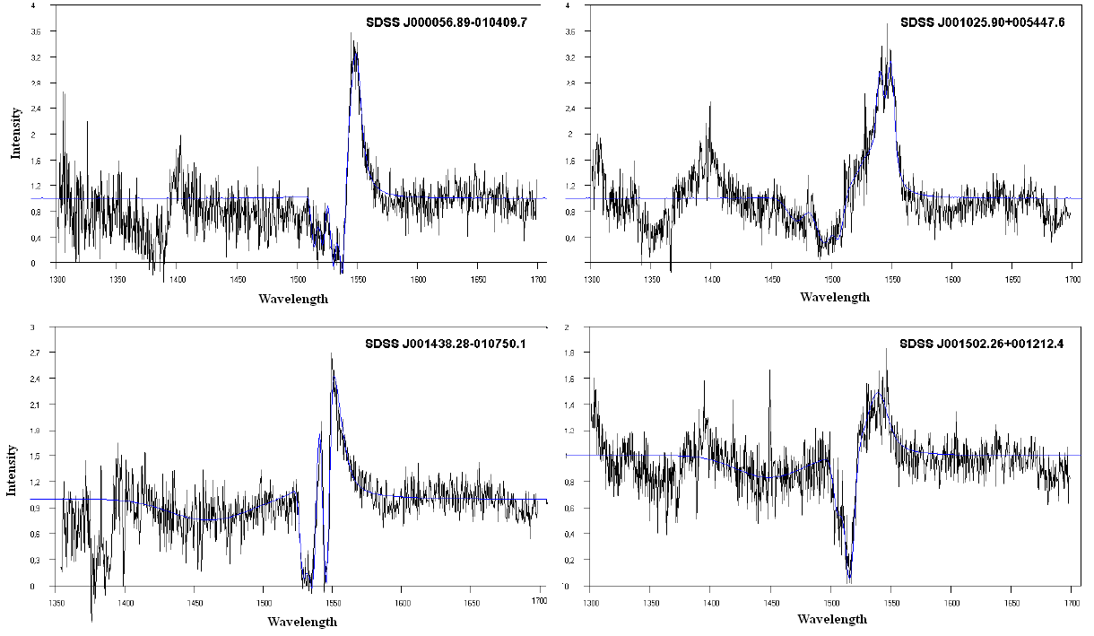
In the figures below we present the fitted spectra of the 21 QSOs.
The black line represents the observed spectrum and the blue line represents the GR Model fit.

Slide 44
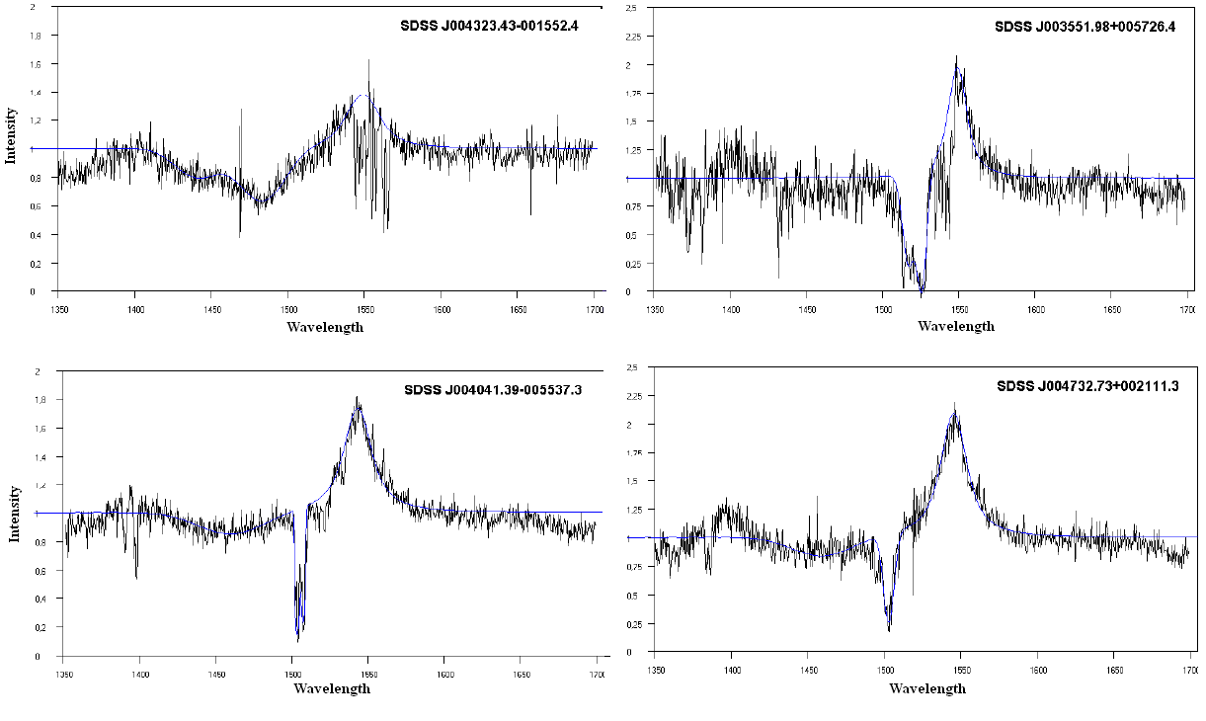

Slide 45
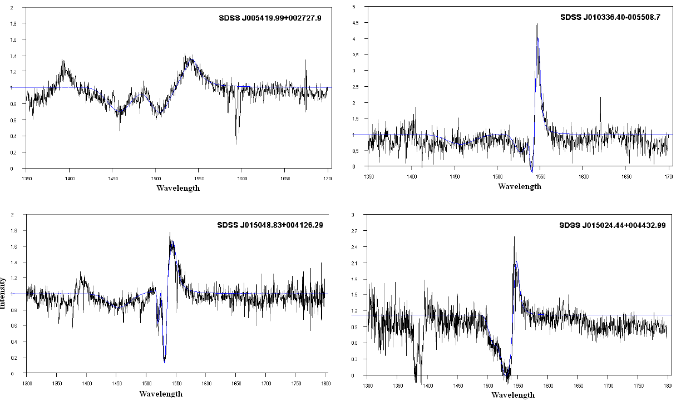

Slide 46
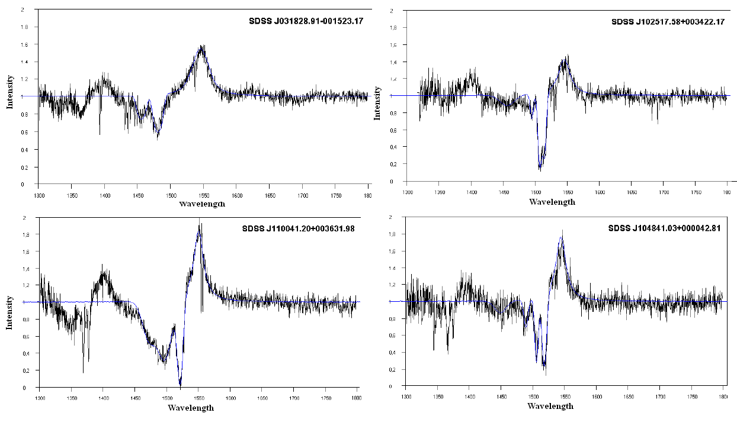

Slide 47
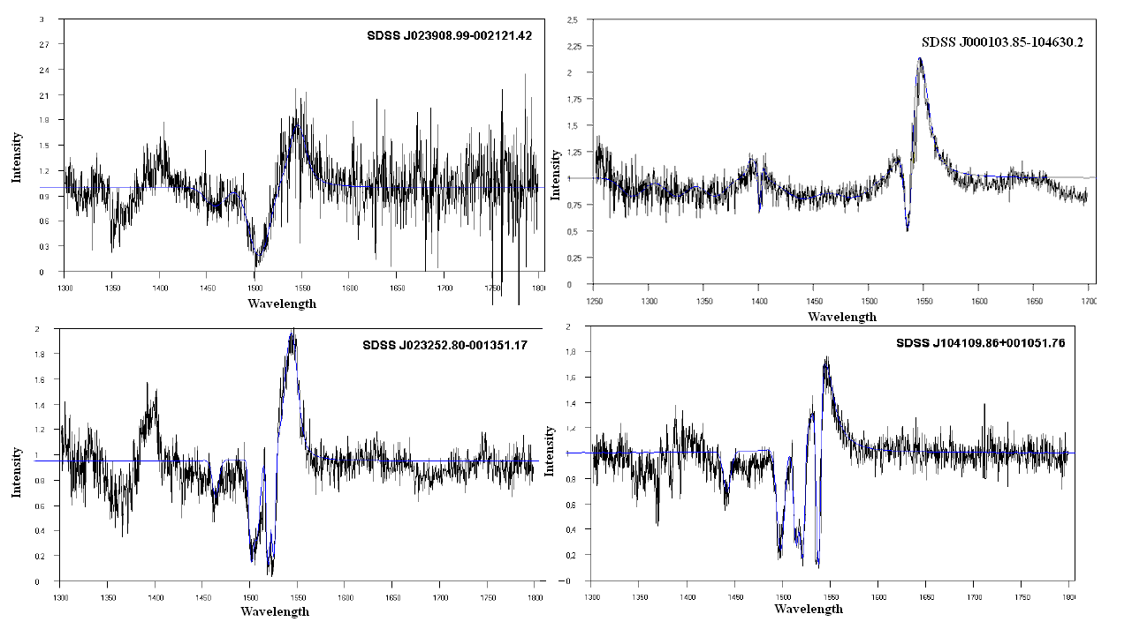

Slide 48
As we study the emission lines of the 21 HiBALQSOs with GR model we can calculate the values of: the typical standard deviation (σ), the Lorentz distribution factor (γ), the source function at the observation time (S_{e}), the FWHM, the column density (CD), the optical depth of the line center (ξ) and the emission energy (E_{em}).
In the following table we can see the values of the above important parameters.
The 21 HiBALQSOs were sorted in descending order of the clouds radial velocities beginning with the QSO that had the cloud with the highest radial velocity

Slide 49
# | SDSS Name | <Vrad> | <σe> | <ξ> | <FWHM> | <Ee> | <CD> | <γ>
1 | J001502.26+001212.4 | 1934,5 | 8 | 0,5225 | 20,6325 | 5,019255 | 3,26E+10
2 | J005419.99+002727.9 | 1354 | 11 | 0,5035 | 19,97 | 6,0717835 | 3,95E+10 | 0,38
3 | J004041.39-005537.3 | 1161 | 10 | 0,76 | 20,2765 | 10,781985 | 7,01E+10 | 0,82
4 | J104841.03+000042.81 | 1161 | 9,5 | 0,8075 | 18,5785 | 10,4530745 | 6,80E+10 | 0,41
5 | J001025.90+005447.6 | 1112 | 6,5 | 1,425 | 19,2205 | 21,32396 | 1,39E+11
6 | J023252.80-001351.17 | 1083,5 | 7 | 0,855 | 19,0495 | 9,721844 | 6,32E+10
7 | J015048.83+004126.29 | 1064 | 8 | 0,5985 | 16,301 | 6,705215 | 4,36E+10 | 1,00
8 | J104109.86+001051.76 | 967,5 | 10 | 0,7125 | 19,6875 | 9,8472525 | 6,40E+10 | 0,71
9 | J004732.73+002111.3 | 774 | 11 | 0,8075 | 22,1155 | 17,0788 | 1,11E+11 | 0,71
10 | J015024.44+004432.99 | 774 | 5 | 1,9 | 13,678 | 20,719395 | 1,35E+11 | 1,41
11 | J102517.58+003422.17 | 774 | 10,5 | 0,4465 | 20,744 | 6,1385985 | 3,99E+10 | 1,00
12 | J000913.77-095754.5 | 774 | 5 | 0,7 | 9,818 | 7,30375 | 4,75E+10 | 0,71
13 | J031828.91-001523.17 | 725,5 | 13,5 | 0,6175 | 28,322 | 9,884429 | 6,43E+10 | 1,12
14 | J023908.99-002121.42 | 678 | 10 | 0,76 | 19,3155 | 10,421867 | 6,78E+10 | 0,38
15 | J001438.28-010750.1 | 580,5 | 7,5 | 1,425 | 17,192 | 20,025975 | 1,30E+11 | 0,71
16 | J010336.40-005508.7 | 580,5 | 3 | 2,185 | 8,141 | 21,84706 | 1,42E+11 | 1,00
17 | J000103.85-104630.2 | 580,5 | 9 | 0,95 | 19,4225 | 15,809955 | 1,03E+11 | 0,94
18 | J004323.43-001552.4 | 387 | 11 | 0,57 | 20,737 | 6,241643 | 4,06E+10 | 0,63
19 | J000056.89-010409.7 | 97 | 5,2 | 0,95 | 10,973 | 16,622395 | 1,08E+11 | 0,82
20 | J110041.20+003631.98 | 0 | 9,5 | 0,76 | 18,4035 | 11,31933 | 7,38E+10 | 0,45
21 | J003551.98+005726.4 | 0 | 7 | 0,855 | 14,221 | 11,186945 | 7,27E+10 | 0,71
Mean |  | 788,69 | 8,44 | 0,91 | 17,94 | 12,12 | 7,88E+10 | 0,77
STDV |  | 460,43 | 2,57 | 0,46 | 4,55 | 5,52 | 3,59E+10 | 0,27
Max |  | 1249,12 | 11,01 | 1,37 | 22,49 | 17,64 | 1,15E+11 | 1,04
Min |  | 328,26 | 5,87 | 0,45 | 13,39 | 6,60 | 4,29E+10 | 0,5

Slide 50
In the following diagrams we present the different values of all the above parameters as a function of radial velocities, that is an expression of the distance from the galactic center

Slide 52
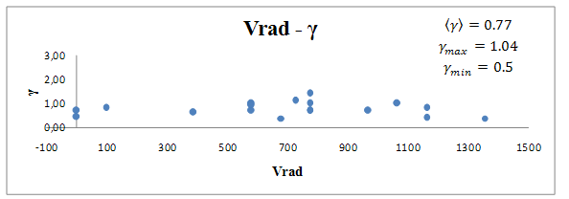

Slide 53
Conclusions
1. The main point of our study is that now, as we can see in the tables above, with GR model, we can calculate the values of a group of important parameters of the regions that produce the emission or absorption lines (clouds, blobs, disc).

Slide 54
After a detailed analysis of the absorption spectra lines of the same group of 21 HiBALQSOs (as will be presented by Mr Stathopoulos in a next presentation) we conclude that perhaps the resonance C IV emission spectral lines, present p Cyg profiles. This means that in a future work we should try to calculate the mass loss from the regions that create these emission lines.

Slide 55
We fitted (simulated) all the resonance C IV emission lines with a Voigt distribution. This means that in the disc (or cloud) region that produces the C IV resonance lines, pressure exists, perhaps able to create a shock (Fromerth & Melia 2001) due to great decrease of the kinematic energy and perhaps this is the reason of the radiant energy.
Notes:
Κακή σύνταξη. Δεν καταλαβαίνω.

Slide 56
4. As we can see we simulated the C IV emission lines with a Voigt distribution, this means with a distribution with one pick.
In the case that the emission lines arise from an emission disc (Holt et al. 1992, Collin-Souffrin 1987, Collin & Hure 2001), we know that the disc model indicates such a shape only when the observation line and the rotational axis of the disc form a small angle between 0-5 degrees (see Antonucci, R. 1993).

Slide 57
In this figure we can see the theoretical emission profiles that arise from the disc model as a function of the inclination angles (Chen, K. & Halpern, J. P. 1989)

Slide 58
In a next presentation (Thursday afternoon) Dr Lyratzi will present an important study of Si IV resonance lines of the same group of 21 HiBALQSOs.

Slide 59
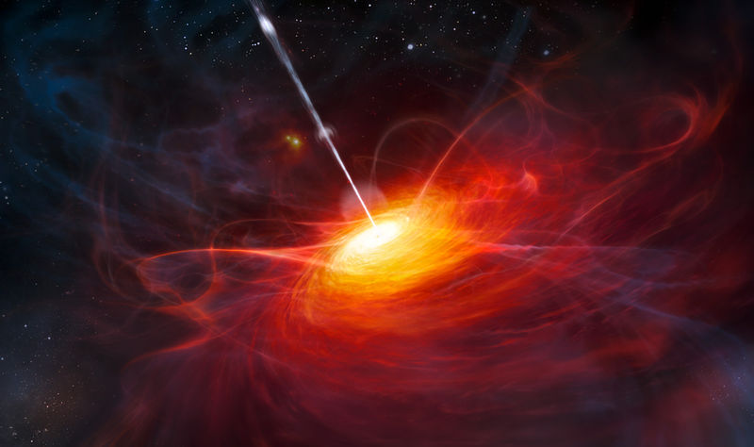
Thank you very much for your attention

Slide 60
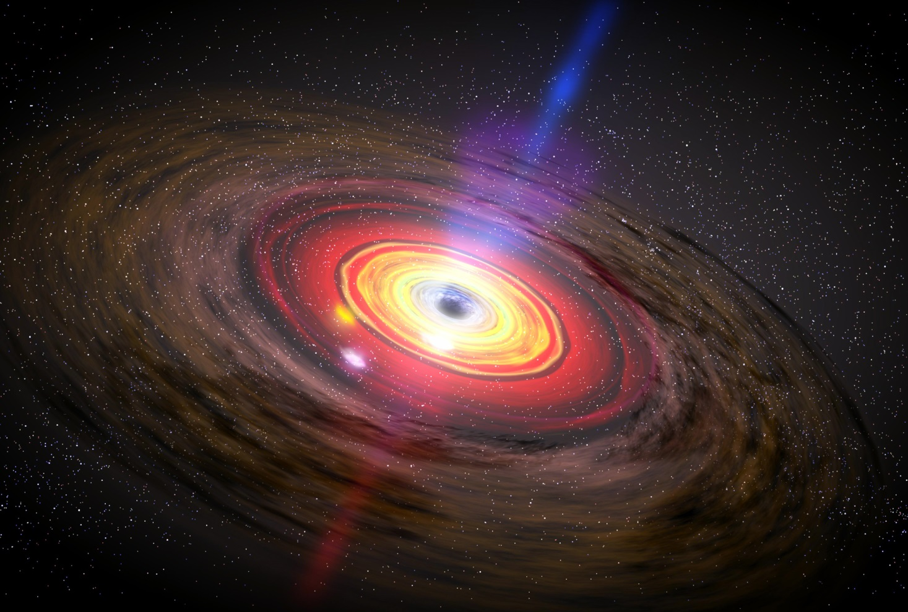
Blobs in the inner regions of the accretion disc
Artistic depiction

