Slide 1
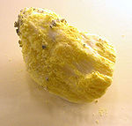
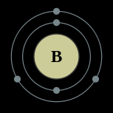
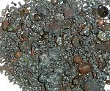
بوره
بورق
2s²2p¹
Stark broadening of B IV lines for astrophysical and laboratory plasma research
M S Dimitrijević, M Christova, Z Simić, A Kovaćević, S Sahal-Bréchot
Astronomical Observatory, Volgina 7, 11060 Belgrade 38, Serbia
Department of Applied Physics, Technical University-Sofia, 1000 Sofia, Bulgaria
Observatoire de Paris, 92195 Meudon Cedex, France

Slide 2
Stark broadening in Astrophysics
Efficient for modelling and analysing spectra of moderately hot (А), hot (В), and very hot (О) stars.
Dominant collisional line broadening process in all layers of the atmosphere of white dwarfs.
Well applied for accurate spectroscopic diagnostics and modelling.

Slide 3
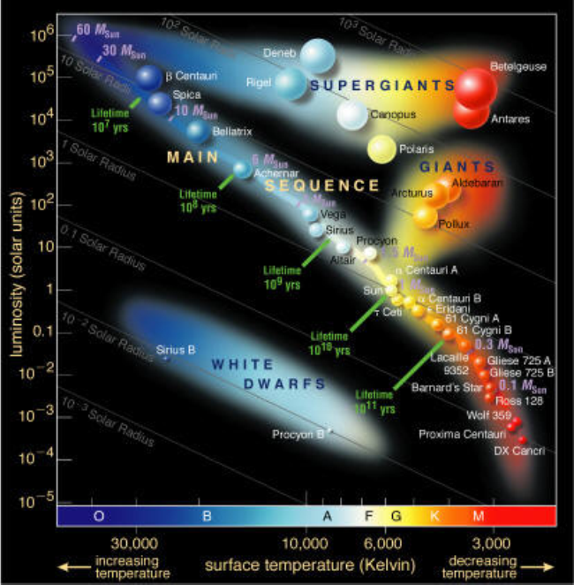
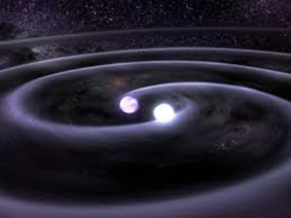
Astrophysical plasma research

Slide 4
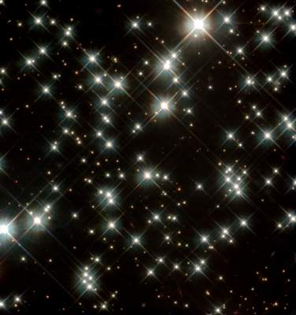
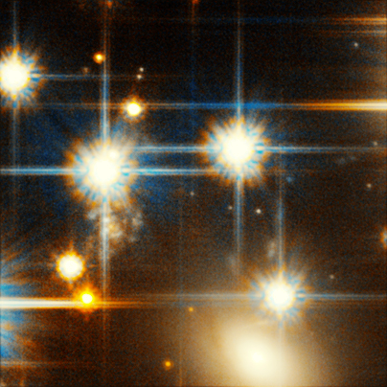
Astrophysical plasma research
White dwarf stars in the Milky Way Galaxy
Faint white dwarf star in globular cluster ngc 6397

Slide 5
Astrophysical plasma research
Interpretation of the spectra of white dwarfs allows understanding the evolution of these very old stars
Cosmochronometry - studying stellar evolution to determine the age and history of stellar populations.

Slide 6
Cosmology
Evolution of the Universe, birth, growing and death of the stars – major interest.
The light element trio LiBeB – at the centre of the astrophysical puzzles.
The origins of LiBeB to big bang nucleosynthesis, cosmic-ray spallation, and stellar evolution.
Abundance determination of LiBeB – provide data on the astrophysical processes that can produce and destroy these rare elements.
The light elements – sensitive probes of stellar models the stable isotopes of all three consist of nuclei with small binding energies that are destroyed easily by (p, a) reactions at modest temperatures.

Slide 7
? boron
Special interest – the origin and evolution of boron: hardly produced by standard big bang nucleosynthesis and cannot be produced by nuclear fusions in stellar interiors.
Disagreements between traditional models for these processes and observations:
The theory predicts that Be and B abundance would scale quadratically with the overall metal abundance, however they scale linearly.
Model: ¹¹B / ¹⁰B ≈ 2,5
Observations: ¹¹B / ¹⁰B ≈ 4
The surface abundance of a light elements is less than the star’s initial abundance – an observational constraint for testing models of stellar interiors.

Slide 8
Boron and hot stars
Boron alone is observable in hot stars.
The studies confirm the conclusion that boron is mainly produced by primary process in the early Galaxy.
A principle goal of most of studies of hot stars – to establish the present-day boron abundance in order to improve the understanding of the Galactic chemical evolution of boron.
Boron in hot stars – a tracer of some of the various processes affecting a star’s surface composition that are not included in the standard models of stellar evolution.
Boron abundance – the clue to unravelling the nonstandard processes that affect young hot stars.

Slide 9
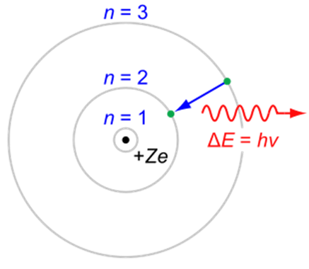
Spectral line profile
Knowledge of numerous profiles, especially for trace elements, which are used as useful probes for modern spectroscopic diagnostics.

Slide 10
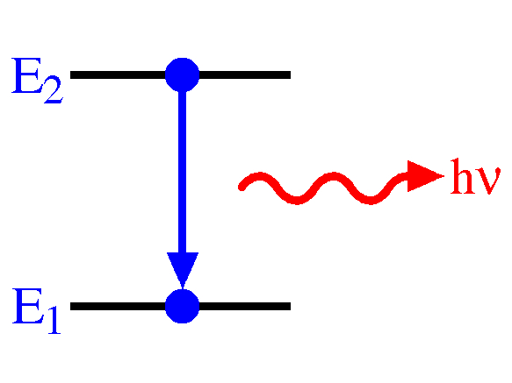
STARK broadening theory
Sahal-Bréchot theory based on the semi-classical perturbation formalism
Calculation of Stark parameters using:
- atomic data from TOPbase catalogue
- calculated oscillator strengths using Bates & Damgaard method and experimental values of energy levels from the reference of Kramida at all.

Slide 11
Results
Width: 91 – 30 % - electron contribution 3 – 20 % - proton contribution
5 – 50 % ionized helium contribution
Electron impact widths of B IV spectral line versus the temperature for electron density 10¹⁸ cm⁻³.

Slide 12
Results
Shift:
60 - 70 % ionized helium
24 – 28 % - proton contribution
5 – 14 % - electron contribution
Electron impact shifts of B IV spectral line versus the temperature for electron density 10¹⁸ cm⁻³.

Slide 13
Results
Electron impact widths of B IV spectral line versus electron density for temperature 2E5 K.

Slide 14
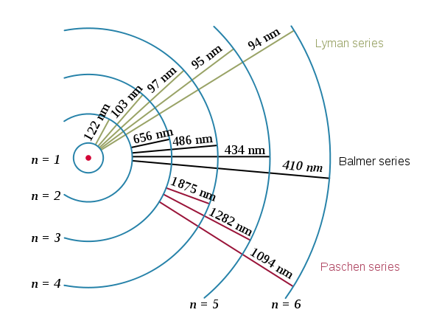
Spectral series

Slide 15
Results
Electron impact width of spectral lines within one spectral series versus the principle quantum number for temperature 1e5 K and electron density 10¹⁴ cm⁻³.

Slide 16
Results
Electron impact widths of B IV spectral line versus the temperature for electron density 10¹⁸ cm⁻³.

Slide 17
Results
Electron impact shifts of B IV spectral line versus the temperature for electron density 10¹⁷ cm⁻³.

Slide 18
Conclusion
Calculation of Stark parameters using:
- atomic data from TOPbase catalogue
- calculated oscillator strengths using Bates & Damgaard method and experimental values of energy levels from the reference of Kramida at all.
Comparison: experimental values of energy levels of Kramida at all. and calculated oscillator strengths using Bates & Damgaard method. We found that the difference in Stark width and shift is within 1 - 3%. This means that the Bates & Damgaard method for oscillator strengths calculations in the case of B IV transitions is adequate.
Virtual Atomic and Molecular Data Centre http://www.vamdc.eu

Slide 19
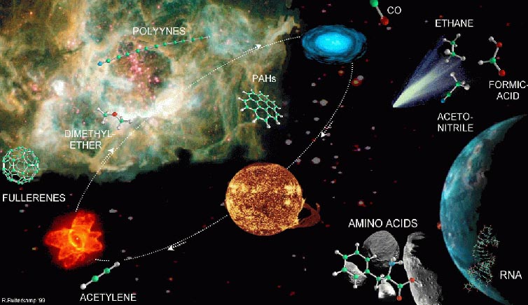
Acknowledgments
Project 176002, supported by the Ministry of Education, Science and Technological development of Serbia
COST scientific programme on The Chemical Cosmos: Understanding Chemistry in Astronomical Environments
Partial financial support from Technical University – Sofia
http://www.vamdc.org

Slide 20
References
http://whitedwarf.org/research/
http://fuse.pha.jhu.edu/
K A Venn, A M Brooks, D L Lambert, M Lemke, N Langer, D J Lennon and F P Keenan 2002 ApJ 565 571-586
K Cunha and V V Smith 1999 ApJ 512 1006-1013
K Tan, J Shi and G Zhao 2010 ApJ 713 458-468
C R Proffitt, P Jönsson, U Litzén, J C Pickering and G M Wahlgren 1999 ApJ 516 342-348
M Meneguzzi, J Audouze and H Reeves 1971 A&A 15 337
D K Duncan, D L Lambert and M Lemke 1992 ApJ 401 584
D K Duncan, F Primas, L M Rebull, A M Bosegaard, C P Deliyannis, L M Hobbs, J R King, and S G Ryan 1997 ApJ 488 338
M Shima, 1963 Geochim. Cosmochim. Acta 27 991
A M Ritchey, S R Federman, Y Sheffer and D L Lambert 2011 ApJ 728 70
S Sahal-Brechot 2010 J. of Phys.: Conf. Ser. 257 012028
S Sahal-Bréchot 1969 Astron. Astrophys. 1 91
S Sahal-Bréchot 1969 Astron. Astrophys. 2 322

Slide 21
Hvala!

