Slide 1
Semiclassical perturbation Stark widths for doubly charged argon spectral lines R. Hamdi¹, N. Ben Nessib², S. Sahal-Bréchot³, M. S. Dimitrijević^{3,4}
1: Groupe de recherche en physique atomique et astrophysique, Faculté des Sciences de Bizerte, Université de Carthage. Tunisia
2: Department of Physics and Astronomy, College of Science, King Saud University. PO Box 2455, Riyadh 11451, Saudi Arabia
3: Laboratoire d’Etude du Rayonnement et de la Matière en Astrophysique, Observatoire de Paris, UMR CNRS 8112, UPMC, 5 Place Jules Janssen, 92195 Meudon Cedex, France
4:Astronomical Observatory, Volgina 7, 11060 Belgrade, Serbia

Slide 2
Doubly charged argon (Ar III) spectral lines are observed in many astrophysical plasmas.
In RodrÍguez et al. (1999), Ar III lines are used in the determination of abundance in galactic H II regions.
- Ar III spectral lines are also observed in hydrogen-rich subdwarf B stars (Blanchette et al. 2008; O’Toole & Heber 2006)
Method:
- SCP approach (Sahal-Bréchot 1969a,b) : 32 spectral lines
- Energies : NIST database
- Oscillator strengths: Hartree-Fock relativistic approach (Cowan code, Cowan 1981)
+ atomic model including 17 configurations
- Comparison: Djurović et al. (2011), Bukvić et al. (2008), Djeniže et al. (1996)

Slide 3
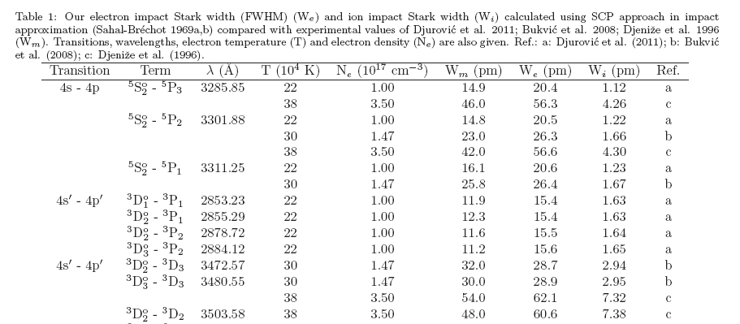

Slide 4
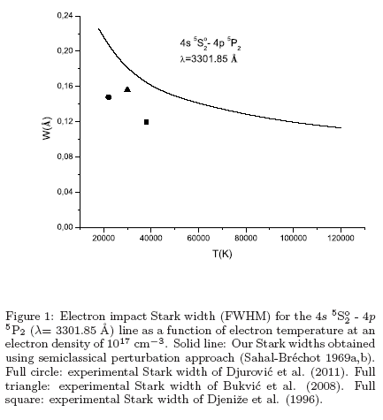
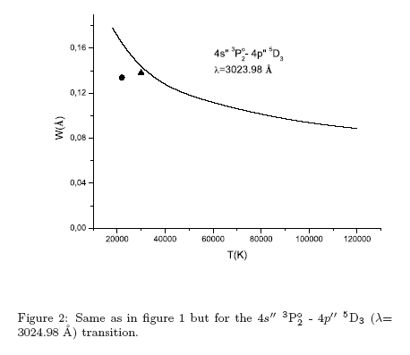
Our Stark widths are in acceptable agreement with the experimental results.

Slide 5
On the Stark broadening of Pb IV spectral lines within the 3000 – 7000 Å spectral range
R. Hamdi¹, N. Ben Nessib², S. Sahal-Bréchot³, M. S. Dimitrijević^{3,4}
1: Groupe de recherche en physique atomique et astrophysique, Faculté des Sciences de Bizerte, Université de Carthage. Tunisia
2: Department of Physics and Astronomy, College of Science, King Saud University. PO Box 2455, Riyadh 11451, Saudi Arabia
3: Laboratoire d’Etude du Rayonnement et de la Matière en Astrophysique, Observatoire de Paris, UMR CNRS 8112, UPMC, 5 Place Jules Janssen, 92195 Meudon Cedex, France
4: Astronomical Observatory, Volgina 7, 11060 Belgrade, Serbia

Slide 6
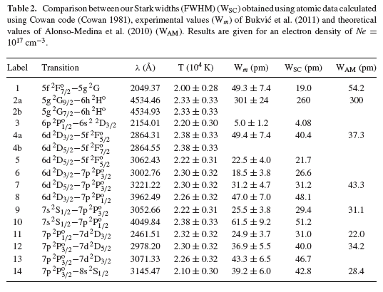
Stark broadening parameters for 114 spectral lines of Pb IV have been determined recently using SCP approach.
The complete obtained results and their analysis and comparison with other
theoretical and experimental data are published in MNRAS (Hamdi R., Ben
Nessib N., Dimitrijević M.S. Sahal-Bréchot S., 2013, MNRAS, 431, 1039 ).

Slide 7
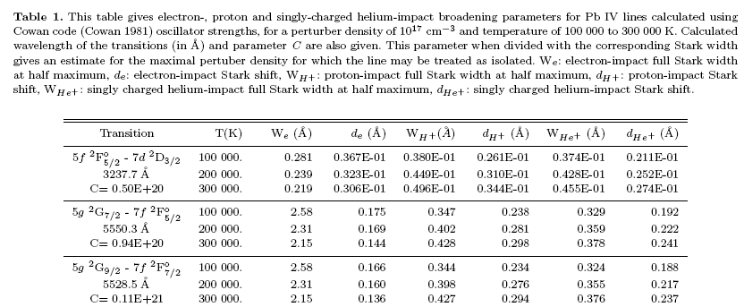
Here are presented results for 31 spectral lines from the 3000-7000 Å spectral range in the visible part of the spectrum.

Slide 8
Thank You

