Slide 1
Composite profile of the Fe Kα spectral line emitted from a binary system of supermassive black holes
Predrag Jovanović¹, Vesna Borka Jovanović²
and Duško Borka²
¹Astronomical Observatory, Belgrade, Serbia
²Vinča Institute of Nuclear Sciences, Lab. 040, Belgrade, Serbia

Slide 2
Outline
The broad Fe Kα spectral line emitted from a relativistic accretion disk around central supermassive black hole (SMBH) of AGN
  our investigations: simulations of the Fe Kα line profiles, based on ray-tracing in Kerr metric
Supermassive black hole binaries (SMBHBs)
  our investigations: simulations of the composite Fe Kα line profiles emitted from two accretion disks around components moving along Keplerian orbits
Conclusions

Slide 3
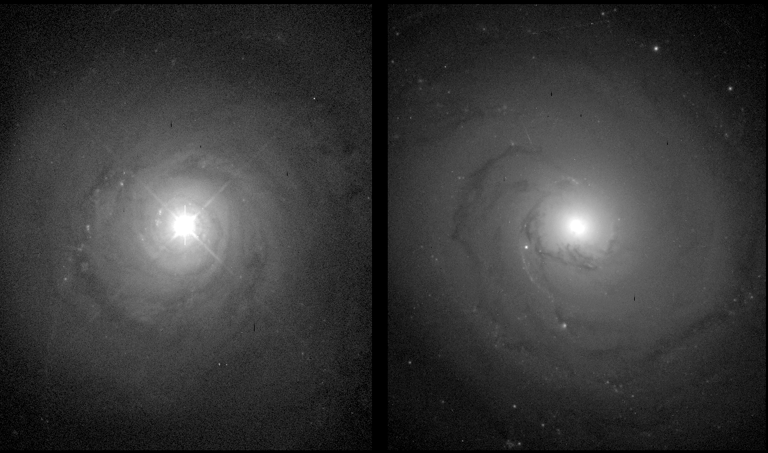
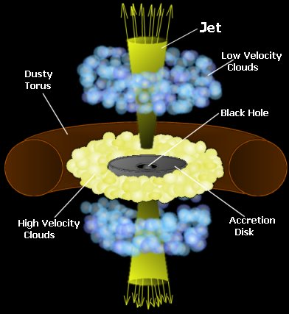
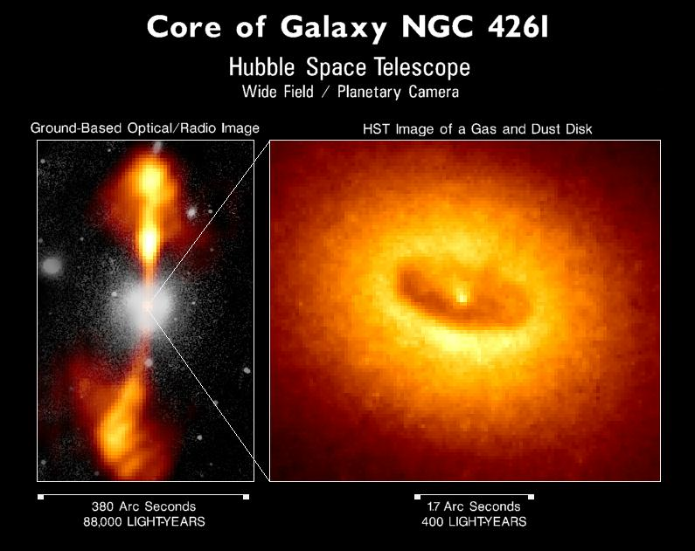
SMBHs in Active Galaxies
Left: NGC 5548 (Seyfert galaxy)
Right: NGC 3277 (regular galaxy)
Small very bright core embedded in an otherwise typical galaxy

Slide 4
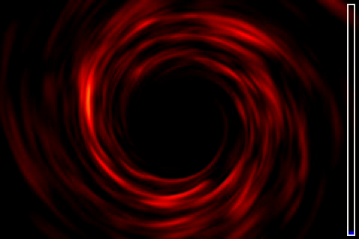
Armitage, P. J., Reynolds, C. S. 2003, MNRAS, 341, 1041

Slide 5
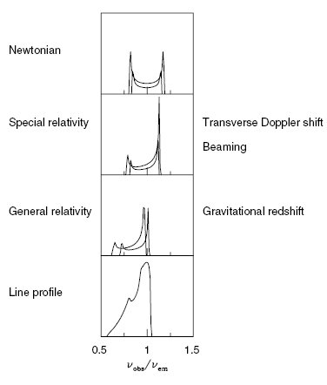

The broad Fe Kα spectral line
broad emission spectral line at 6.4 keV
asymetric profile with narrow bright blue peak and wide faint red peak
Line width corresponds to velocity:
v ~ 100.000 km/s (MCG-6-30-15)
v ~ 48.000 km/s (MCG-5-23-16)
v ~ 20000 – 30000 km/s (many other)
Tanaka et al, 1995, Nature, 375, 659
Fabian, A. C. 2006, AN, 327, 943

Slide 6
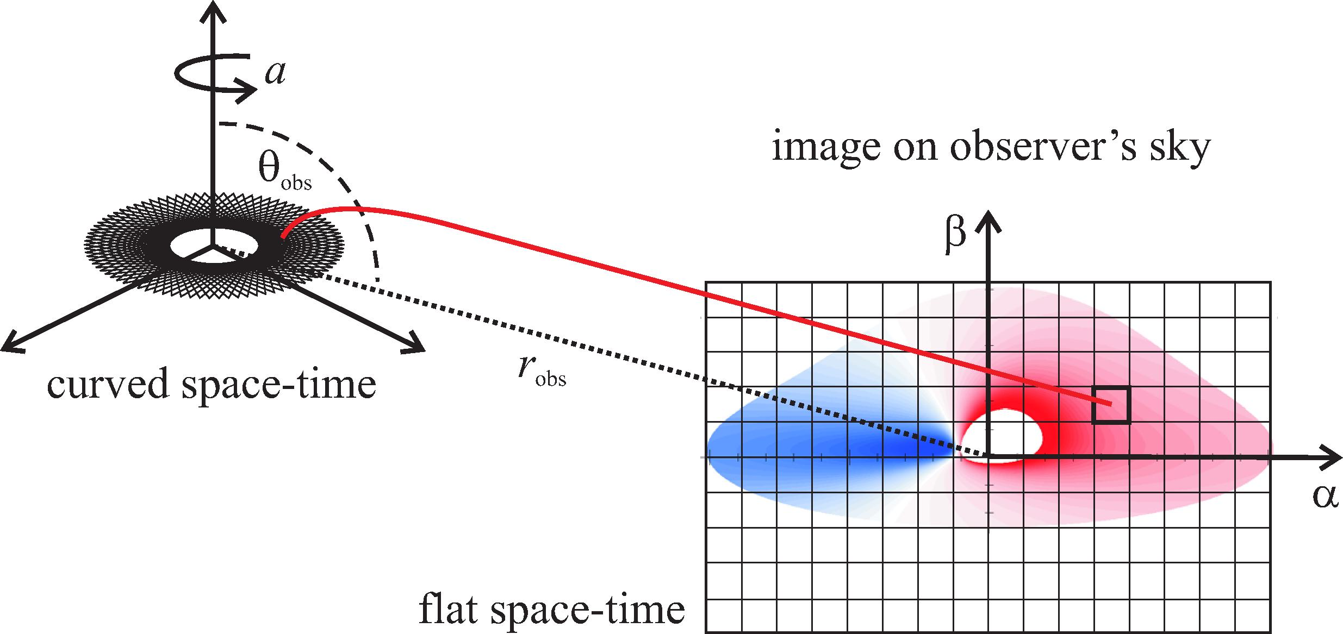

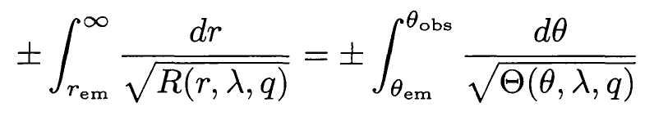
Our investigations: ray-tracing in Kerr metric
Surface emissivity of the disk:
Total observed flux:
Energy shift:

Slide 7
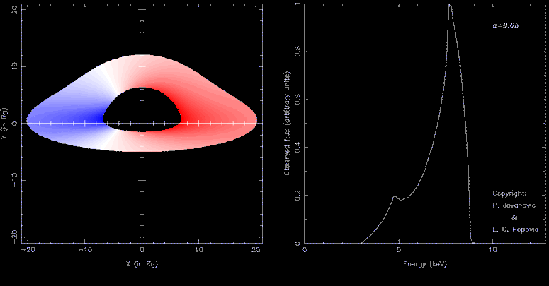
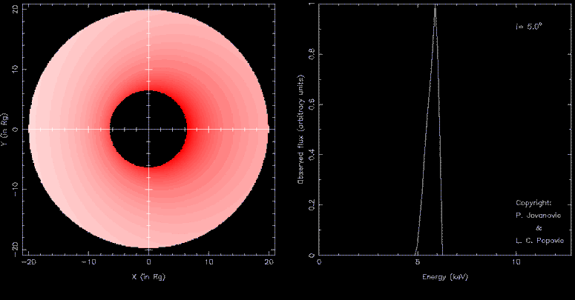
Jovanović & Popović, 2008, Fortschr. Phys. 56, 456

Slide 8
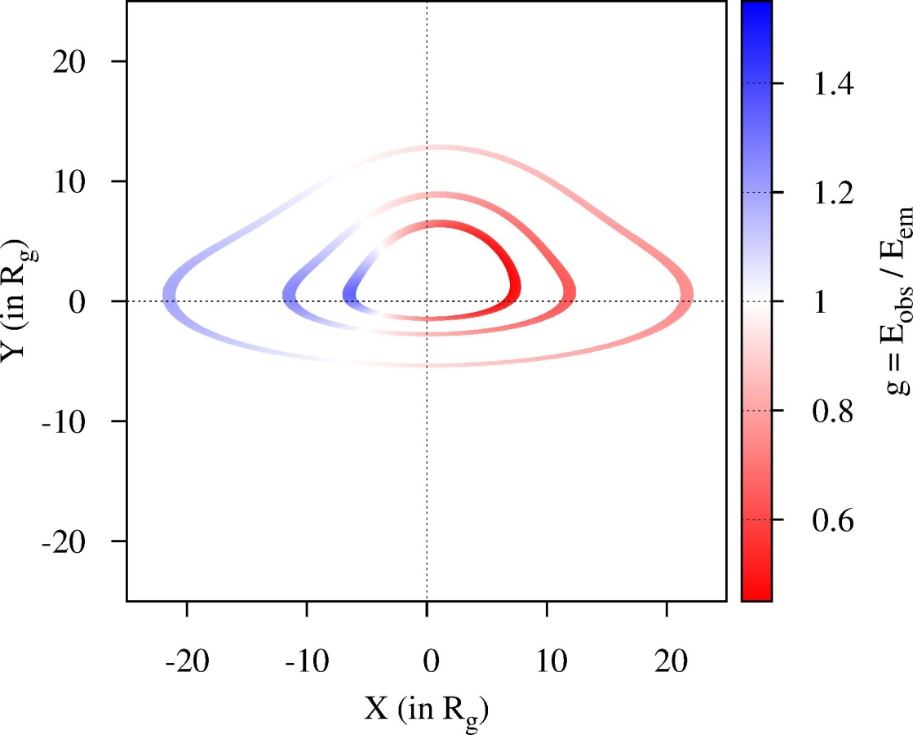
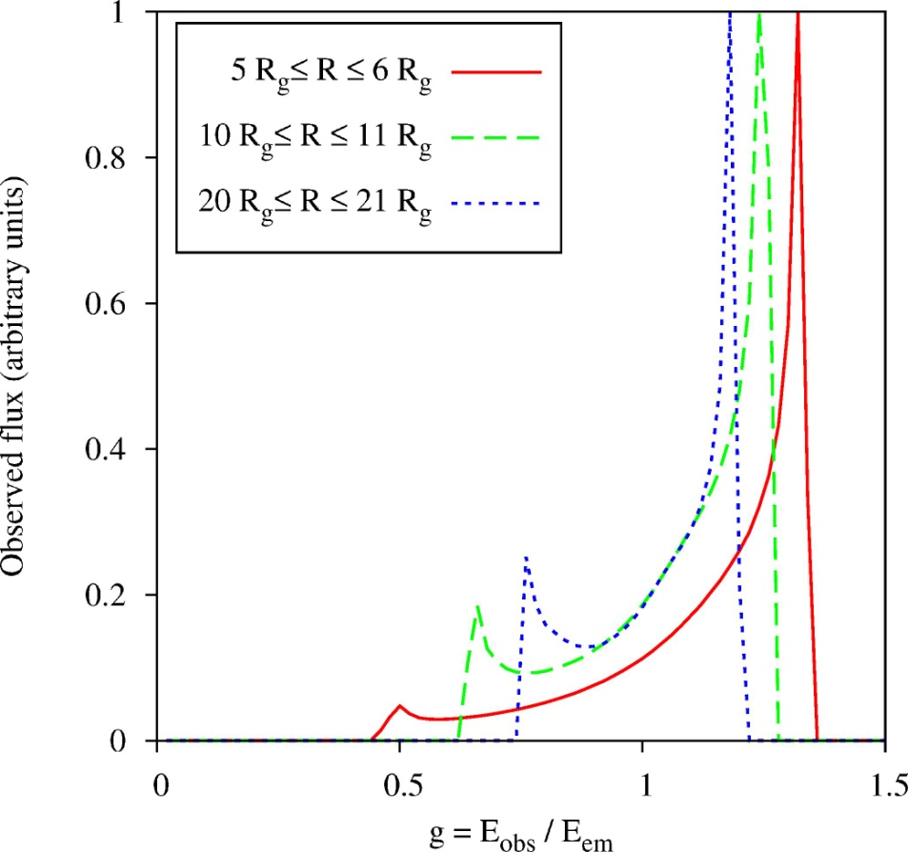
Simulated profiles of the Fe Kα line emitted from narrow rings in accretion disk

Slide 9
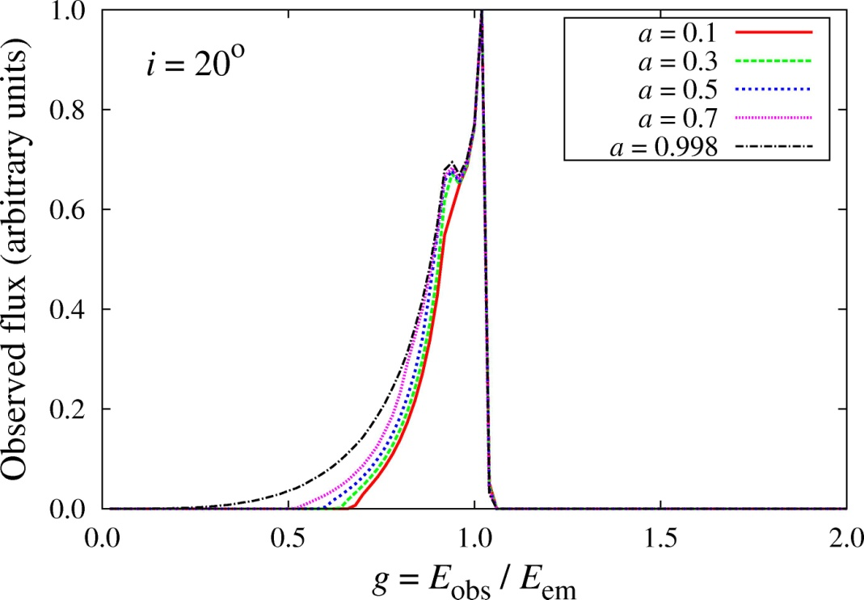
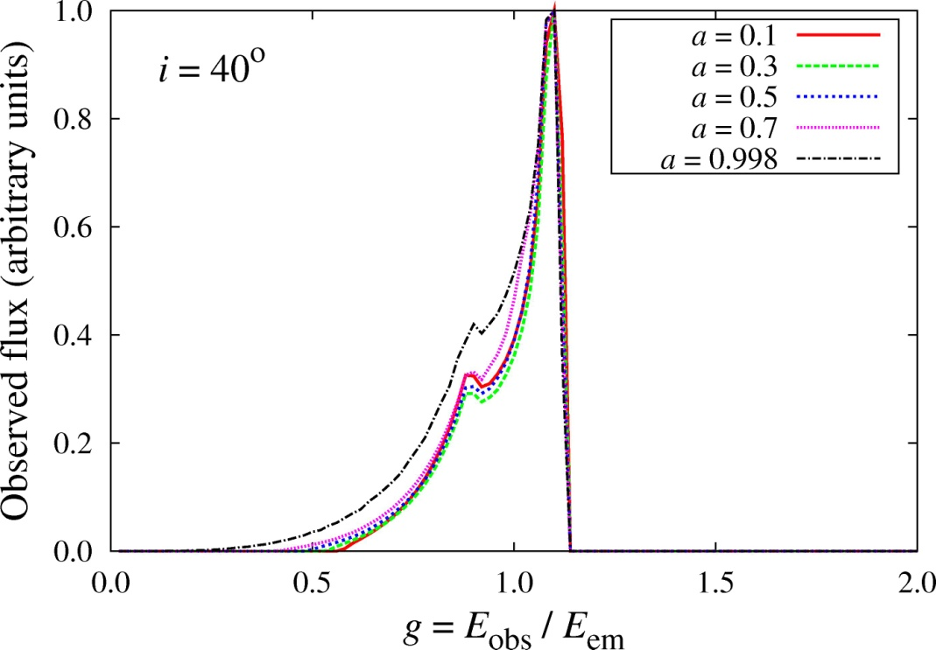
Modeled Fe Kα spectral line profiles for several values of angular momentum parameter a, and for inclination angle i = 20º (left) and i = 40º (right)
Jovanović, Borka Jovanović, Borka, 2011, Baltic Astronomy, 20, 468

Slide 10
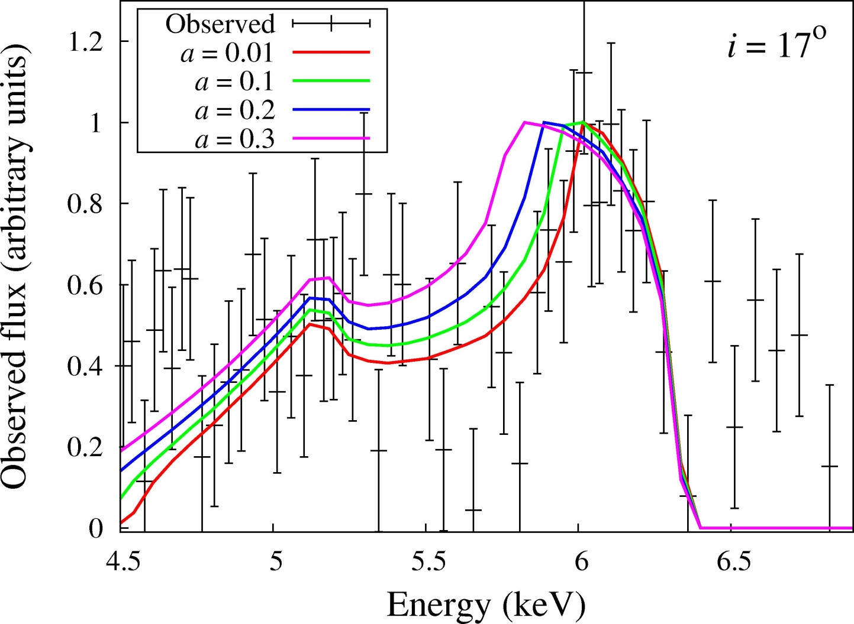
Observations of the Fe Kα line in the case of the nucleus of Cygnus A (3C 405) (black crosses with error bars) observed by Chandra, and the corresponding simulated profiles for 4 different values of black hole spin (solid color lines).
Simulations vs observations
Jovanović, Borka Jovanović, Borka, 2011, Baltic Astronomy, 20, 468

Slide 11

Supermassive black hole binaries (SMBHBs)

Slide 12
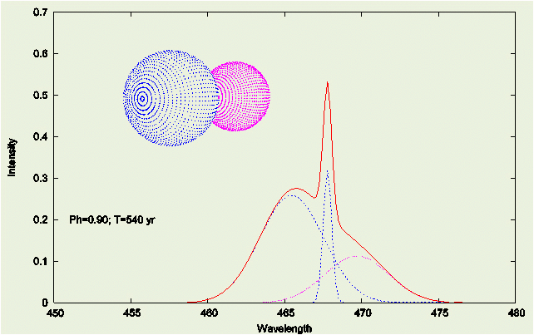
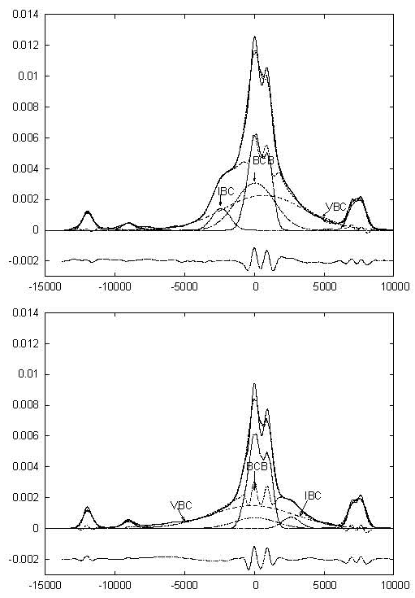
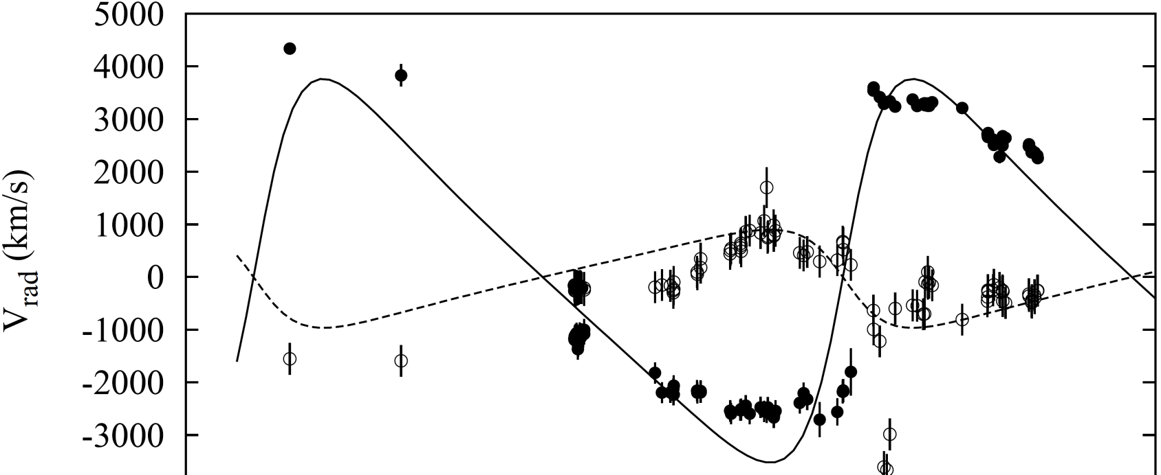
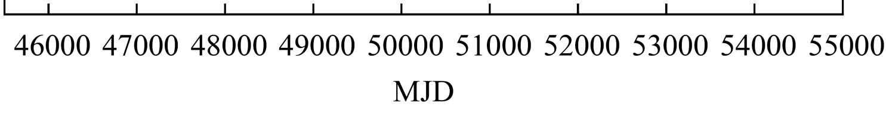
Optical lines from SMBHBs
Popović, 2012, NewAR, 56, 74
Bon et al. 2012, ApJ, 759, 118

Slide 13
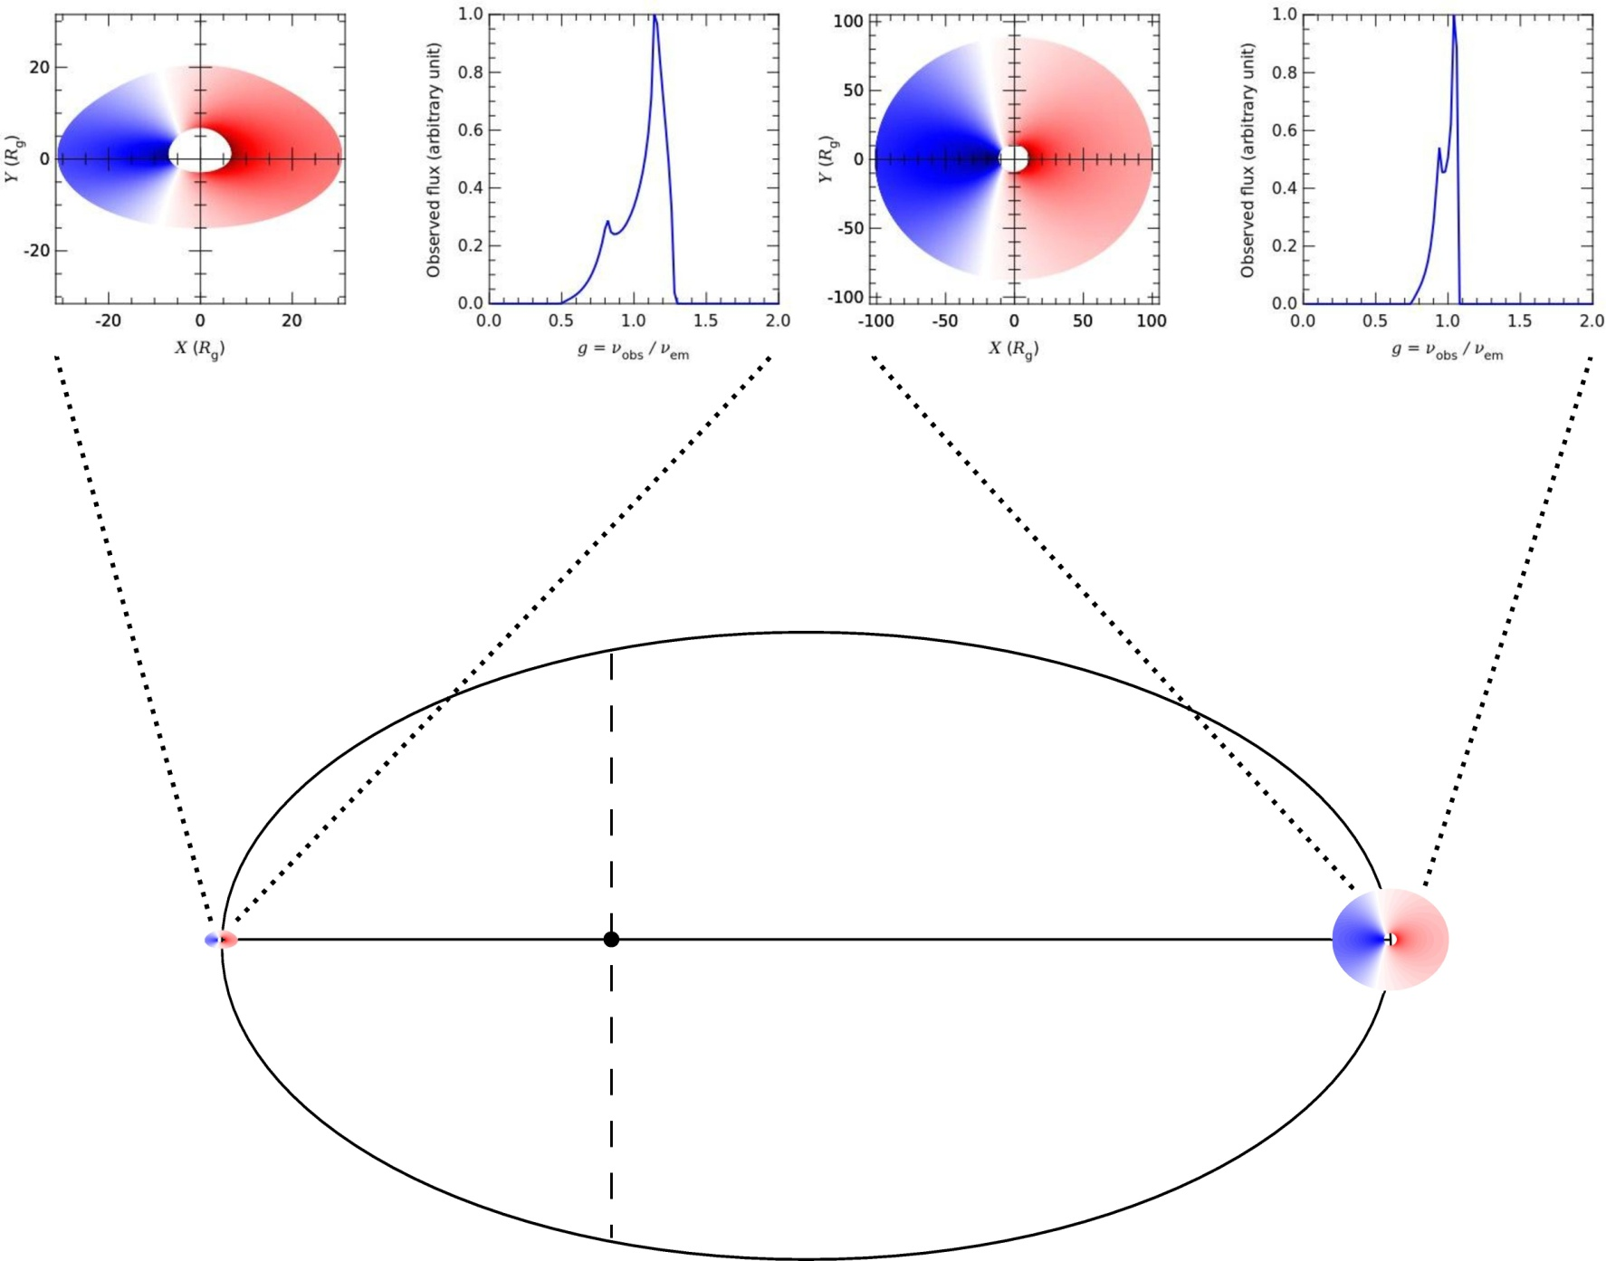
The broad Fe Kα line from SMBHBs
M₁ = 10⁸ M
M₂ = q M₁
i = 60º
a = 0.1
R_{in} = R_{ms}
R_{out} = 30 R_{g}
i = 30º
a = 0.1
R_{in} = 10 R_{g}
R_{out} = 100 R_{g}

Slide 14
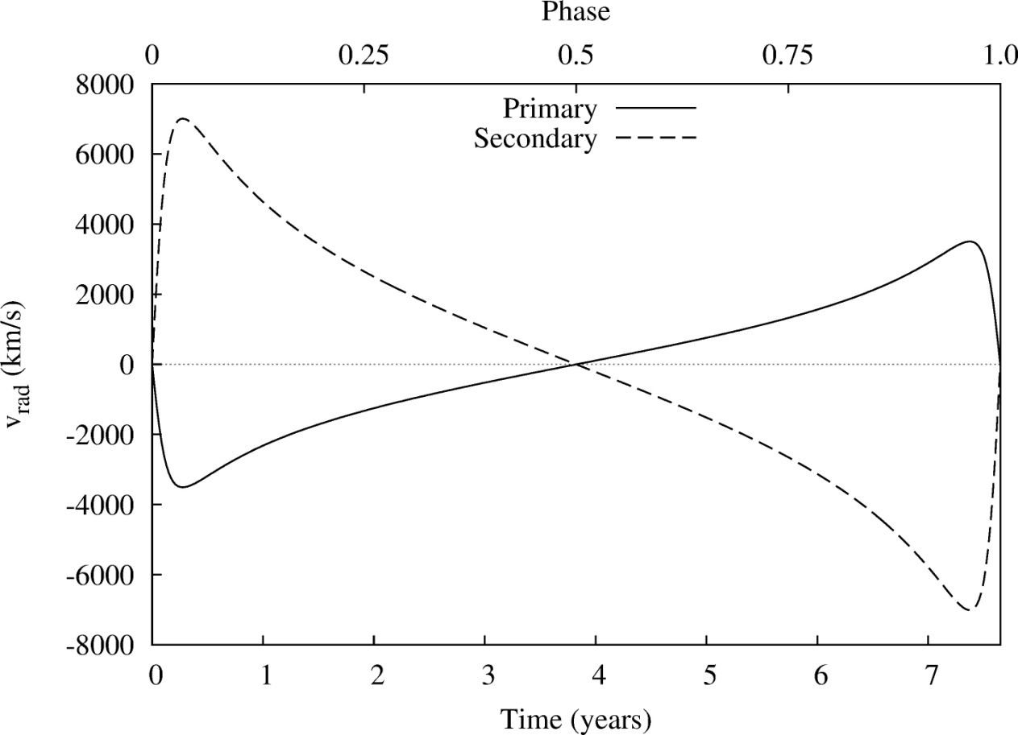
Keplerian radial velocity curves of SMBHBs
K_{1,2} – semiamplitudes of the velocity curves,
γ – systemic velocity
Keplerian radial velocity curves for
and the following orbital elements:
a = 0.01 pc, i = 60º, e = 0.75 and ω = 90º

Slide 15
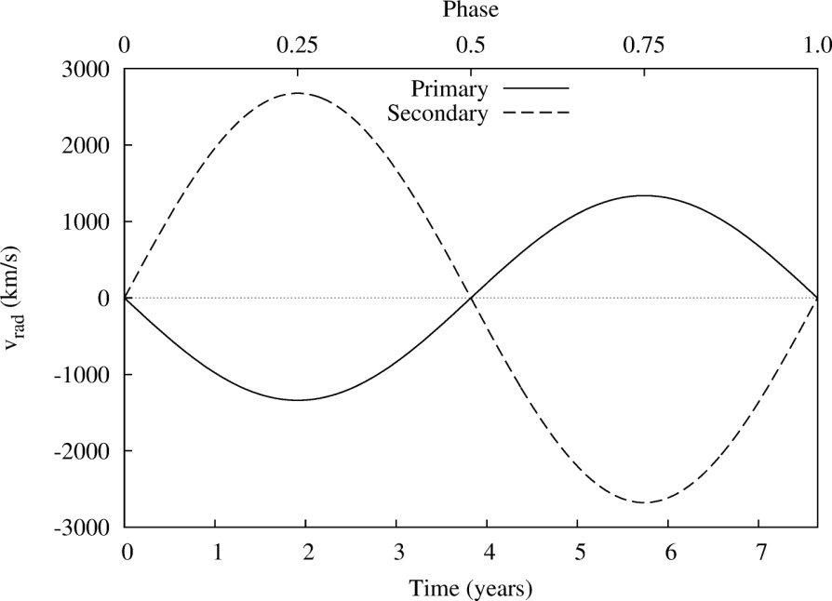
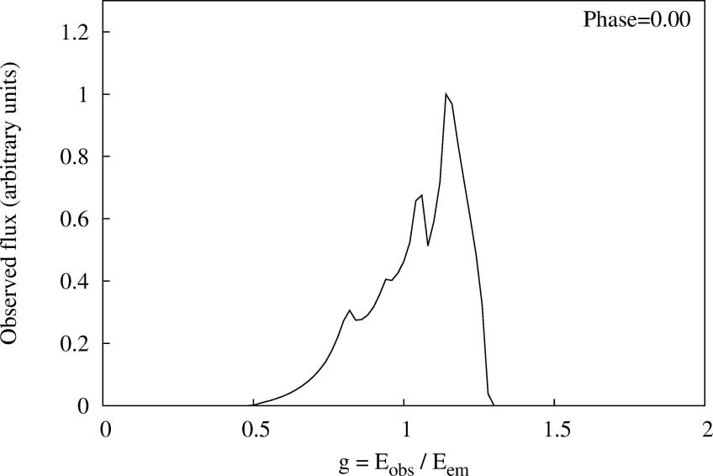
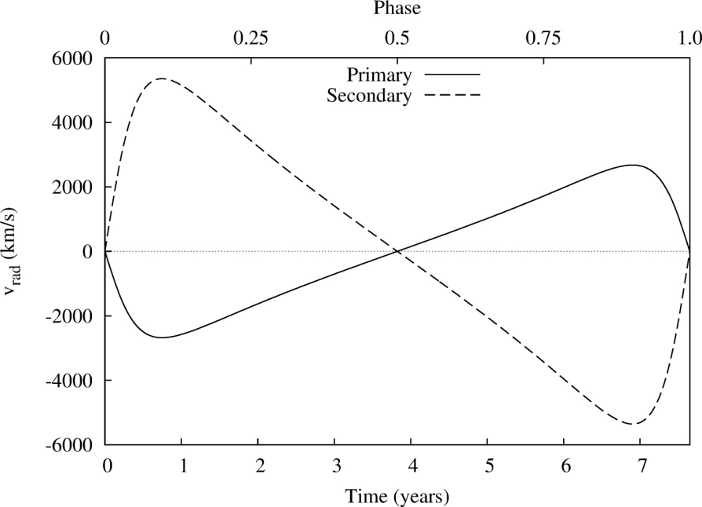
Composite Fe Kα line profiles I
Case I: q = 0.5, a = 0.01 pc, i = 30º, e = 0 and ω = 90º
Case II: q = 0.5, a = 0.01 pc, i = 60º, e = 0.5 and ω = 90º

Slide 16

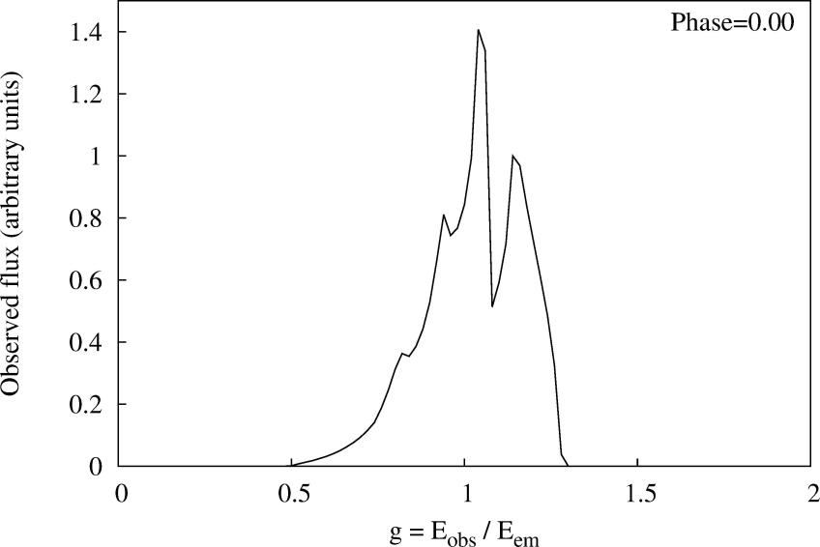
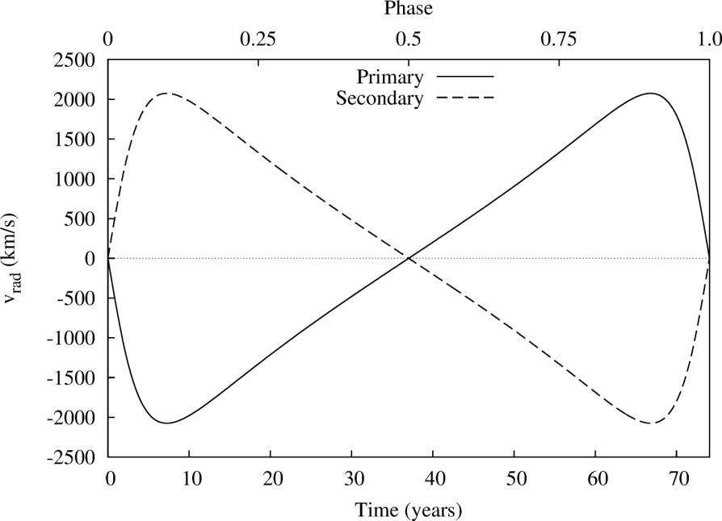
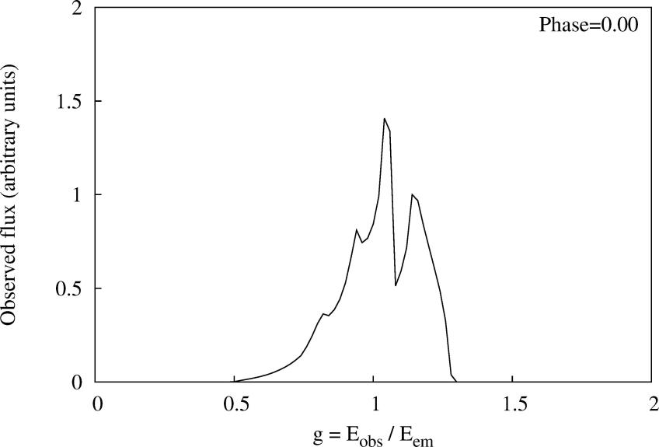
Composite Fe Kα line profiles II
Case III: q = 1.0, a = 0.01 pc, i = 60º, e = 0.75 and ω = 90º
Case IV: q = 1.0, a = 0.05 pc, i = 60º, e = 0.5 and ω = 90º

Slide 17
Conclusions
We developed and performed simulations of the Fe Kα line profiles emitted from relativistic accretion disks around single and binary SMBHs, based on ray-tracing method in Kerr metric
These simulations enables us to study space-time geometry in vicinity of such SMBHs, their properties, strong gravity effects and accretion physics
If detected, the unusual, complex and shifted composite Fe Kα line profiles could provide evidence about presence of the binary SMBH systems
Such complex Fe Kα line profiles could be used for studying the parameters and orbits of SMBHBs, especially in the cases when they are composed from two very different constituent line profiles (e.g. when one of them is significantly wider)
This is the case when primary and secondary SMBHs have different properties and/or their accretion disks have different parameters (such as inner and outer radii and/or emissivity)

Slide 18
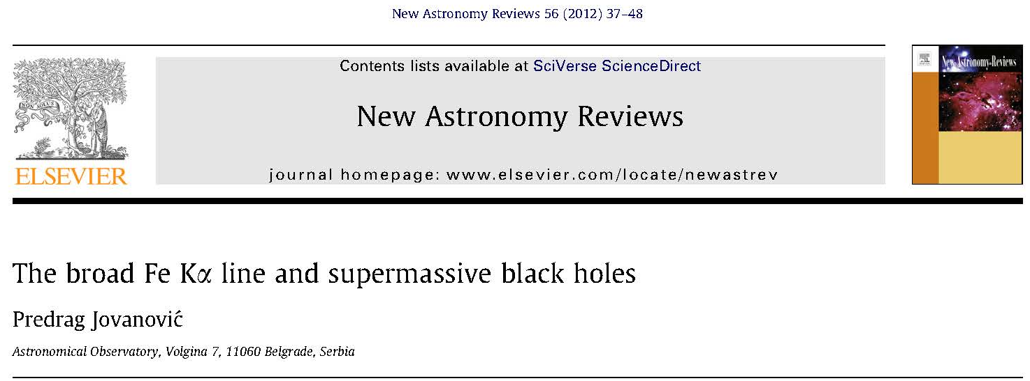

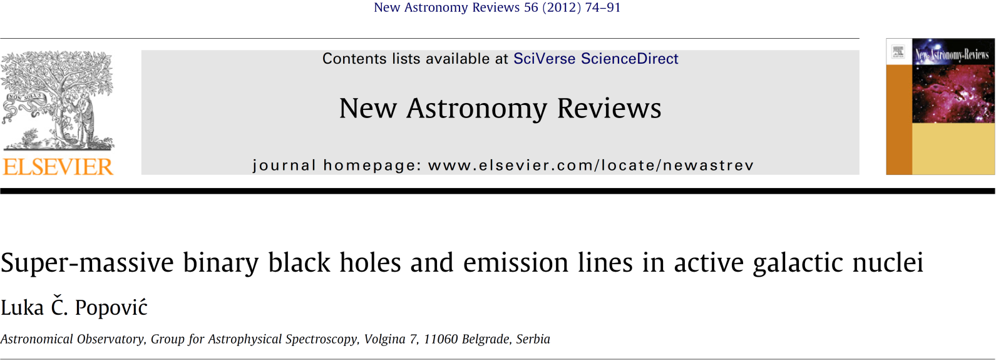
Reviews of our results
Jovanović P., Popović L. Č., 2009, chapter in book “Black Holes and Galaxy Formation”, Nova Science Publishers Inc, Hauppauge NY, USA, 249-294, arXiv:0903.0978

Slide 19
Thank you for attention!

