Slide 1

Spectral characteristics of the AGNs type 1 in the optical/UV spectral band
Jelena Kovačević Dojčinović, Luka Č. Popović
Astronomical observatory Belgrade

Slide 2
Outline
1. Introduction
2. Modelling the UV/optical spectra
2.1 Multigaussian model
2.2 UV/optical Fe II templates
2.3 Balmer continuum model
3. Kinematics of the emission regions in AGNs
3.1 Where the optical/UV Fe II lines arise?
3.2 Virilization of the Broad Line Region
4. Contribution of the starbursts to AGN spectra
5. Summary

Slide 3
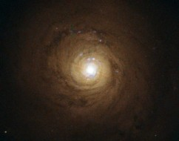
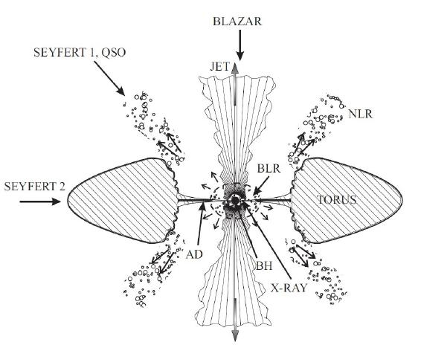
Introduction: AGNs type 1
NGC 5548
ESA/Hubble and NASA.
Jovanović & Popović, 2009

Slide 4
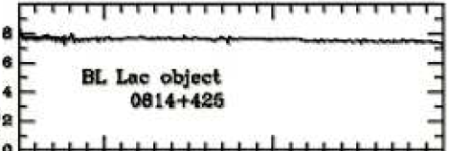
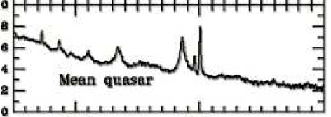
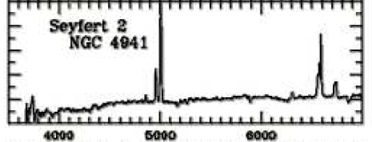
Introduction: AGNs type 1
Blasar
AGN type 1
AGN type 2
Jovanović & Popović, 2009

Slide 5
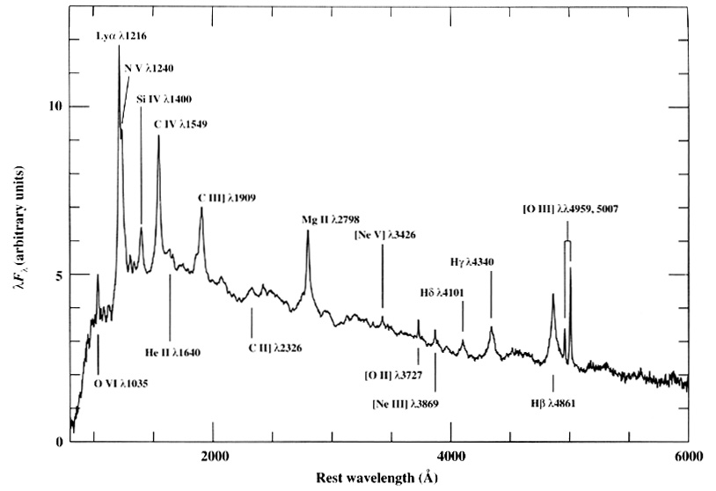
Introduction:
AGN type 1: UV and optical spectrum
Broad Line Region (BLR)
density: 10¹⁰ cm⁻³
distance: ~pc
Velocities: ~ 1000 km/s
BLR
AGN type 1
NLR
Jovanović & Popović, 2009
Narrow Line Region (NLR)
density: 10³ cm⁻³
distance: ~kpc
Velocities: ~ 100 km/s
Francis et al. 1991

Slide 6
Introduction:
Very complex spectra!
Host galaxy contribution (1 % - 10 %)
power low continuum
Balmer continuum
UV and optical iron lines
?
UV/optical
Fe II lines
Balmer
continuum
Power low
Francis et al. 1991

Slide 7
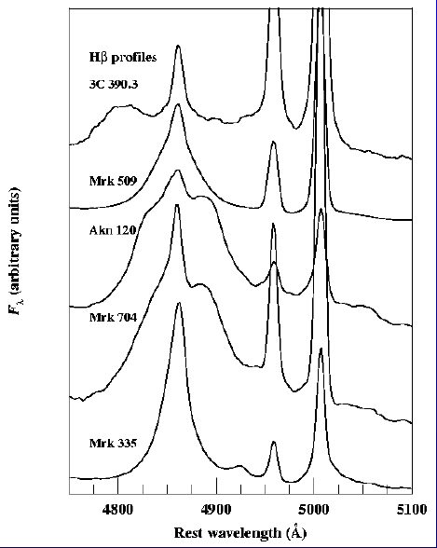
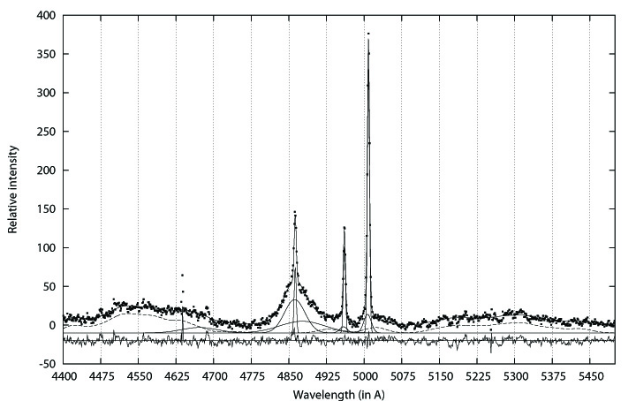
Introduction:
complex shapes of the broad
emission lines
contribution of the starbursts
Peterson 1997
BLR
NLR
[O III]
Hβ

Slide 8
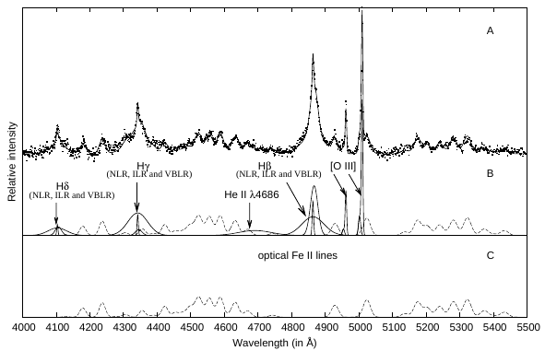
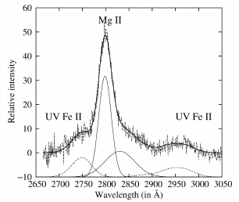
2. Modeling the optical spectra:
2.1 Multigaussian model
Different components of emission lines are coming from different layers of emission regions.
Each component (represented as Gaussian) reflects the physical and kinematical properties of emission region where it arises.
Correlations between properties of different lines lead to better insight in the AGN structure, and kinematical and physical properties of gas in AGNs.

Slide 9
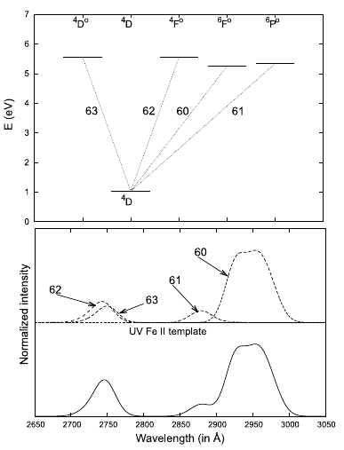
2. Modeling the optical spectra:
2.2 UV/optical Fe II template
Optical Fe II template:
UV Fe II template:
Popović et al. 2003, ApJ, 599, 185
Kovačević-Dojčinović & Popović, 2015, ApJS, 221, 35.
Kovačević et al. 2010, ApJS, 189, 15.
Shapovalova et al. 2012, ApJS, 202, 10.
see http://servo.aob.rs/FeII AGN/

Slide 10
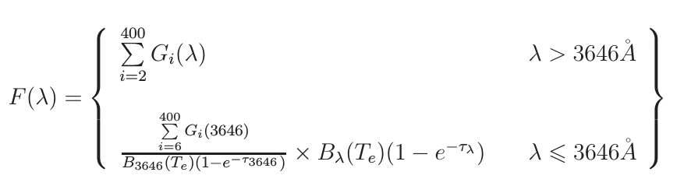
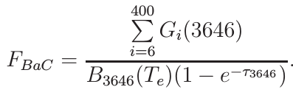
2. Modeling the optical spectra:
2.3 Balmer continuum model
Kovačević et al. 2014, AdSpR, 54, 1347
Balmer continuum model: Balmer continuum
(Grandi 1982, λ<3646A) + high order Balmer lines (n=3-400, λ>3646A)
One parameter of freedom less – we are calculating the intensity of the Balmer continuum using high order Balmer lines
Good fit near Balmer edge
power low
Balmer continuum
High order Balmer lines

Slide 11
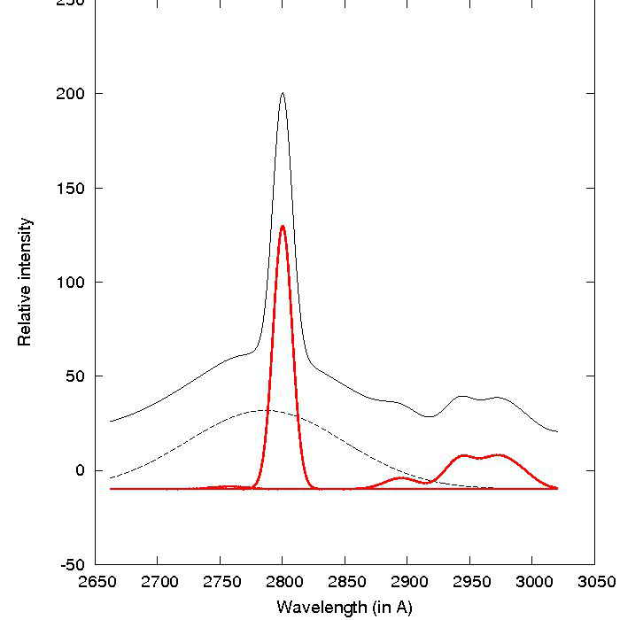
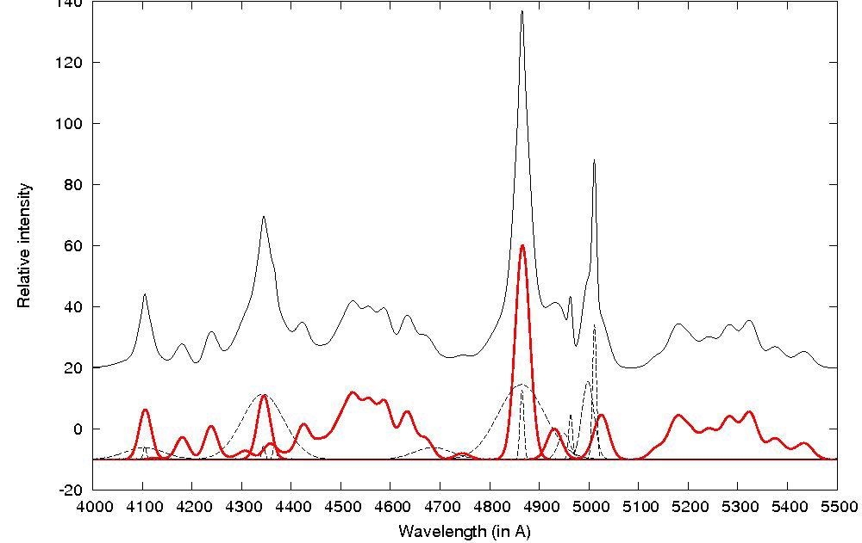
3. Kinematics of the emission regions in AGNs
3.1 Where the optical/UV Fe II lines arise?
NLR
large AGN sample from SDSS
Correlations between the widths (and between shifts)
of UV/optical Fe II, Mg II 2800 A and Balmer lines core
indicate that the iron lines arise in the same emission region where
the core of the Balmer lines arise: Intermediate Line Region (ILR).
Kovačević et al. 2010, ApJS, 189, 15.
Kovačević-Dojčinović & Popović, 2015, ApJS, 221, 35
Barth et al. 2013
ILR
BLR
UV (2650-3050 Å) optical (4000-5600 Å)
Mg II
Hβ
[O III]
Hγ
Hδ
Fe II
UV Fe II
Fe II

Slide 12
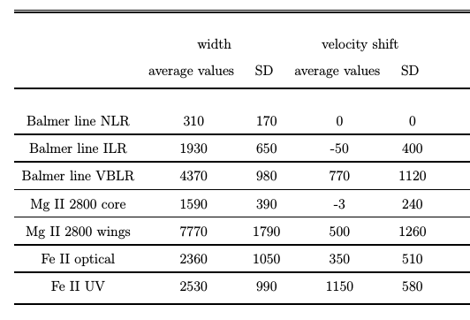
3. Kinematics of the emission regions in AGNs
3.1 Where the optical/UV Fe II lines arise?
NLR
ILR
BLR
Large redshift!
Inflaw of the gas,
asymmetry of the UV Fe II emission region?
Kovačević-Dojčinović & Popović, 2015, ApJS, 221, 35.

Slide 13
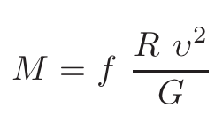
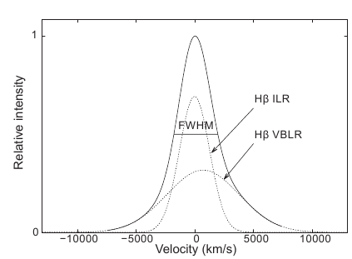
3. Kinematics of the emission regions in AGNs
3.1 Virilization of the Broad Line Region
NLR
Virial assumption: the main broadening
mechanism of the broad lines is the Keplerian motion around the supermassive black hole.
BLR
Supermassive black hole mass:
= FWHM
BH
Open questions:
Is virial assumption correct for all broad lines?
Is it correct for all AGN population?

Slide 14
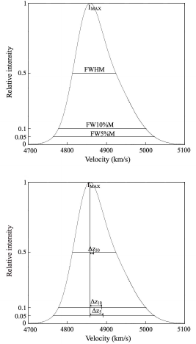
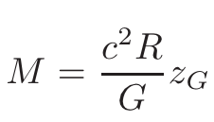



3. Kinematics of the emission regions in AGNs
3.1 Virilization of the Broad Line Region: Hβ, Mg II 2800 Å
R FWHM²
BH
BH
- gravitational redshift
We expect :
We use a large sample of AGNs with no
blue asymmetry, to check are Hβ, Mg II 2800 Å
lines virilized, i.e. can they be used for
black hole mass estimation.

Slide 15
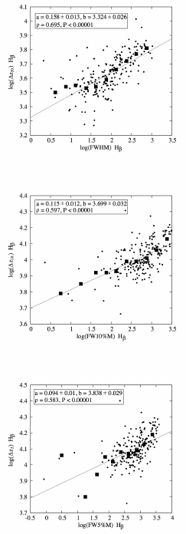
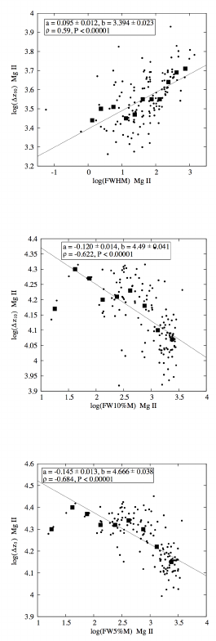
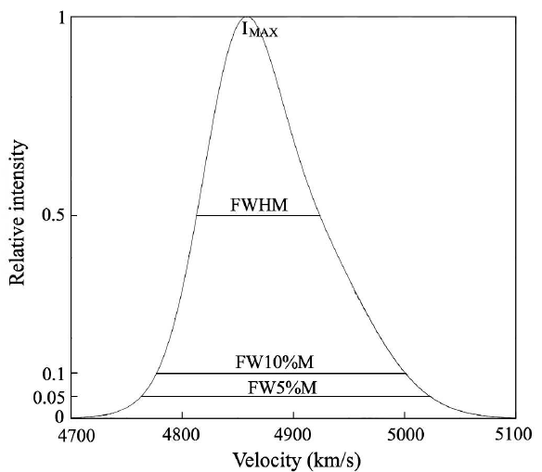
3. Kinematics of the emission regions in AGNs
3.1 Virilization of the Broad Line Region: Hβ, Mg II 2800 Å
Hβ
Mg II
50% I_{max}
10% I_{max}
5% I_{max}

Slide 16
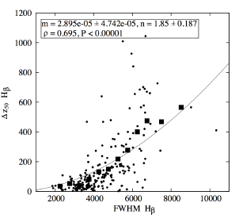
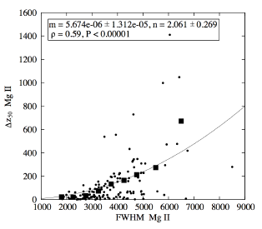
3. Kinematics of the emission regions in AGNs
3.1 Virilization of the Broad Line Region: Hβ, Mg II 2800 Å
n
fit with:
Hβ
Theoretically expected: n = 2
50% I_{max}
Hβ:
n= 1.85 ∓0.19
Mg II:
n = 2.06 ∓0.27
Hβ line is good virial estimator at all intensity
levels, but Mg II line only at half intensity.
Hβ more confident line for M_{BH} estimation!
Mg II
50% I_{max}
Jonić et al. 2016, Ap&SS, 361, 101

Slide 17
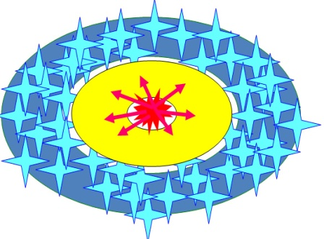
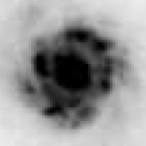
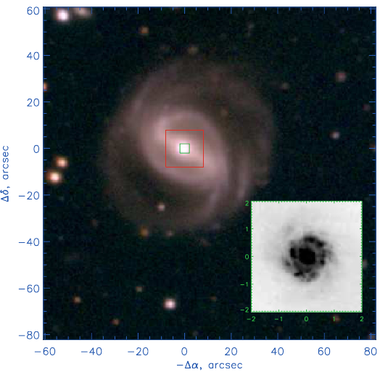
4. Contribution of the starbursts to AGN spectra
Popović et al. 2009, AJ, 137, 3548
AGN+ starburst
Mrk 493, HST
Example: Mrk 493, HST
emission lines from AGN
emission regions
+
emission lines from
starbursts

Slide 18
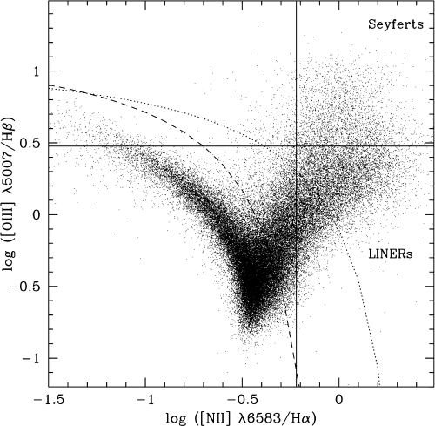
4. Contribution of the starbursts to AGN spectra
Baldwin et al. 1981,
Kewley et al. 2001,
Kauffmann et al. 2003
AGN
Popović, L. Č., Kovačević, J. 2011, ApJ, 738, 68
0.5
SB
R = log([O III]₅₀₀₇/Hβ_{NLR})
R > 0.5
“pure AGN”
247 objects
R < 0.5
”AGN+ starburst”
46 objects
Example: Mrk 493, HST

Slide 19
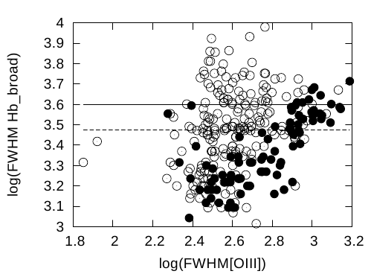
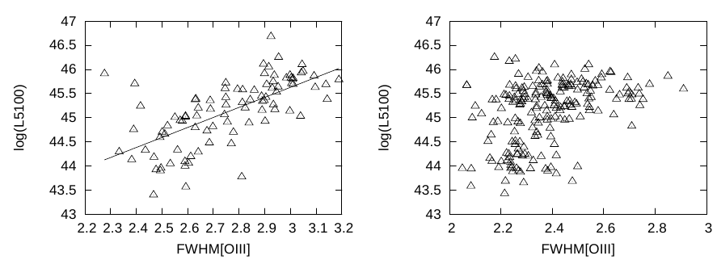
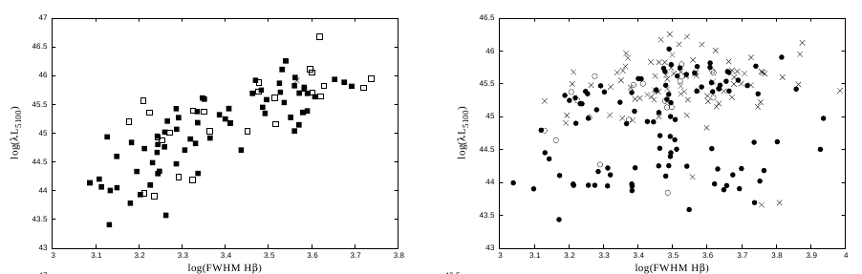
4. Contribution of the starbursts to AGN spectra
AGN+ starburst
pure AGN
● AGN + starburst
○ pure AGN
AGN+ starburst
pure AGN
Influence of the starburst radiation to the continuum luminosity and line widths
Problem with the M_{BH} estimation!
log L₅₁₀₀
log L₅₁₀₀
log FWHM Hβ
log FWHM Hβ
Popović, L. Č., Kovačević, J. 2011, ApJ, 738, 68

Slide 20
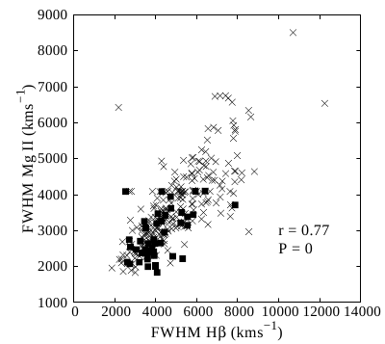
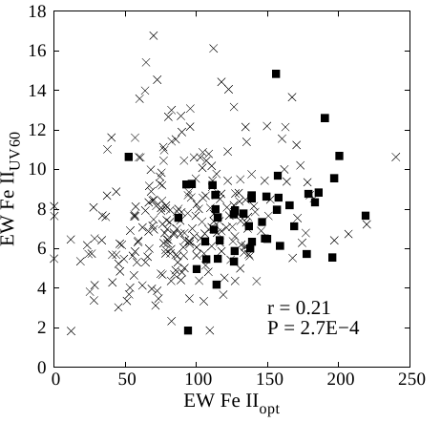
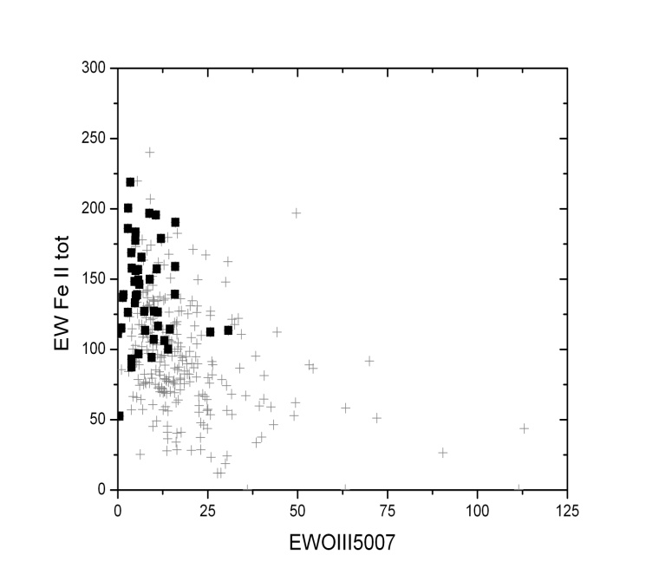
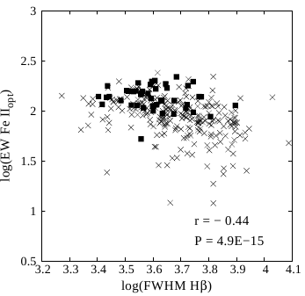
4. Contribution of the starbursts to AGN spectra
● AGN + starburst
× pure AGN
Influence of the starbursts:
solution for unexplained correlations?
EV 1 correlations, Boroson and Green 1992
Kovačević-Dojčinović & Popović, 2015, ApJS, 221, 35

Slide 21
Summary
The spectra of AGNs are very complex. Continuum emission and emission lines can be decomposed into parts which are coming from different regions in AGN. Contribution of host galaxy and starbursts must be taken into account.
Widths and shifts of the emission lines tell as about geometry and kinematics of the emission regions in AGN structure. Correlations between
shifts, or between widths of emission lines imply kinematical connection of their emission regions.
The virial assumption is valid for Hβ and Mg II lines with no blue asymmetry, so they can be used for the black hole mass estimation. Hβ is more confident for that purpose, since in wings of Mg II virial assumption failed.
The starburst nearby AGNs contribute in emission lines and continuum in AGN spectra and change the spectral properties. It must be taken into account when using AGN spectra for black hole mass estimation. Possible connection of the starbursts with unexplained correlations in AGN sectra.
Thank you for attention

