Slide 1
ATOM-RYDBERG ATOM PROCESSES IN
THE STELLAR ATMOSPHERES:
DWARF ATMOSPHERES, QUIET SUN AND SUNSPOTS
V. A. SREĆKOVIĆ¹, A. A. MIHAJLOV¹, LJ. M. IGNJATOVIĆ¹,
and M. S. DIMITRIJEVIĆ^{2,3}
¹Institute of Physics, P.O.Box 57, Pregrevica 118, Belgrade, Serbia
²Observatoire de Paris, UMR CNRS 8112, UPMC,92195 Meudon Cedex, France;
³Astronomical Observatory, Volgina 7, 11060 Belgrade, Serbia
vlada@ipb.ac.rs
X SBAC, Belgrade 2016.

Slide 2


The Team
Institute of Physics, Belgrade
Prof Dr. A. A. Mihajlov
Dr. V.A. Srećković
Dr. Lj.M. Ignjatović
AOB (Astronomical Observatory Belgrade)
Prof Dr. M.S. Dimitrijević
Collaborators: all over the world. Russia, Dept. of Physics, St-Petersburg University,Russia
A.N. Klyucharev, Bezuglov …, others from AOB…, Italy, Croatia… Now I present:

Slide 3
I will present the results from
our recent papers:
Monthly Notices of the Royal Astronomical Society
and few more rec. papers …

Slide 4
Outline
Present our investigation: of chemi-ionization processes,
and influence on solar photosphere and WD atmospheres
our investigation : of chemi-ionization + pre-ionization(mixing),
and influence on solar photosphere
investigation : chemi-ionization + pre-ionization(mixing),
and influence on DB WD atmospheres
Further invest. of chemi-ionization + pre-ionization(mixing),
influence on sunspot atmospheres…
and
few words about MOL-D Database

Slide 5



Sun
In order to improve the modeling of the solar photosphere, as well as to model atmospheres of other similar and cooler stars where the main constituent is also hydrogen, it is necessary to take into account the influence of all the relevant collisional processes on the excited-atom populations in weakly ionized hydrogen plasmas.
Group of chemi-ionization atom collisional processes in weakly ionized layers of stellar atmospheres (ionization degree less than 10⁻³) was studied. In order to demonstrate the significance of these processes it was necessary to compare their efficiency, from the aspect of their influence on the free electron and excited atom populations, with the efficiency of the known concurrent processes of electron–atom impact ionization and etc.
We study
hydrogen in excited Rydberg state
in collision with hydrogen in ground state we have asoc. ion.ization H₂⁺ and e
Associative chemi-ion.
(1)
2 possible channels
(2)
Consequently, in this case the efficiency of the chemi-ionization processes has to be compared with the efficiency of the processes
(3)

Slide 6
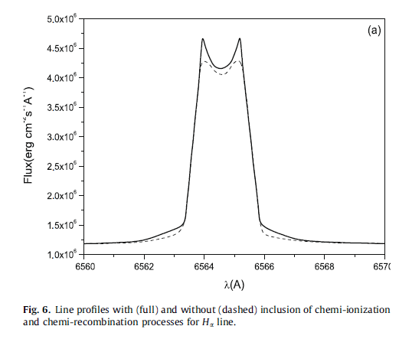
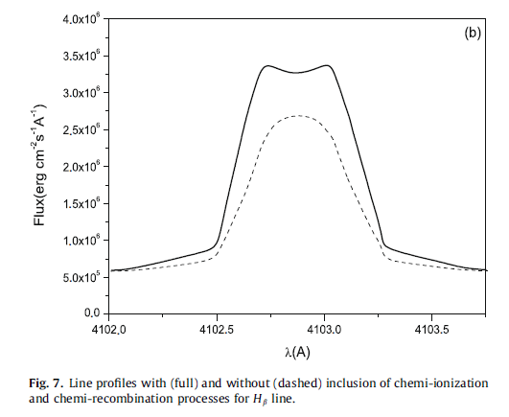
Let us emphasize the fact that here as the starting point we focus on the hydrogen case, since our main aim is to draw attention of astronomers to the processes (1)–(2), and to show that the importance of these processes for non-local thermodynamic equilibrium (LTE) modeling of solar atmosphere should be investigated. For this purpose, it should be demonstrated that in the solar photosphere the efficiency of these processes is greater than, or at least comparable to, the efficiency of processes (3) within those ranges of values of n ≥ 2 and temperature T which are relevant to the chosen solar atmosphere model.
M red dwarf’s
Important thing: Besides all that is mentioned above, the fact that the processes (1)–(2) could be very important for the solar photosphere is supported by the results obtained in Mihajlov et al. (2003a, 2007b), where these processes were included ab initio in a non-LTE modeling of an M red dwarf atmosphere with the effective temperature T_{eff} = 3800 K, using PHOENIX code (see Baron & Hauschildt 1998; Hauschildt et al. 1999; Short et al. 1999). A fact was established that including even the chemi-ionization/recombination only for 4 ≤ n ≤ 8 generates significant changes (by up to 50%), at least in the populations of hydrogen-atom excited states with 2 ≤ n ≤ 20, and if all these processes (with n ≥ 2) are included, a significant change (somewhere up to 2–3 times) is also generated on the free electron density Ne, and, as one of further consequences, significant changes in hydrogen line profiles.
Idea: Keeping in mind that the compositions of the solar and the considered M red dwarf’s photospheres are practically the same and the values of hydrogen-atom density, Ne, and T in these photospheres change within similar regions (Fontenla et al. 2007; Vernazza et al. 1981; Mihajlov et al. 2007b), one can expect that the influence of processes (1)–(2) on the hydrogen-atom excited states and free-electron populations in the solar atmosphere will be at least close to their influence in that of the M red dwarf, and that these processes will be very important for weakly ionized layers of the solar atmosphere.

Slide 7
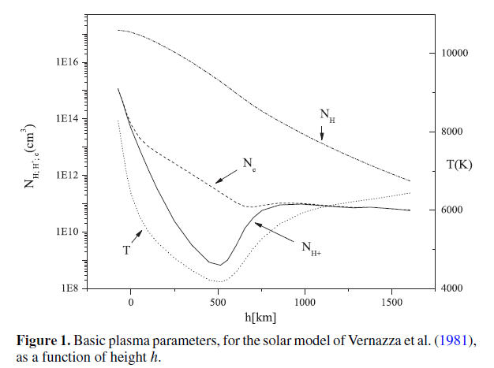
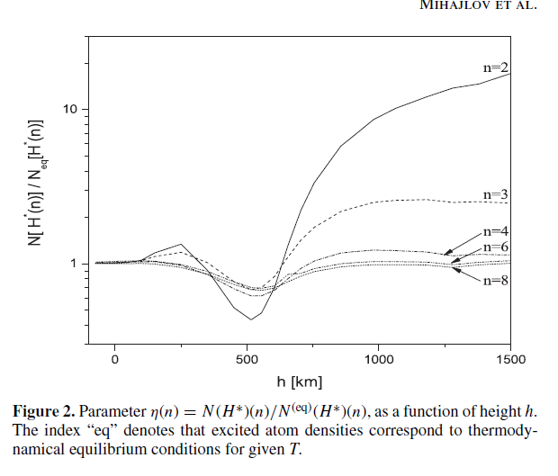
The Considered Model of the Solar Photosphere
In accordance with the aim of this work, we consider here model C of solar atmosphere from Vernazza et al. (1981) and Fontenla et al. (2007). Namely, this is a non-LTE model which is still actual (see Stix 2002), and it is only for this model that all the quantities necessary for our calculations are available in tabular form as functions of height (h) in solar photosphere. In Figure 1, plasma parameters for this model are shown. More significant Fig 2. In Figure 2 are illustrated deviations of non-LTE populations of excited hydrogen atom states with 2 ≤ n ≤ 8 in solar photosphere within the C model of Vernazza et al. (1981). One can see that these deviations are particularly exist for n = 2. Around h = 500 km N (H∗(n = 2)) is one-half of the corresponding equilibrium density, and for h larger than 1000 km it is around 10 times greater. These deviations rapidly decrease with an increase of n. However, even for n = 8 this deviation is around 40% around h = 500 km, illustrating the importance of taking into account the considered processes ab initio in the modeling of solar atmosphere

Slide 8





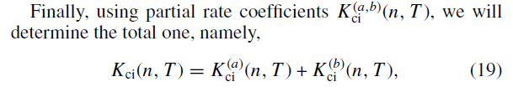
All theoretical data which are needed given in next part:
when one of the processes (1) and (2) is occurred, the ionization probabilities are obtained in the form
partial cross sections
partial rate coefficients for the chemi-ionization processes (1) and (2)
Schematic, steps.
using partial rate coefficients for each channel we will determine the total one

Slide 9
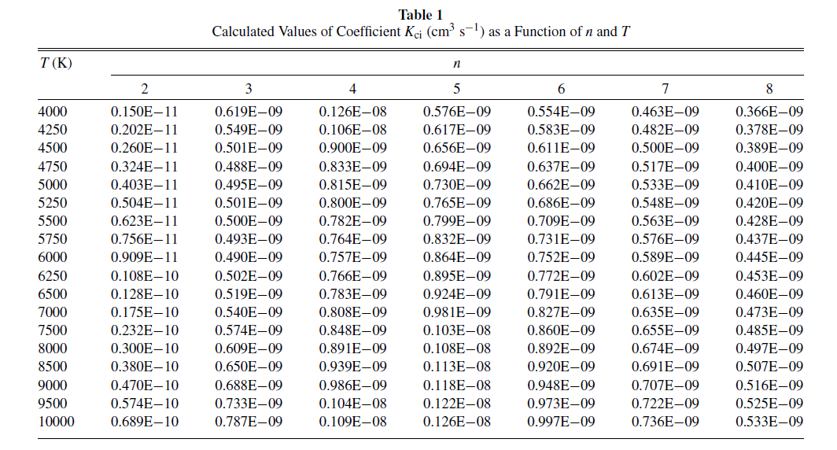
The values of the total chemi-ionization rate coefficients obtained in the described way, are presented in Table 1 . This table cover the regions 2 ≤ n ≤ 8 and 4000 K ≤ T ≤ 10000 K. we can analyze importance of ch.ion. for solar photosphere (see Fig. Vernazza)
n
T

Slide 10


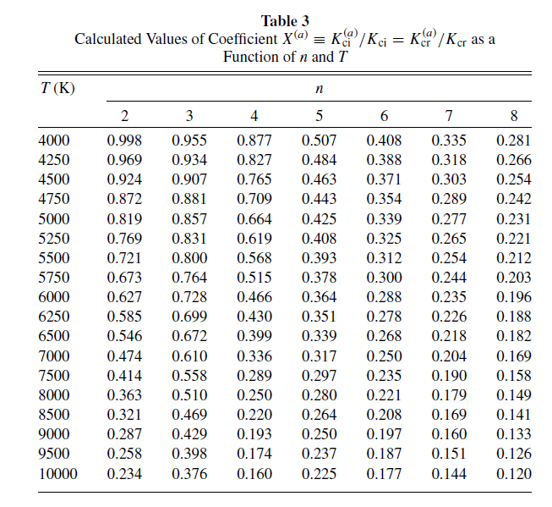
Relative contribution of partial chemi-ionization processes for given n and T with respect to the ch.-ion. total one are characterized by the corresponding branch coefficients
when T increases X decreases i.e.
rate coefficient for asoc. ion. (1) is
smaller comparing to process (2) as is expected.

Slide 11







Comparison of Fluxes of the Considered Processes and concurrent
I_{ci}(n, T ) is the total flux caused by the chemi-ionization processes (1, 2)
and I_{i;ea}(n, T ), be the fluxes caused by the concurrent ionization processes
Using these expressions, we first calculate quantities Fi (n, T ) which characterize the relative efficiency of partial chemi-ionization processes (1, 2) together and the impact
electron–atom ionization (3) in the considered plasma.
RATIO
impact ionization rate coefficients K_{ea}(n, T ) are taken from
Vriens & Smeets (1980).

Slide 12
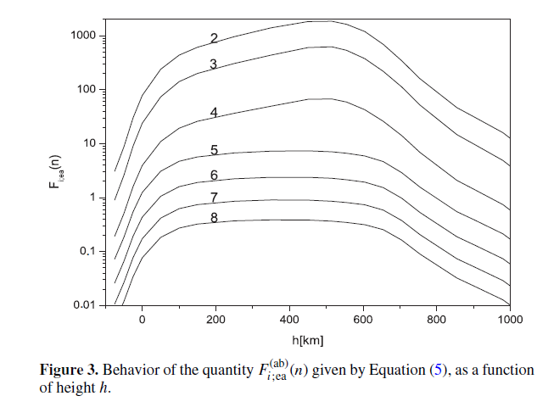
Partial i.e. for every n
In Figure 3, the behavior of the quantities F_{i,ea}(n, T ) for 2 ≤ n ≤ 8 as functions of height h is shown, according to the data (N₁ ground state dencity, Ne, and T) from Vernazza et al. (1981) for solar photosphere. One can see that the efficiency of the considered chemi-ionization processes in comparison with the electron–atom impact ionization is dominant for 2 ≤ n ≤ 6 and becomes comparable for n = 7 and 8.

Slide 13
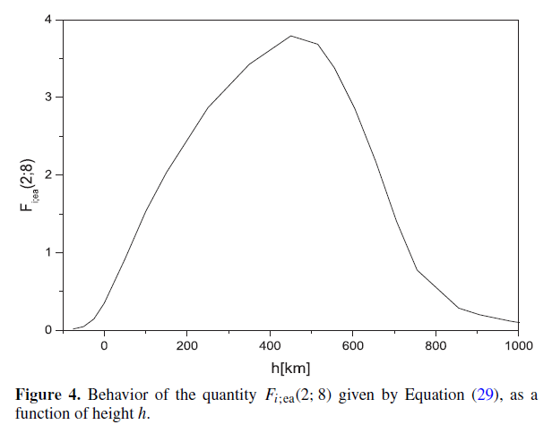
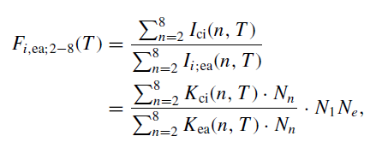
in order to compare the relative influence of the chemi-ionization processes (1) and (2) together to that of the
impact electron–atom ionization process (5) on the whole block of the excited hydrogen atom states with
2 ≤ n ≤ 8, we will calculate quantity F_{i,ea;2−8}(T ), given by
summing
In Figure 4, the behavior of the quantity F_{i,ea;2−8}(T ) as functions of height h is shown according to
the same data from Vernazza et al. (1981). As one can see, the real influence of the chemi-ionization
processes on the total populations of states with 2 ≤ n ≤ 8 remains dominant with respect to the concurrent
electron–atom impact ionization processes almost in the whole photosphere (50 km ≤ h ≤ 750 km).
This means that the chemi-ionization processes influence the radiative properties of the whole solar
atmosphere in the optical region.

Slide 14
Main result. From ApJS few years ago 2011
The obtained results demonstrate the fact that the considered chemi-ionization processes have a very significant influence on the optical properties of the solar photosphere in comparison with the concurrent electron–atom impact ionization processes.
Thus, it is shown that the importance of these processes for non-LTE modeling of solar atmosphere should be necessarily investigated.
End of the first part for solar atmospheres

Slide 15


WD atmospheres
Present the investigation of symmetrical chemi-ionization processes of the helium atom in weakly ionized layers of helium-rich DB white dwarfs.
symmetrical chemi-ionization processes have been considered in domains of principal quantum numbers n ≥ 3
and temperatures 12 000 K ≤ T_{eff} ≤ 30 000 K
Results showed that these processes can be dominant ionization mechanisms in helium-rich DB white dwarf atmosphere layers for log g = 7 and 8 and T_{eff} ≤ 20000 K and have to be implemented in relevant models of weakly ionized helium plasmas
The influence of examined processes is determined by comparison with other relevant ionization processes,
electron-Rydberg atom impact ionization
(2)

Slide 16


Theory
total chemi-ionization rate coefficients as sum of partial (1a) and (1b).
I_{i}^{(a;b)} denote part. fluxes due to processes (1a)–(2b), respectively.
where N(He) and N(He*(n)) denote He(1s²) atom and He*(n) Rydberg atom (n≥3) densities, and K_{i}ª(n; T) and K_{i}^{b}(n; T) denote rate coefficients of processes (1a) and (1b).
We have the total chemi-ionization fluxes I_{i}^{(ab)}

Slide 17
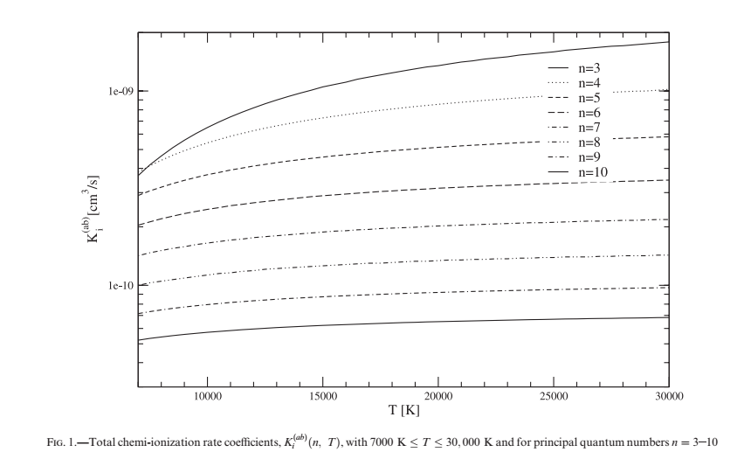
n=3
n=10
Rate coefficient as a function of temp.

Slide 18
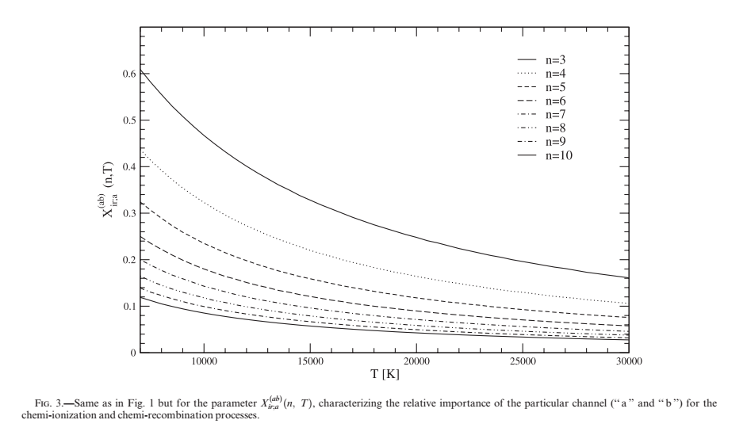
Parameter X
which describe the relative importance of the particular channel (“a” and “b”) of the considered processes.
T ↓ X_{asoc.} ↑

Slide 19




Other, concurrent ionization processes
electron-excited atom impact ionization (eq. [2])
(2)
flux
the ionization and rate coefficients determined by semiempirical
expressions from Vriens & Smeets (1980).
The relative importance of chemi-ionization (eqs. [1a]– [1b]) processes in comparison
with electron-excited atom impact ionization (eq. [3]), processes is characterized by
parameters F_{ir}^{(ab)} defined as ratios of the corresponding fluxes:

Slide 20
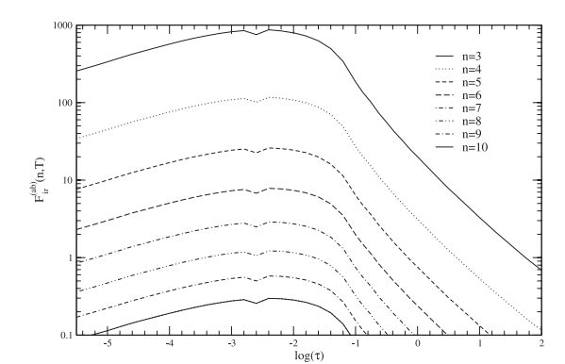
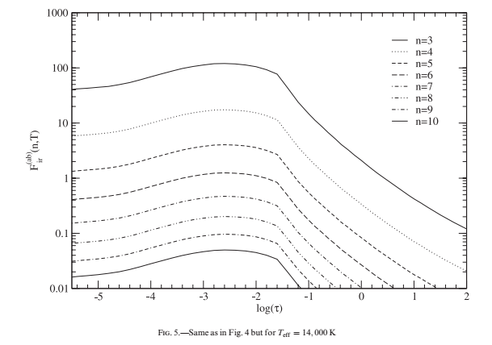
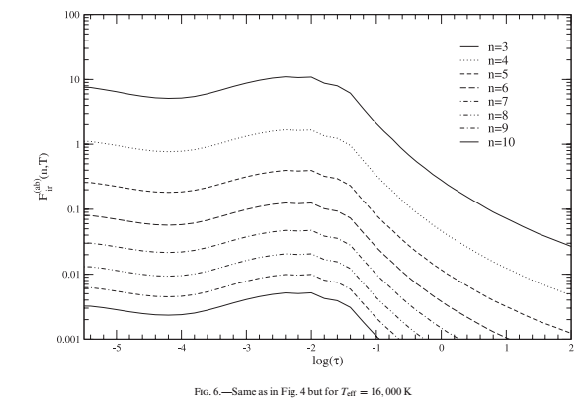
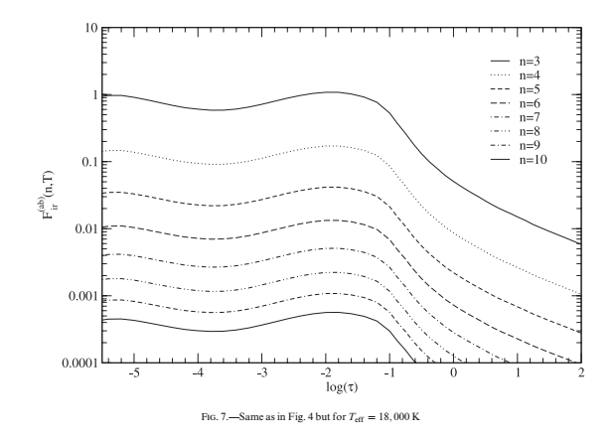
T_{eff}↑ F ↓

Slide 21
Conclusion
from the papers we published few years ago
in ApJS and Baltic Astr. 2011 is
The influence of the chemi-ionization (eqs. [1a]–[1b]) processes must be taken into account for the ab initio modeling of helium-rich DB white dwarf atmospheres, for log g = 7 and 8 and T_{eff} ≤ 20 000 K, since they would influence the basic structure of the atmosphere model. These results and similar ones for hydrogen solar plasma clearly proved the importance of the symmetrical chemi-ionization processes in weakly ionized layers of stellar atmospheres.
End of the first part for WD atmospheres

Slide 22

Next: further investigation with mixing (excitation processes )
MNRAS paper 2016
In our previous research has been notice that such inelastic processes in atom Rydberg-atom collisions, as chemi-ionization and (n-n') mixing, should be considered together.
In this context will be considered the influence of the (n-n')-mixing during a symmetric atom Rydberg-atom collision
processes on the intensity of chemi-ionization process. It will be taken into account A + A*(n,l) collisional systems,
where the principal quantum number n >> 1, where A=H or He
For the first time theoretically to describe together with 1 rate coeff.
Real influence of atom-Rydberg atom processes (chi+mix) in stellar atm.
It will be demonstrated that the inclusion of (n-n') mixing in the calculation, influences significantly on the
values of chemi-ionization rate coefficients (reducing it), particularly in the lower part of the block of the Rydberg states.
Two groups of inelastic processes in slow atom- Rydberg atom collisions, namely: chemi-ionization processes, including the processes of associative ionization and the processes of so called (n-n')-mixing, were for a longer time examined and discussed in literature. Let us note that concerning the processes of chemi-ionization, symmetrical as well as non-symmetrical atom-Rydberg atom collisions have been considered, while the (n-n')- mixing processes have been considered only in the case of symmetrical collisions.
We note that several unsolved problems remained concerning the mentioned processes, connected with the fact that theoretical investigations and interpretation of existing experimental results have been based on the semi-classical approximation. However, as the principal problem we see the fact that the processes of chemi-ionization and (n-n')-mixing in symmetrical atom-Rydberg atom collisions have been up to now considered independently, in spite that one considers that as the ones as well the others are conditioned by the same mechanism². We have in view here the so called dipole resonant mechanism, described several times in literature and discussed in details in Mihajlov et al. (2012).

Slide 23
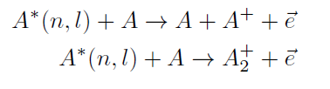
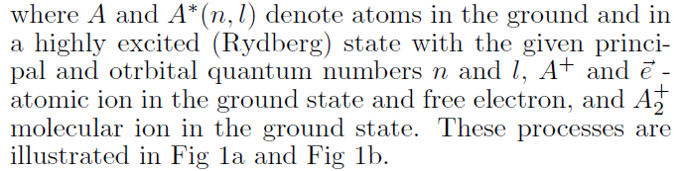
chemi-ionization processes
(1a)
(1b)
and (n-n')-mixing processes, i.e. excitation-deexcitation
processes
(2)
In this work we will investigate the influence of processes (2) on the processes of chemi-ionization (1a) and (1b).
Here, as first is described for this purpose, the way of inclusion of process (2) in the procedure of calculation of rate coefficients of the chemi-ionization processes (1a,b).
Their values are determined under the conditions characteristic for the Solar photosphere in the case A = H(1s) and A= He(1s²) in the case of atmosphere of DB white dwarfs.
Than, the determined here values of these rate coefficients, are compared with the rate coefficients of the same chemi-ionization processes, determined also for the Solar photosphere and DB WD atm. in the previous articles Mihajlov et al. (2003, 2011a, 2011b), but without inclusion of (n-n')-mixing processes. We draw attention that, as a difference from this previous article, chemi- ionization rate coefficients are here without the simplification of the expression for Gaunt factor,

Slide 24
Expressions now without simplification comparing to Mihajlov et al. (2003;2011) and with averaging
Besides, here, as a difference from Mihajlov et al. (2003; 2011a; 2011b), the average chemi-ionization rate coefficient for a given n is obtained as a result of the corresponding averaging of partial chemi-ionization rate coefficients for every l where 0 ≤ l ≤ n-1. l orbital quantum number and n principal q.n

Slide 25





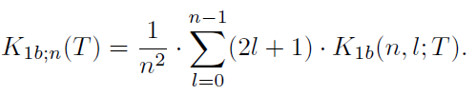
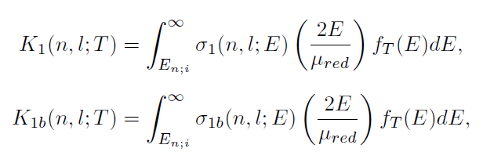

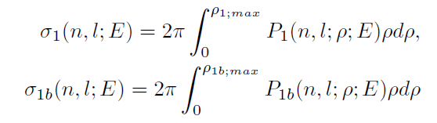
K_{1a}(n; l; T) and K_{1b}(n; l; T) are partial rate coefficients of processes (1a) and (1b) (+pre-ionization), separately determined for given n, l and T, where T is temperature of the considered plasma,
K₁(n; l; T) is the partial rate coefficient of processes (1a) and (1b)(+ pre-ionization) together, namely K₁(n; l; T) = K_{1a}(n; l; T) + K_{1b}(n; l; T) for given n, l and T.
A)
+ pre-ionization
average tot. rate coefficient for
1a and 1b
average rate coefficient for associative ionization
B)
+ pre-ionization
Partial rate coefficients K₁(n; l; T) and K_{1b}(n; l; T) are determined on the basis of standard expressions
are the corresponding cross sections

Slide 26

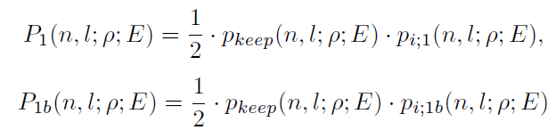

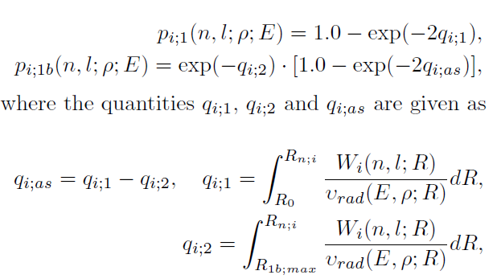
mix.
chemi-ion. 1a+1b
for A) probabil. for process. (1a+1b)+pre-ioniz.
for B) probabil. for process. (1b)+pre-ioniz.
chemi-ion. 1b
Due to the chemi-ionization

Slide 27


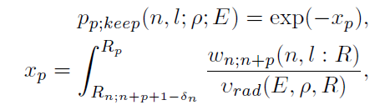
Due to the mixing process.
one can notice that the basic difference, in comparison with previous papers, represents direct taking into
account of the effect of decay of the initial electronic state of the considered atom-Rydberg atom system,
due to the possibility of execution of excitation processes (2) with n′ > n.
Partial pre-ionization probability

Slide 28
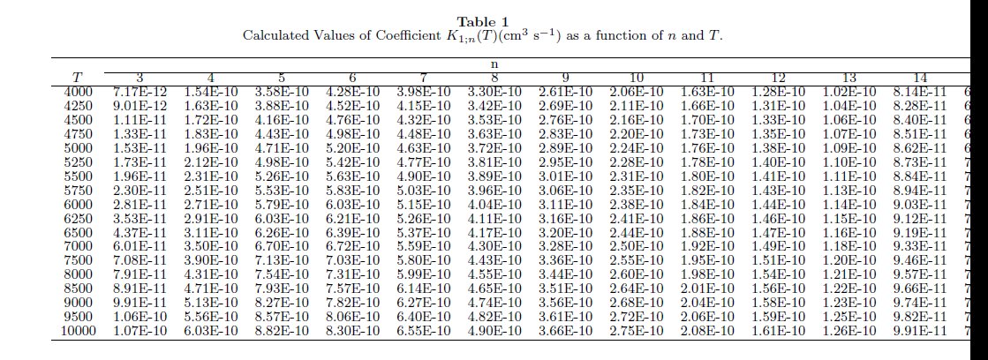
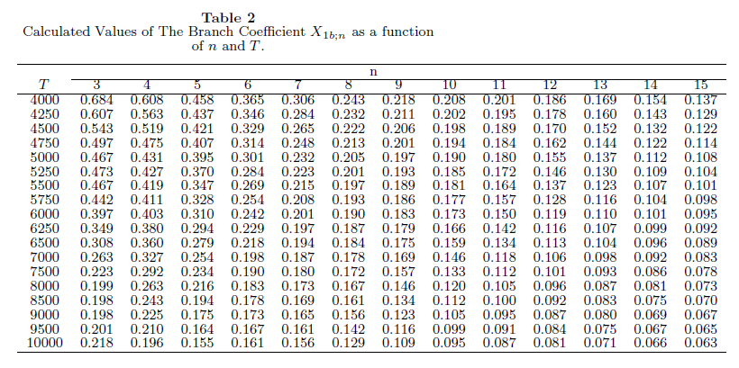
Results:
Total values of the rate coefficients of chemi-ionization processes (+pre-ionozation) K₁(n;T) within the range 3 ≤ n ≤ 14 are presented in Tab. 1. Bearing in mind the main application, of here obtained results, on the photosphere and lower chromosphere of the Sun, calculations of these rate coefficients were performed here for temperatures 4000 K ≤ T ≤ 10000 K.
n
Hydrogen
T
The processes (1b) are characterized in this paper via the corresponding branch coefficient
X_{1b;n}(T) given as
In accordance with the above said rate coefficients are
determined here by adding on of the probability of the
decay of the initial state of the collisional system in
pre-ionization zone with Rydberg electron transitions
from state |n > to state |n+p >, where 1≤p ≤ 5 .
when T increases X decreases i.e.
rate coefficient for asoc. ion. (1) is smaller comparing to process (2) as is expected.

Slide 29
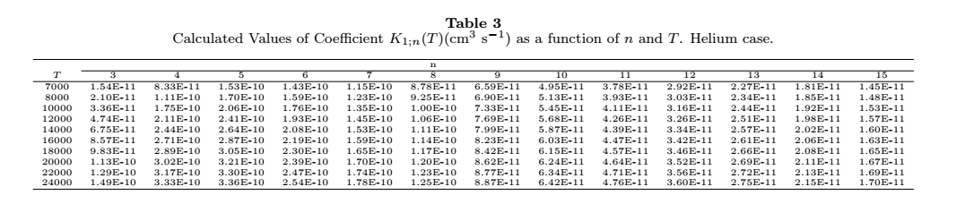
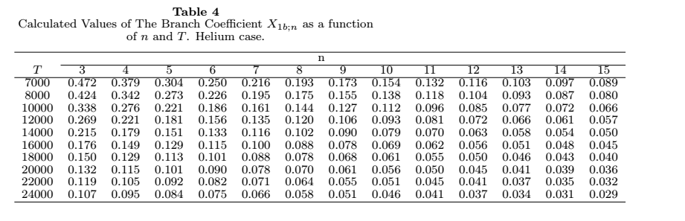
Helium
n
T
As expected

Slide 30
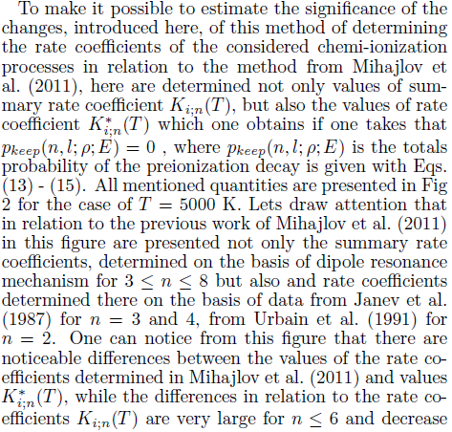
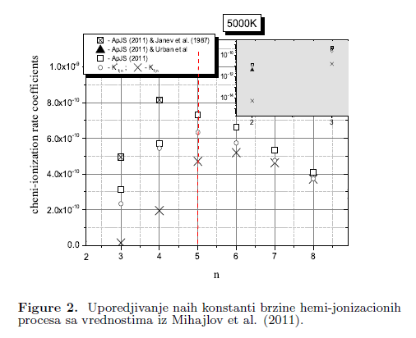
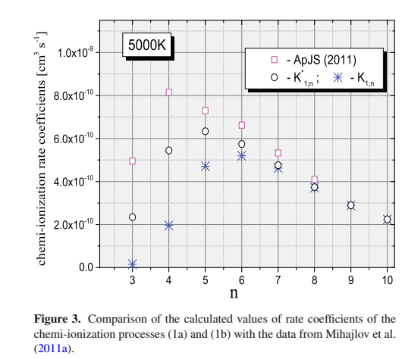
With simplif.(mih11)
Without simplif.(mih11)
+ pre-ionization

Slide 31
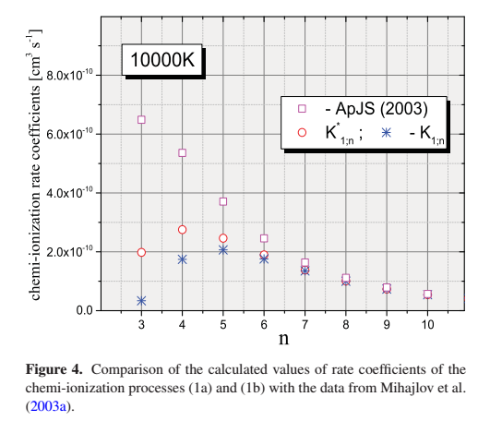
With simplif.(Mih. 2003)
Without simplif.(Mih. 2003)
+ pre-ionization

Slide 32
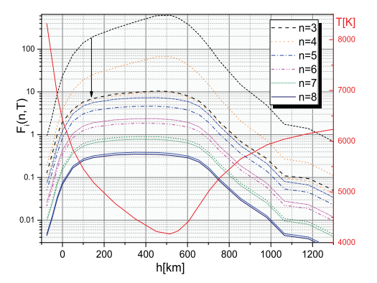
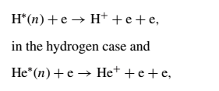
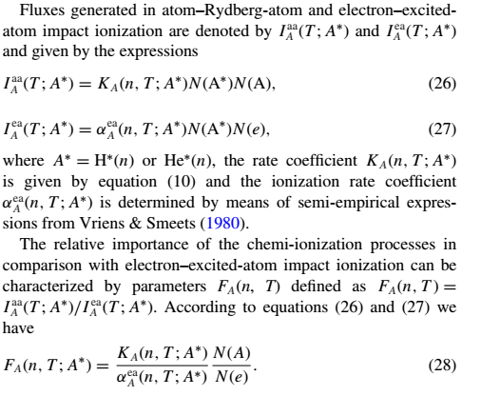
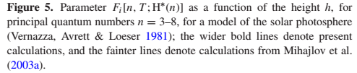
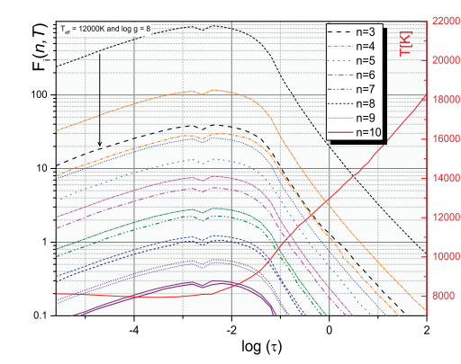
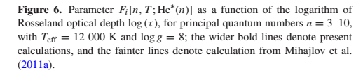
Solar atm.
WD atm.

Slide 33
CONCLUSIONS
MNRAS paper 2016
From the presented material, it is shown that the processes of (n −n’)-mixing (2) have considerable influence on the rates of chemi-ionization processes (1).
Direct calculations have been performed, which show this influence on the quantitative level. The results obtained here are presented in tabular form, where the values of total constants for rates of the processes (1), and also just the rates for the process of associative ionization (1b) for the hydrogen and helium cases are presented. Tables cover the range of values of principal quantum numbers of the Rydberg states of hydrogen and helium atoms from n = 3 to n = 15 and the temperature range from T = 4000 K to T = 10 000 K and T = 7000 K to T = 24 000 K respectively, so that they can be directly applied in connection with the modelling of the photosphere and the lower chromosphere of the Sun and the atmosphere of DB white dwarfs.
The obtained results (Figs. with F) show that the efficiency of the chemi-ionization processes, in spite of the influence of (n − n’)-mixing processes (2) with n’>n in most parts of the photosphere of the Sun and most parts of white-dwarf atmospheres, remains dominant or at least comparable to the efficiency of the concurrent processes.

Slide 34
For the future, or next steps
To calculate efficiency of chemi-ionization with pre-ionization in respect
to concurrent process for the sunspot atmosphere model.
To calculate for M red dwarfs atmosphere model with pre-ionization
To get something like this

Slide 35
MOL-D
The data presented here, soon can bee also access through http://servo.aob.rs as web service and database http://servo.aob.rs/mold.
MOL-D database is a collection of cross-sections and rate coefficients for specific collisional processes and a web service within the Serbian Virtual Observatory (SerVO) and the Virtual Atomic and Molecular Data Center (VAMDC)
Jevremovic, Vujcic, Sreckovic, Mihajlov, Dimitrijevic…

Slide 36
Data needed for modeling stellar atmospheres, Early universe chemistry …

Slide 37
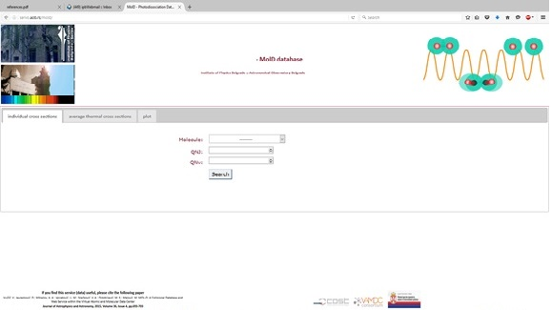
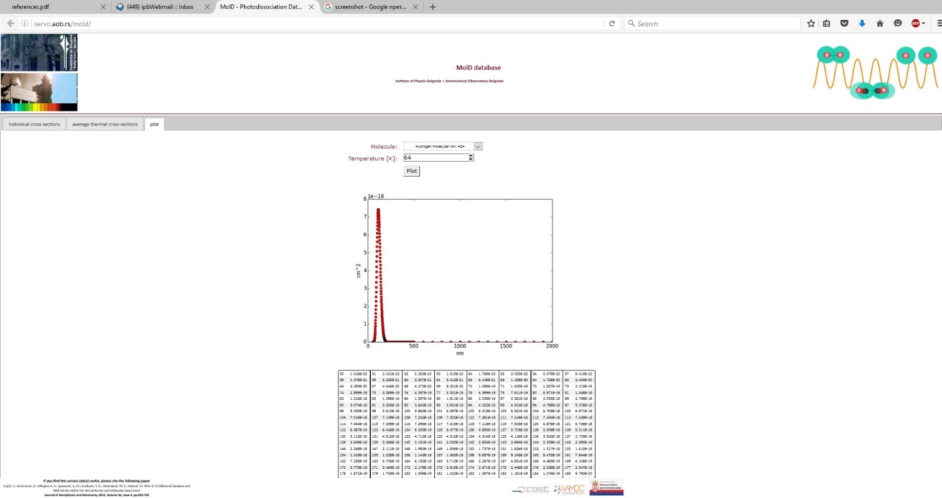
screenshot

Slide 38
MOL-D is services compatible with VAMDC standards and
act as a VAMDC "nodes . They can be accessed by tools,
applications or libraries which comply to VAMDC interoperability requirements,
such as VAMDC portal query, Astrogrid VODesktop etc. VAMDC - compliant
tools allow for distributed queries across multiple VAMDC nodes via SOAP protocol for
web services, along with standardized VAMDC-TAP data access protocol
and XSAMS XML schema for data serialization and representation.
Technical characteristics
MOL-D are implemented on top of VAMDC NodeSoftware
in Django, a Python framework for web application development. They apply
custom-built data models which fit their specfic datasets. All-encompasing
VAMDC model would not offer optimal performance and would be
more complicated to maintain. In the process of a node development, custom "dictionaries"
(which map VAMDC reserved keywords to local models' attributes) are defined as
well as query translator

Slide 39
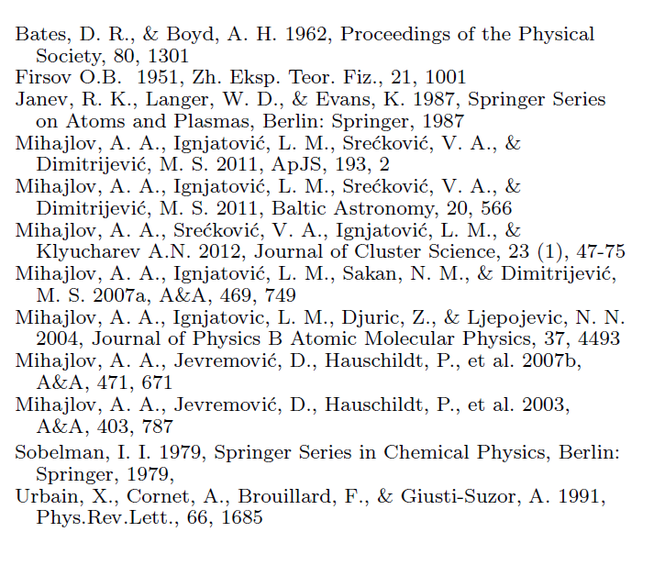
References
Mihajlov Anatolij A, Sreckovic Vladimir A,Dimitrijevic Ignjatovic Ljubinko M, Milan S (2016) Atom–Rydberg-atom chemi-ionization processes in solar and DB white-dwarf atmospheres in the presence of (n–n′)-mixing channels
Monthly Notices of the Royal Astronomical Society 458 (2), 2215-2220
Mihajlov Anatolij A,Ignjatovic Ljubinko M,Sreckovic Vladimir A,Dimitrijevic Milan S (2011) The Influence of Chemi-Ionization and Recombination Processes on Spectral Line Shapes in Stellar Atmospheres,
BALTIC ASTRONOMY, vol. 20, br. 4, str. 566-571
Mihajlov Anatolij A,Ignjatovic Ljubinko M,Sreckovic Vladimir A,Dimitrijevic Milan S (2011) Chemi-ionization in Solar Photosphere: Influence on the Hydrogen Atom Excited States Population,
ASTROPHYSICAL JOURNAL SUPPLEMENT SERIES, vol. 193, br. 1,
Mihajlov, A. A.; Ignjatović, Lj. M.; Dimitrijević, M. S.; Djurić, Z. (2003)
Symmetrical Chemi-Ionization and Chemi-Recombination Processes in Low-Temperature Layers of Helium-rich DB White Dwarf Atmospheres
The Astrophysical Journal Supplement Series, Volume 147, Issue 2, pp. 369-377

Slide 40
Thank you

