Slide 1
Spectroscopic Investigation of Gravitationally Lensed Quasars
S. Marčeta Mandić¹, E. Bon¹, P. Jovanović¹ , A. Moiseev², A. A. Smirnova², L. Č. Popović¹
¹ Astronomical Observatory, Belgrade, Serbia
² Special Astrophysical Observatory of the Russian Academy of Science, Russia
X SBAC, Belgrade, 30 May – 3 June, 2016
sladjana.mandic@gmail.com

Slide 2
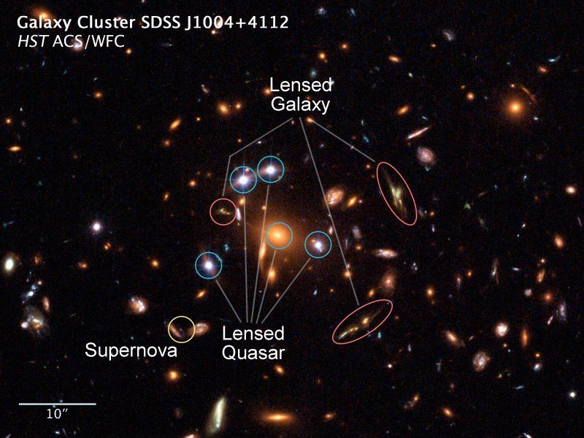
Motivation
Gravitational lensing is deflection of light from background source by gravity of massive objects, and it causes: multiple or ring-like images, amplification, etc.
For our investigation we have used quasar SDSS J1004+4112 lensed by galaxy cluster (time delays between it's images were used for investigation of cluster structure)
Theory of GL: redshifts of different images of the same source should be equal
Observation: some difference in redshifts of lensed images (Δz) were detected
Is that the case here? Also, we wanted to investigate if there some correlation between time delays (τ) and redshift differences (Δz)

Slide 3
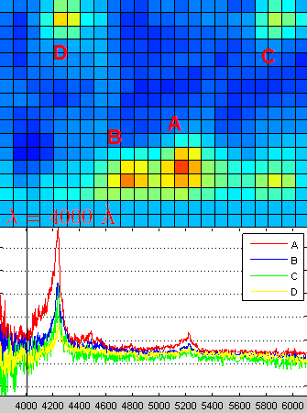
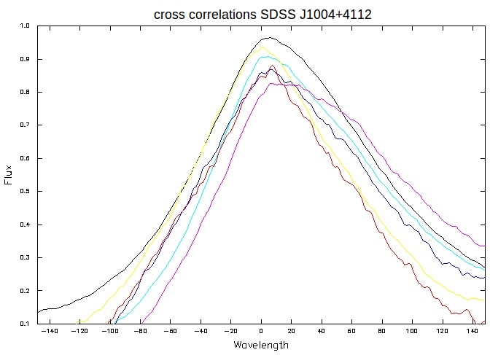
Methods
We have analyzed spectra of 4 lensed images, and between each lensed images (AB, AC, etc) we determined:
Line shifts (Δλ) using cross correlation for C III] and CIV lines.
Redshift differences (Δz) for each line, and averages.
Q: if the mean measured redshift difference significant?

Slide 4
Results & Conclusions
We found that Δz between AD images is significant (order-of-magnitude over the error).
The largest time delay (>1250 days) was measured between AD pair of images (Fohlmeister, J. et al. 2007, ApJ, 662).
This might indicate that there could be some connection of the Δz and τ between gravitationally lensed images.
The difference in redshifts could be caused by several reasons from different mass distribution of lens to unknown structures behind the lens.
Detailed investigation of these causes will be performed on SDSS J1004+4112;
Also we will apply similar investigation on the sample of the multiple-imaged gravitationally lensed systems.
Thank you for your attention!

