Slide 1

Bayesian Probability theory in Astronomy: Looking for stellar activity cycles in photometric data-series.
Ana Borisova, Institute of Astronomy, BAS
Lasko Laskov, Institute of Mathematics and Informatics, BAS
Valeri Hambryan, Astrophysical Institute and
University Observatory, Friedrich Schiller University of Jena

Slide 2
Bayesian probability theory: history
Tomas Bayes - 18th century
Pierre-Simon Laplace – general version applied to celestial mechanics, medical statistics, reliability theory, jurisprudence
Prior probabilities: uniform priors, conjugate priors, inverse probabilities
frequentist statistics, confidence intervals - 1920
objective and subjective directions

Slide 3
Bayesian probability theory: history & basic concepts
Objective Bayesian Inference – Harold Jeffreys 1939 “Theory of probability”
Concepts of maximum entropy for priors constructing - Edwin Jaynes 1957
Dennis Lindley - "Introduction to Probability and Statistics from a Bayesian Viewpoint“ – 1965
1980 Markov chain Monte-Carlo methods – removed many computational problems
Applications : machine learning, data mining, Bayesian network, Bayesian Kepler periodogram

Slide 4
Bayesian probability theory: basic concepts
Bayesian probability theory – evaluates the probability of Hypothesis, using some prior probability, updated with the new relevant data or additional information.
Interprets the probability as a “state of knowledge”
Frequentist approach – Hypothesis is accepted or rejected without assigning to probability
Bayes theorem: P(H|D)=P(D|H)P(H)/P(D) for conditional probability of the hypothesis

Slide 5
Bayesian probability theory: calculations
Setting the Hypothesis space and prior probabilities
Data models and parameter space, the observational errors
Hypothesis testing
The global likelihood function P(D|H)
Marginalization of the nuisance parameters – estimation of the most probable, mean and mode parameters and the confidence intervals

Slide 6
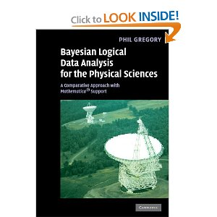
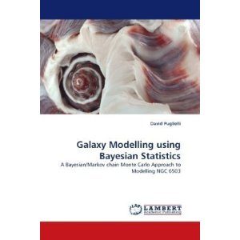
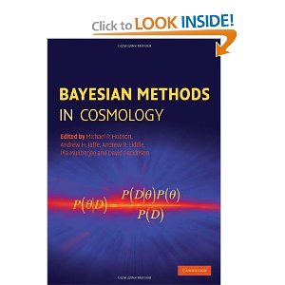
Bayesian probability theory: last decade in astronomy - books
Bayesian Logical Data Analysis for the Physical Sciences: A Comparative Approach with Mathematica® Support, (2005, 2006, 2010) P.C Gregory
Galaxy Modelling using Bayesian Statistics: A Bayesian/Markov chain Monte Carlo Approach to Modelling NGC 6503, 2010, D. Puglielli
Bayesian Methods in Cosmology , 2010, Michael P. Hobson, Andrew H. Jaffe
Bayesian Inference in Science and Engineering: 27th International Workshop on Bayesian Inference and Maximum Entropy Methods, 2007, Kevin H. Knuth, Ariel Caticha, Julian L. Center, and Adom Giffin
Blind Image Deconvolution: Theory and Applications P. Campisi, 2007, K. Egiazarian

Slide 7
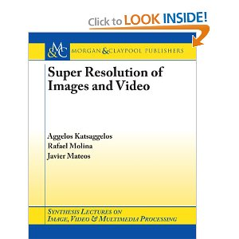
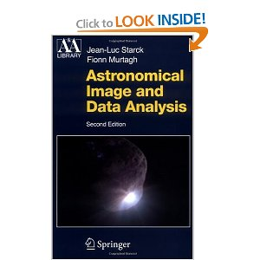
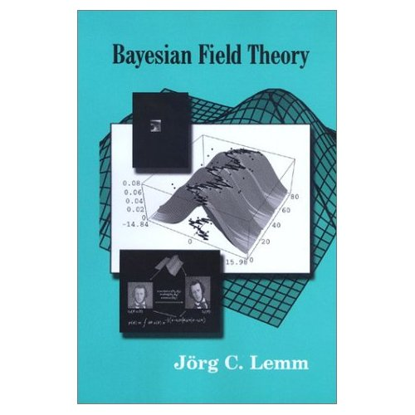
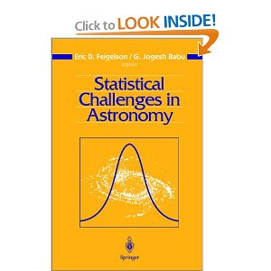
Bayesian probability theory: last decade in astronomy - books
Super Resolution of Images, 2006, Aggelos Katsaggelos
Astronomical Image and Data Analysis, 2006, J.-L. Starck and F. Murtagh
Bayesian Field Theory , 2003, Jorg C. Lem
Statistical Challenges in Astronomy, 2003, E. Feigelson, G. Babu

Slide 8
Bayesian probability theory: astronomical applications
BAYES-ME
Magnetic Fields from Hinode Quiet-Sun Observations
MULTINEST/SUPERBAYES
robust Bayesian inference tool for cosmology and particle physics
ARGO: Algorithm for the Reconstruction of Galaxy-traced Over-densities
  Bayesian reconstruction of the cosmological large-scale structure: methodology, inverse algorithms and numerical optimization
Bayesian Photometric Redshift code BPZ
ZEBRA - Zurich Extragalactic Bayesian Redshift Analyzer

Slide 9
Bayesian probability theory: last decade in astronomy - publications
Last 10 years ~ 300 publications in the most popular astronomical journals, from ~ 15/yr in the beginning up to 50/yr by the end
  Cosmology: data analysis, parameter estimation, MCB
  Gravitational lessening:
  Image deconvolution&object identification and classification
  Light and RV curves analysis
  SN identification
  Spectral fitting and deconvolution
  New planet searches (Kepler periodogram)
  Sun – solar flare predictions, magnetic fields, solar oscillations
  The Galaxy – kinematics, SFR
  Asteroid and comet data
Model Parameter estimation, Hypothesis testing, Object detection and classification

Slide 10
Gregory-Loredo method,
Gaussian noise case
Hypothesises: constant, nonperiodic, periodic signal
Time series: d_{i}=d_{pi} +e_{i,} (d_{i} – d_{pi}) – Gaussian distribution
Data model for the periodic signal – stepwise function, with parameters:
  P, or ω − period or angular frequency, (p_{lo}, p_{hi})
  m – number of bins from 2 to 12
  r_{i} – light curve value in i bin
  b – Noise scale parameter , (0.05, 1.95)
  Jeffreys priors

Slide 11
Gregory-Loredo method,
Gaussian noise case – simulated data series tests
sinusoidal light curve with random data points distribution
Np – number of data point 20 – 70 in a 100 years time interval
Tested periods – 2 to 12 years
Magnitude amplitude 0.2 to 1.0 mag
bootstraping

Slide 12
Gregory-Loredo method,
Gaussian noise case – simulated data series tests

Slide 13
Gregory-Loredo method,
Gaussian noise case – simulated data series tests

Slide 14
Gregory-Loredo method : the case of CF Oct rotational variability
Period range 19 – 21^{d}
Error parameter
Number of bins parameter
-----------------------------------------------------------------------
Dataset m_{max} P_{max} Prob_{max} P_{mean} cre. int. P_{bret}
-----------------------------------------------------------------------
BAM 3 20.04 0.31 20.04 0.01 20.04
PHOT 2 20.17 0.16 20.16 0.03 20.16
HIP 2 20.46 0.07 20.45 0.05 20.51
ASAS 3 19.94 0.68 19.94 0.02 19.93
-----------------------------------------------------------------------ALL 3 20.16 0.45 20.14 0.04 20.11
-----------------------------------------------------------------------

Slide 15
Gregory-Loredo method : the case of CF Oct long-term cyclic variability
Hypothesis testing:
Hc/(Hc+Hnp+Hp) ~ 10⁻³
Hnp/(Hc+Hnp+Hp) ~ 10⁻⁹
Hp/(Hc+Hnp+Hp) ~ 0.995
Period range: 10 до 6000^{d}
<V> magnitudes:
periods: 3582^{d}, (~9.81y); 2432.5^{d} (~6.66y), 1173^{d} (~3.21y)
Confidence intervals: 300^{d}, 150^{d}, 20^{d}
Probablity: 0.02 , 0,008, 0.0003

Slide 16
Bayesian probability theory and
Astroinformatics?
Objective direction of the Bayes theory – useful tool for data-mining heterogeneous data series (with random time distribution, sparse data, different measurement errors)
Hypothesis testing – opportunity for updating the “state of the knowledge” with new data release
Subjective direction – base for machine learning techniques in astronomy (to be realized in galaxy classification)
Error parameter analysis – opportunity for additional signal detection

Slide 17
Благодаря за вниманието

