Slide 1
On the link between the solar energetic particles and eruptive coronal phenomena Statistical study in solar cycle 23
R. Miteva¹ and K.-L. Klein¹
in collaboration with
S. W. Samwel² G. Trottet¹ O. Malandraki³ G. Dorrian³
¹ LESIA-Observatoire de Paris, CNRS, Univ. Paris 6 and 7, France
² National Research Institute of Astronomy and Geophysics, Egypt
³ National Observatory of Athens, Greece
rositsa.miteva@obspm.fr

Slide 2
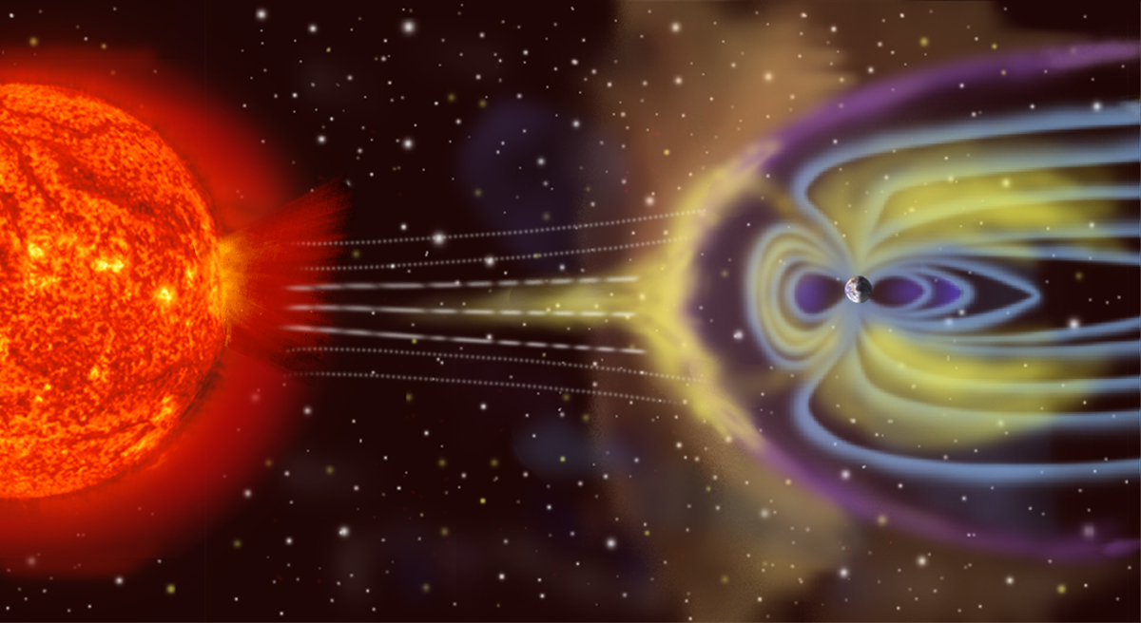
Motivation
Astrophysics
To study the particle acceleration and transport by combined in situ (particle fluxes) and remote observations (radiation signatures from gamma to radio waves)
Space weather effects
Refers to the conditions on the Sun, in the solar wind, magnetosphere, ionosphere and thermosphere, which can influence the performance and reliability of space-borne and ground-based technological systems and which can affect human life and health (US National SW plan)
http://sec.gsfc.nasa.gov

Slide 3
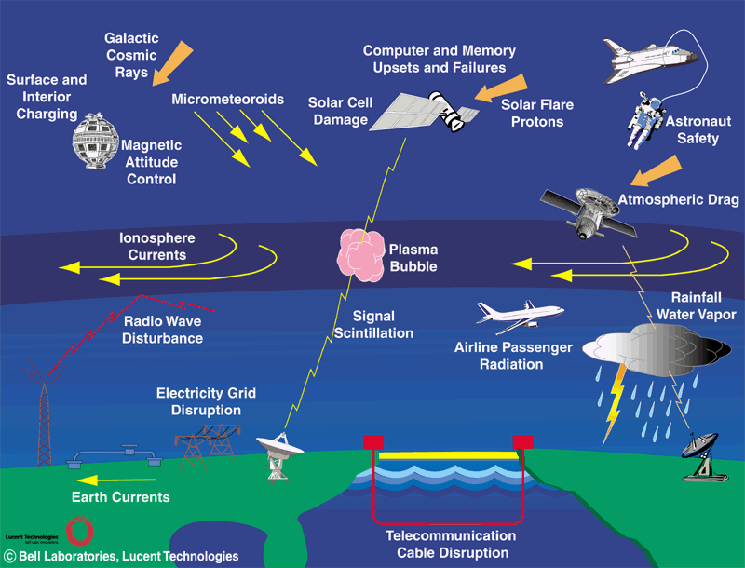
Solar–terrestrial relationship/Space weather

Slide 4
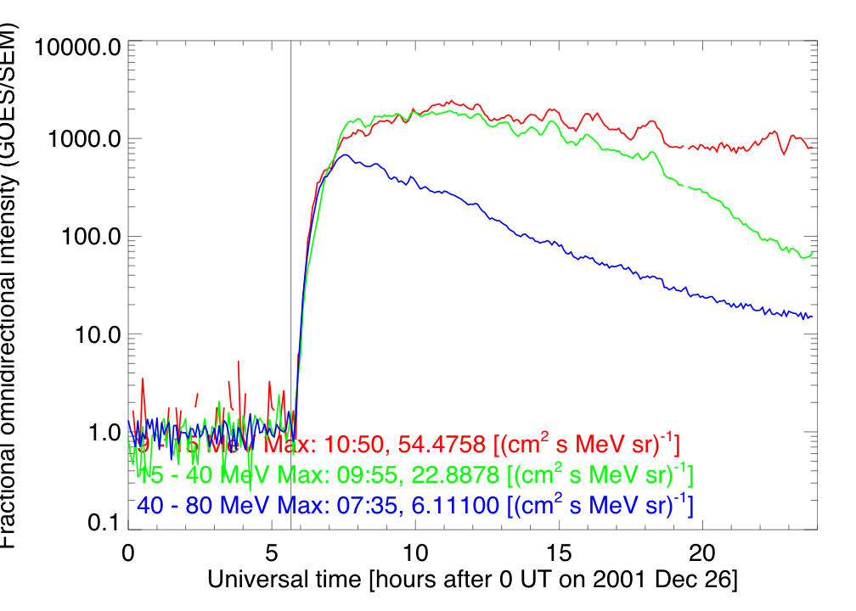
Solar energetic particles (SEPs)
SEP events
flux of energetic particles (protons >10 MeV,
electrons > 10 keV)
observed in situ
deka-MeV protons
• GOES (~27 MeV)
• Wind/EPACT (~23 MeV)
• Cane et al. 2010 (~25 MeV)
→ peak intensity, J_{p} (cm² s sr MeV)^{–1}
→ onset time ±30 (to ~60) min
Time coverage: 1997–2006
SEP events: ~100 (with origin in the
western heliosphere)
Association: solar flares and CMEs

Slide 5
SEP acceleration, connection, transport
I. Particle acceleration
physical relationship between in situ particles and
coronal activity/particle accelerator
(flare–CME relationship!)
II. Magnetic connection
particle access to open magnetic field lines
particle access from high corona to Earth
III. Particle transport
scattering

Slide 6
I. Particle acceleration
shock wave
B
radio emission
accelerated particles
CME
A. Magnetic reconnection
(small acceleration site
and short timescales)
• flares
• behind CMEs
B. Shock acceleration
(broad and long lasting
accelerator)
• flare blast shock wave
• CME piston-driven shock
X-rays
flare
B
A
open field lines
post-flare
loops
γ-rays, HXR, Hα
solar surface

Slide 7
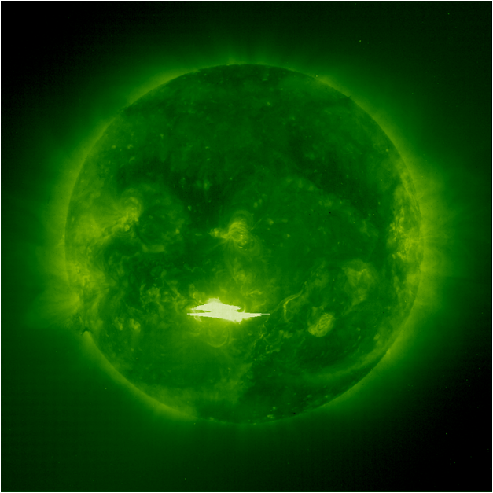
Solar flare
→ sudden release of the stored
magnetic energy in the corona,
~ 10²⁵ Joules,
emission covering the entire
EM spectrum (from γ- to radio)
X- and M-class
(GOES 1-8 Å; western location)
Solar Geophysical Data reports
→ SXR peak flux (10^{–4} W m^{–2})
SOHO/EIT 28/10/2003

Slide 8
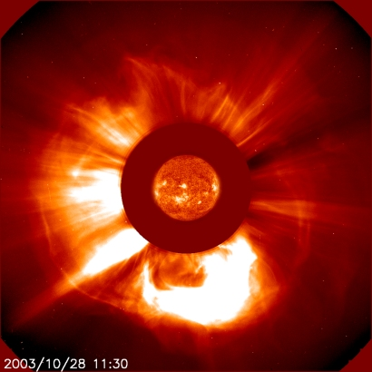
Coronal mass ejection (CMEs)
→ mass (< 10¹³ kg) and embedded
magnetic field expelled into the
IP space
SOHO/LASCO catalogue
→ on-sky projected speed
(100s–3000 km s^{–1})
SOHO/LASCO C2 28/10/2003

Slide 9
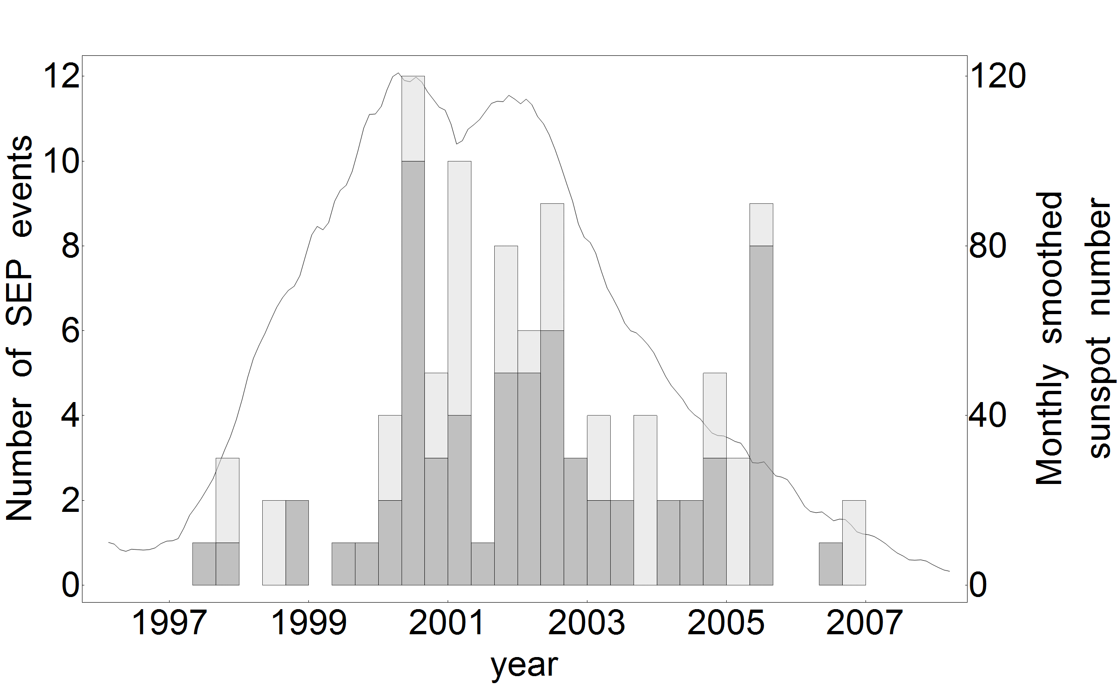
SEPs and solar cycle
X
M
ROB Belgium

Slide 10
II. Magnetic connection to Earth
C. Particle access to open field lines
from the acceleration site to to 2.5 R_{S}
D. Particle access to Earth
access to magnetic field line
connected to 1 AU
C
source
surface
D
IP magnetic
field line

Slide 11
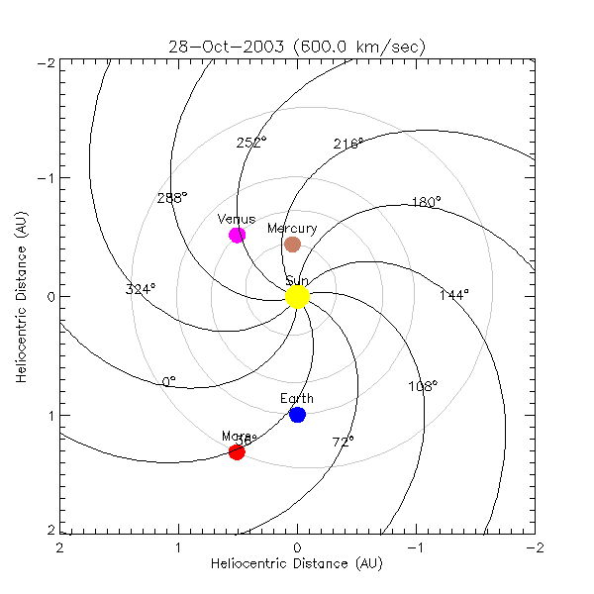
D. Parker spiral magnetic field
Calculated with HELIO
(helio-vo.eu/servces)
Parker spiral IMF
(Parker 1963)
≈ 1.2 AU
45°
depends on solar wind speed
‘SoWi’ SEP category
50% in solar wind

Slide 12
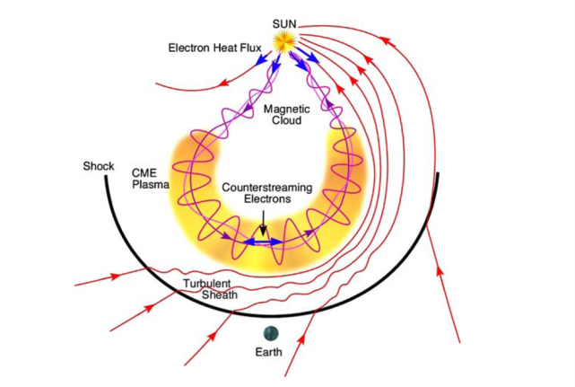
D. Interplanetary coronal mass ejection (ICME)
Case studies on SEP propagation within ICMEs
Torsti et al. (2004), Malandraki et al. (2005), Masson et al. (2012)
Statistical approach: ICME configuration and SEP propagation
present study
ICME catalogue
Richardson and Cane (2010)
Zurbuchen and
Richardson (2004)
‘ICME’ SEP category
20% within ICME

Slide 13
Aim
To study the physical relationship between in situ particles and coronal activity from a statistical perspective
To build the correlations between
SEP events (particle intensity) and
solar activity (flare SXR flux and CME speed)
→ taking into account IP magnetic field (IMF) configuration

Slide 14
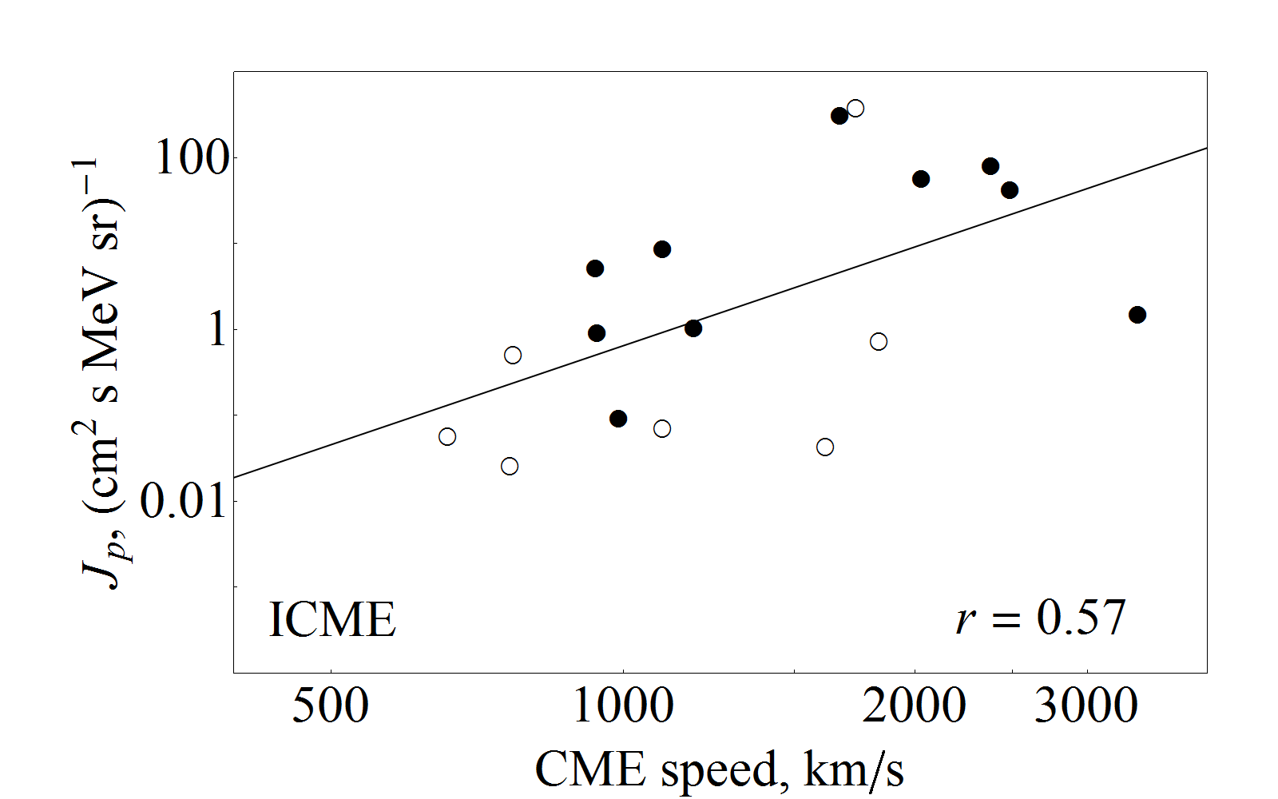
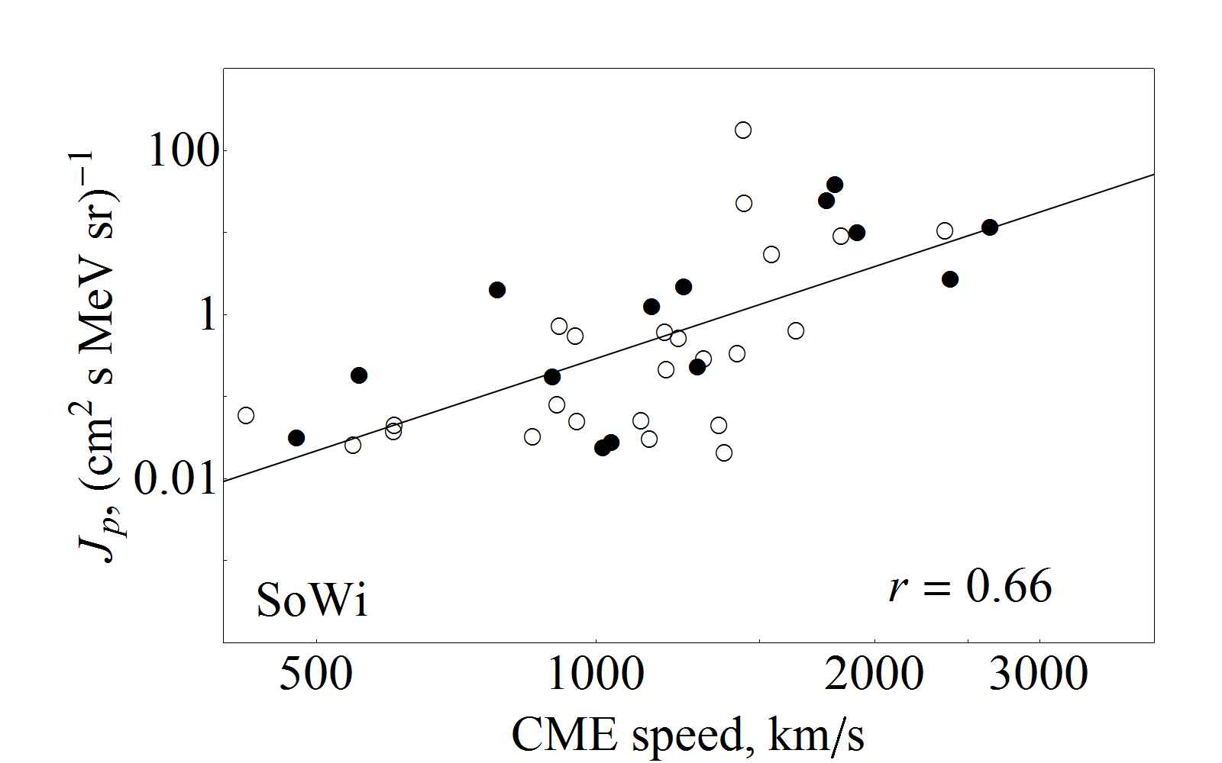
Statistical analysis
Peak particle intensity vs. CME projected speed
ICME events: r = 0.57 ± 0.15
SoWi events: r = 0.66 ± 0.07
All events: r = 0.63 ± 0.05
Standard deviation,
method by Wall & Jenkins (2003)
0.6–0.7 (Kahler 2001, Gopalswamy et al. 2003, Cane et al. 2010)

Slide 15
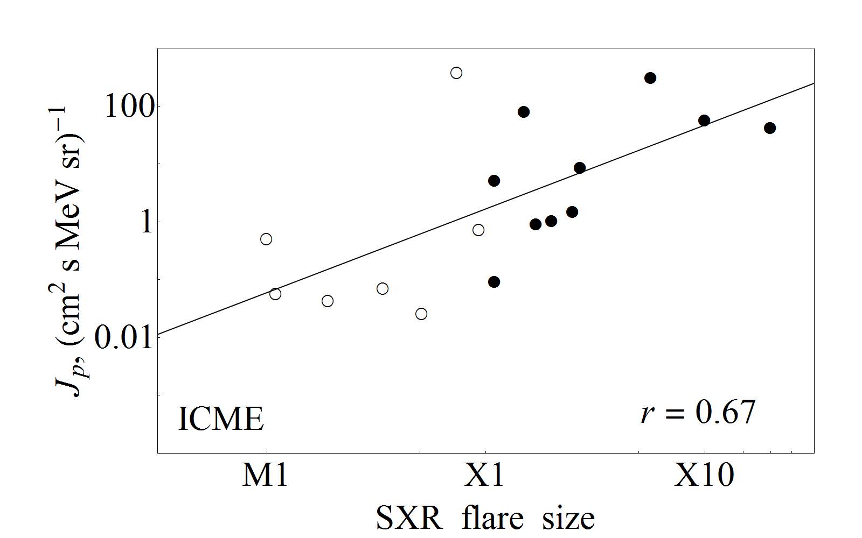
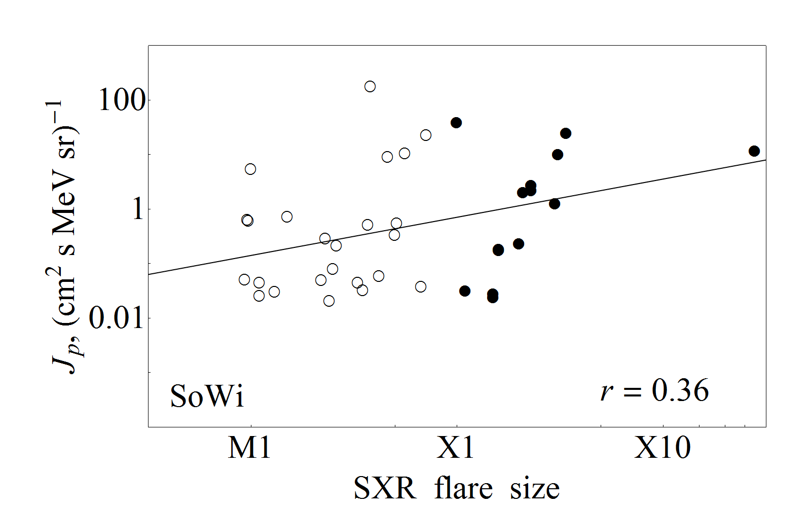
Statistical analysis
Peak particle intensity vs. SXR flux
ICME events: r = 0.67 ± 0.12
SoWi events: r = 0.36 ± 0.13
All events: r = 0.59 ± 0.07
weak flare influence
or transport effects?
0.4–0.6 (Kahler 1982, Cane et al. 2010)

Slide 16
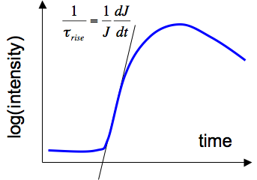
III. Particle transport
Rise time:
signature of particle transport
effects
Methods:
a. steepest slope
b. max–onset
…
subjectivity!
a
b
Short rise time: less scattering

Slide 17
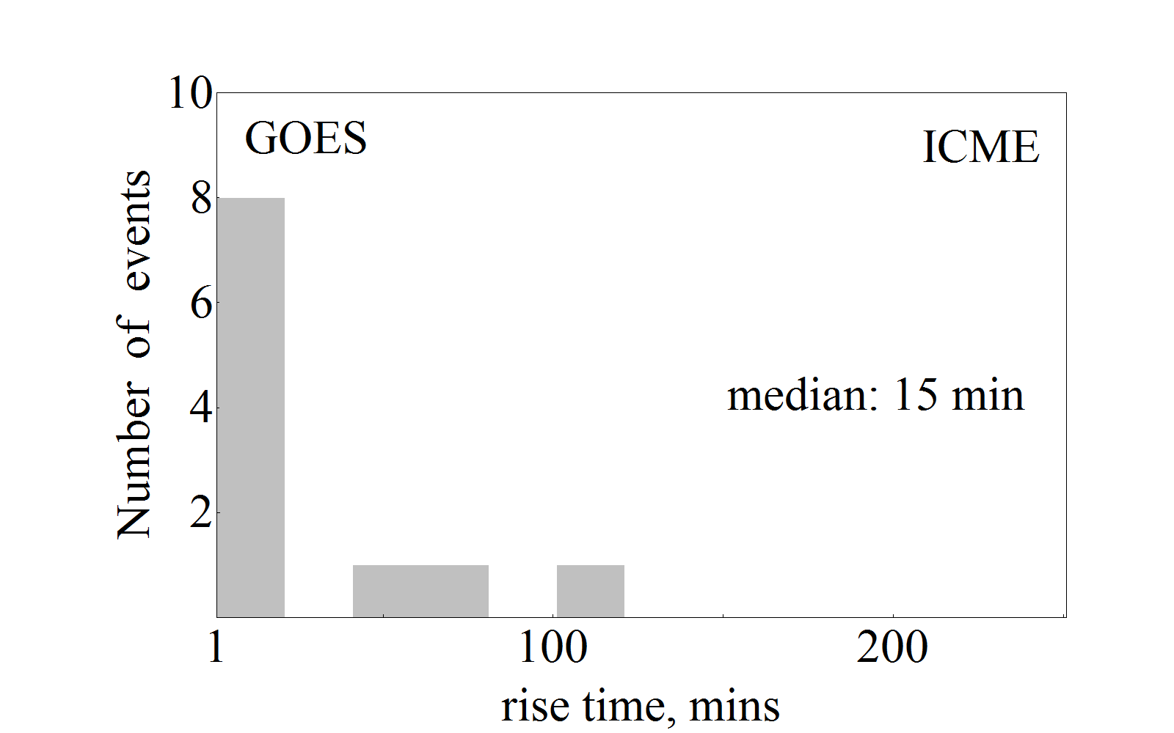
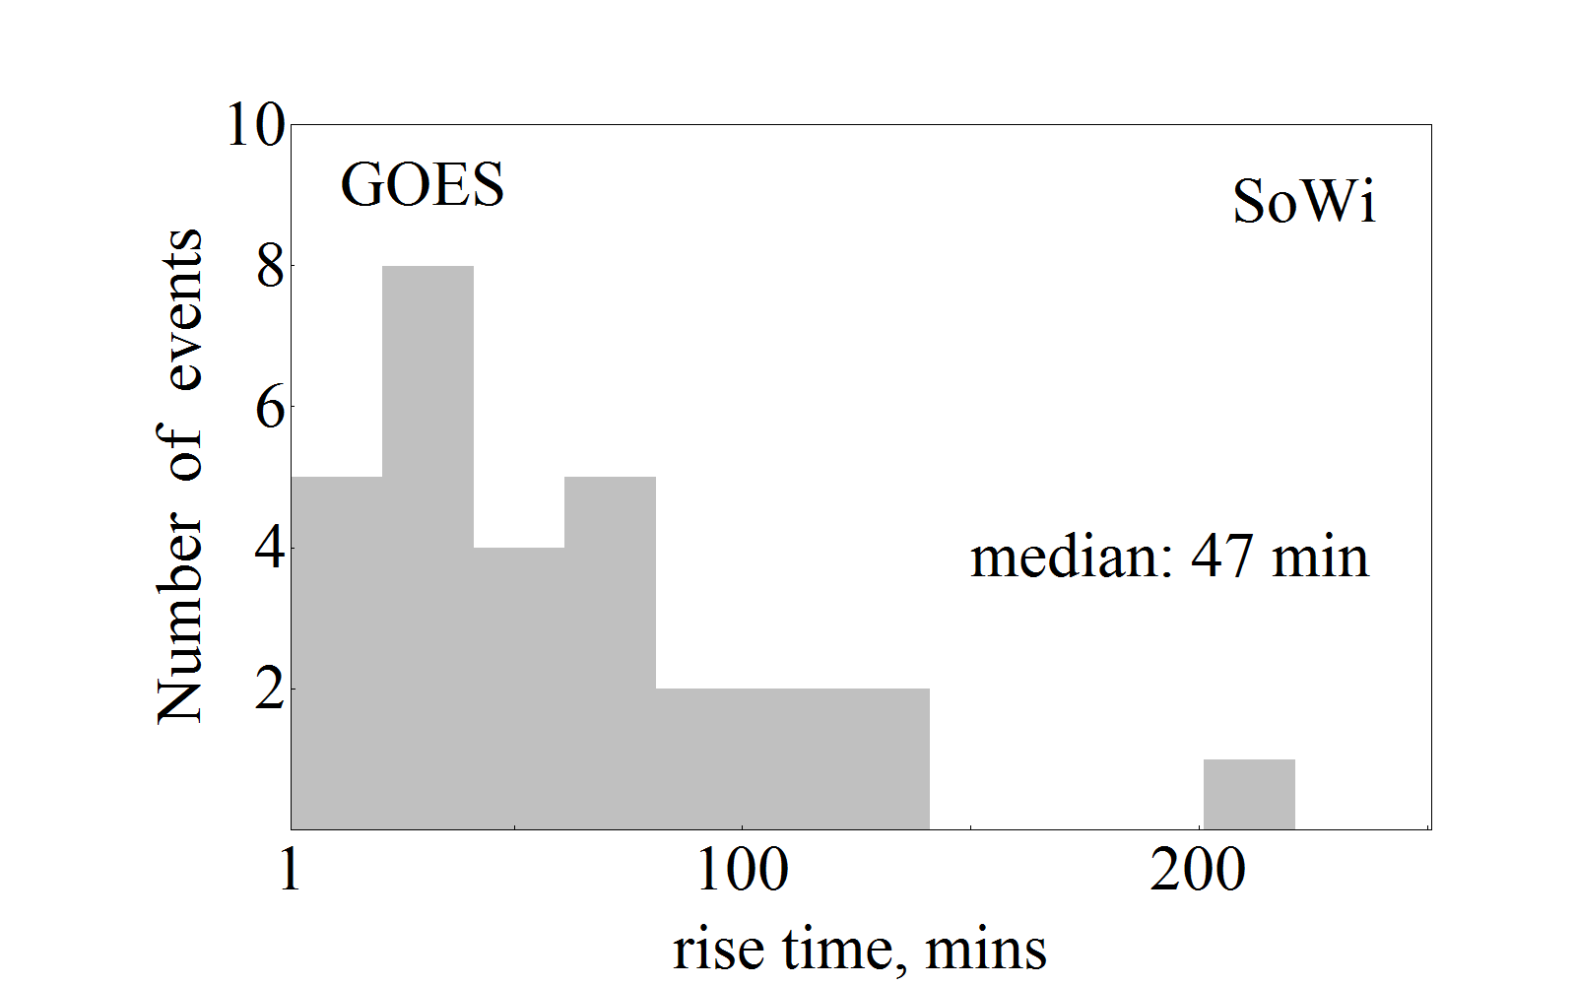
SEP rise time
→ Signature of IP transport effects
± 6
ICME events: weak scattering
SoWi events: stronger scattering
± 25
Wind/EPACT protons
ICME events rise time: 11 ± 7 min
SoWi events rise time: 66 ± 35 min

Slide 18
Radio spectral analysis
Diagnostic
electron acceleration: flare reconnection vs. shocks
electron escape: confinement vs. open field lines
electron propagation: from low corona (cm-λ) to IP space (DH/km-λ)
Data
~10 ground-based radio observatories
(spectra 20 MHz – 4.5 GHz; single frequency plots 0.2–15 GHz)
Wind/WAVES (3 kHz–14 MHz)
Results
for all ICME and SoWi events

Slide 19
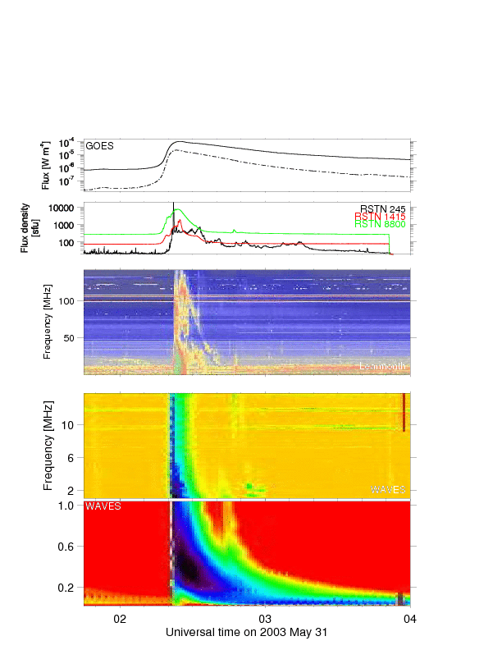
Radio spectral analysis
0.5 R_{S}
100 MHz
2 R_{S}
15 MHz
Radio emission
obs. freq. ~ density^{0.5}
+
density vs. height-model
1 AU
20 kHz

Slide 20
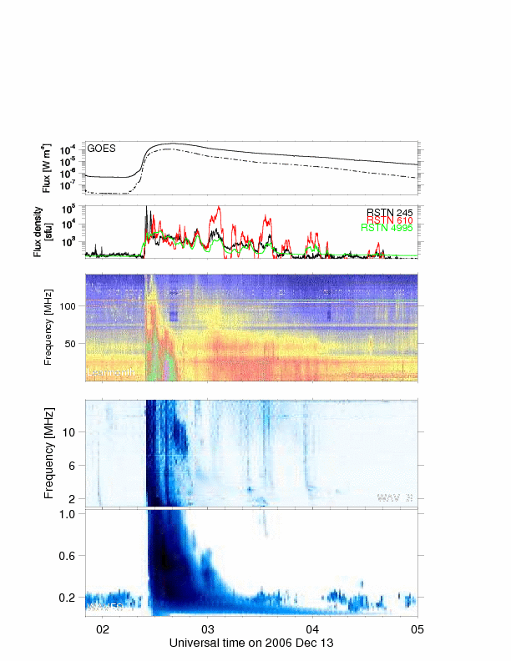
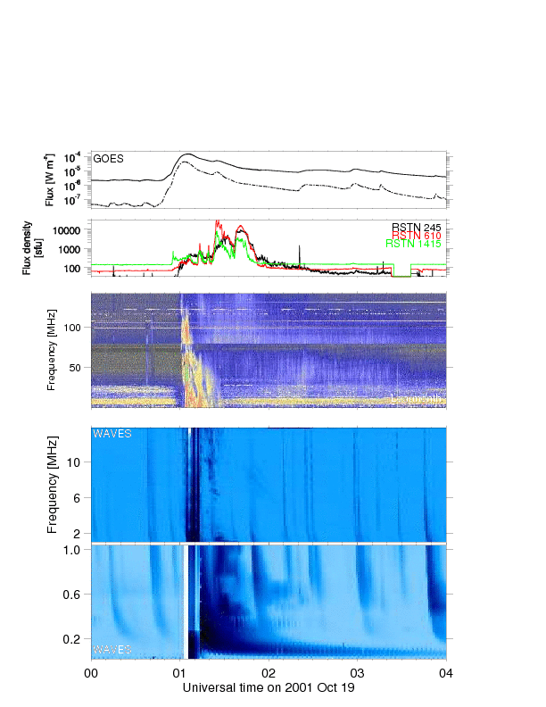
Radio spectral analysis
prompt escape (50–60 %)
delayed escape (20–30 %)

Slide 21
Results
I. Particle acceleration + particle escape (radio analysis)
→ good correlation of the particle intensity with CME speed for
ICME/SoWi category
→ good/poor correlation of the particle intensity with SXR flare flux in
ICME/SoWi category of SEP events
→ type II (shocks) vs. III (flare) radio bursts: majority vs. all cases
II. Magnetic connection (IMF conditions)
→ 20% of all SEP events propagate within ICME
→ 30% – in the vicinity of the ICME
→ 50% – along Parker spiral
III. Particle transport (rise time analysis)
→ short/long rise time for ICME/SoWi particle events: weak/stronger scattering

Slide 22
Interpretation
I. Particle acceleration + particle escape (radio analysis)
→ mixed flare/CME contribution to ICME/SoWi particle events
II.+III. Magnetic connection + particle transport
→ scattering
1. SEP amplitude:
acceleration strength;
escape/confinement;
scattering effects
pure flare
component
observed
profile
Particle intensity
2. SEP duration:
acceleration time;
scattering effects
pure CME
component
1.
2.
2.
time

