Slide 1
Active Galactic Nuclei: Progress and Problems
Martin Gaskell
Astronomy Department, University of Texas, Austin, TX 78712-0259, USA
gaskell@astro.as.utexas.edu
[45 min + 15 min]

Slide 2
Last Year: A Mystery Story!
(a “who-dun-it”)
Elements:
Some mysterious happening(s)
Lots of interesting “suspects”
Lots of pieces of evidence (“clues”)
As the story goes on, evidence points to different suspects
At the climax, the real culprit is revealed
All puzzles are explained
LAST YEAR: “WITH AGNs - WE ARE AT STAGE 5!”

Slide 3
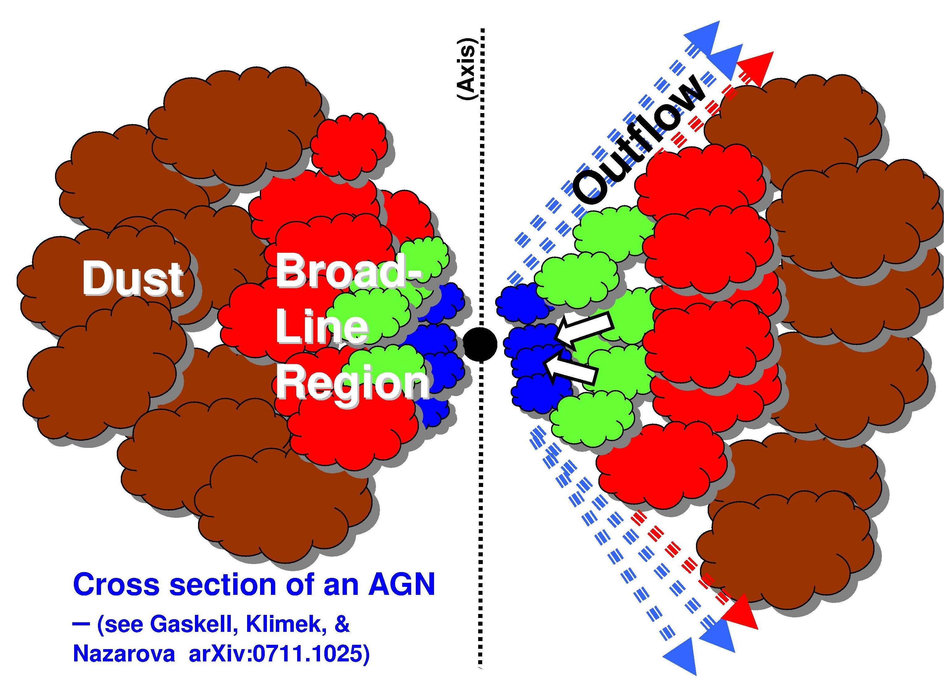
LAST YEAR’S
CONCLUSIONS:
Now plenty of good clues to what an AGN looks like, and how it works.
We needed to do two things to complete the story:
Convict the culprit!
  (I.e., convince the judge and jury)
Wrap up the (many!) loose ends in the plot of the book/movie.

Slide 4
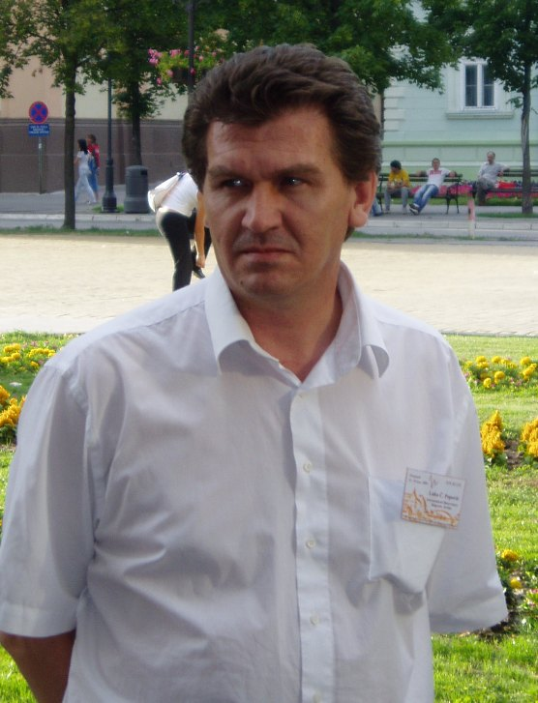
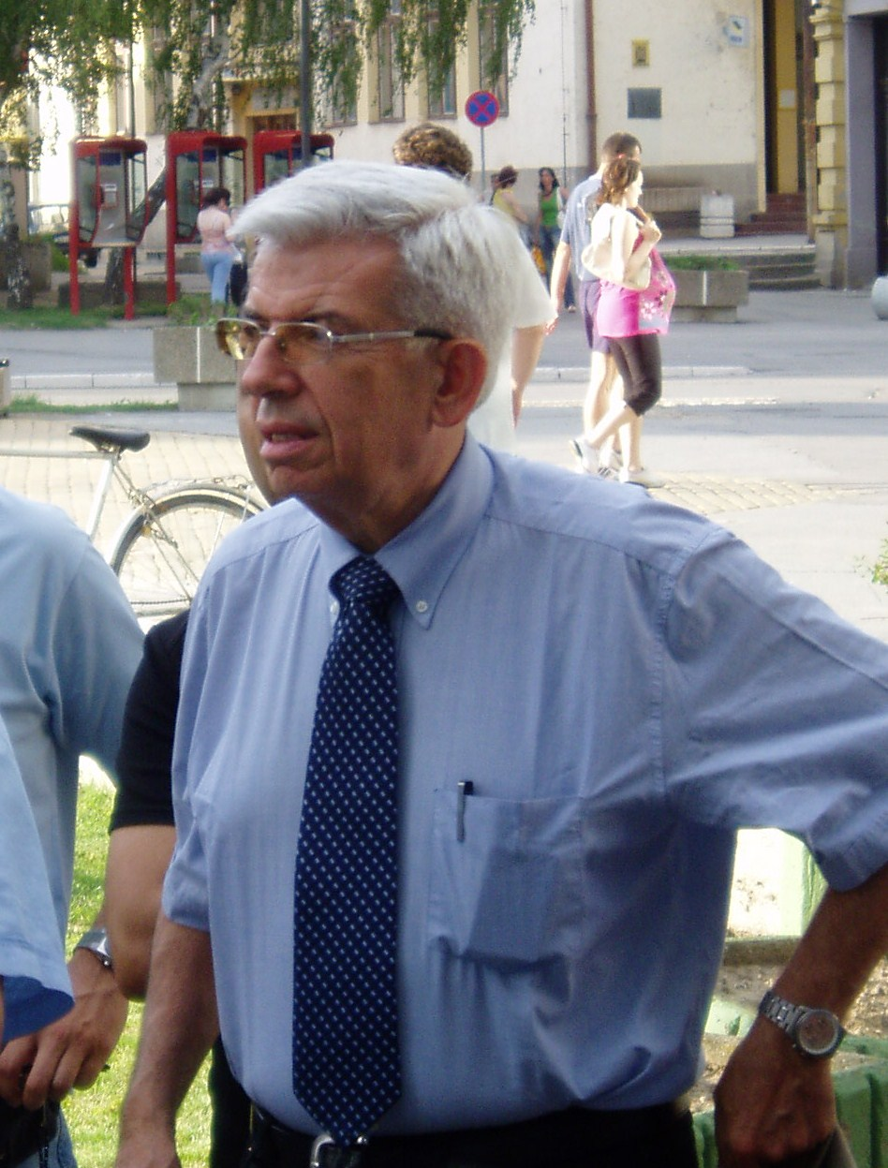
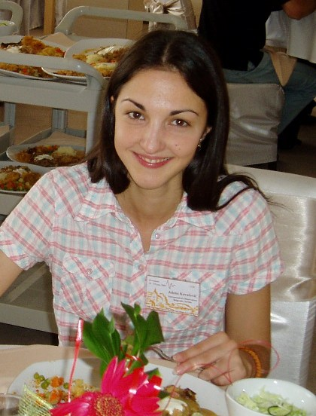
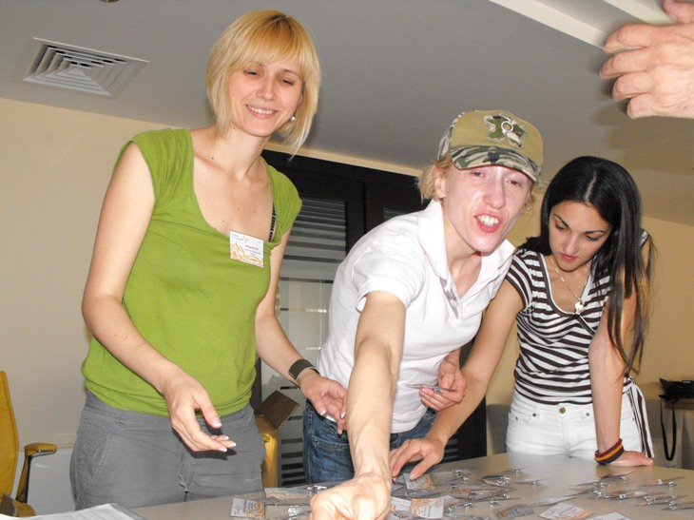
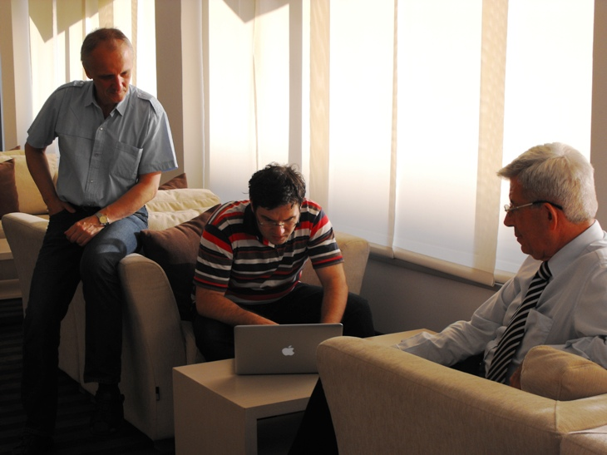
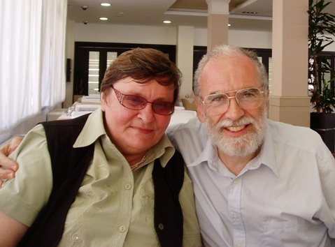
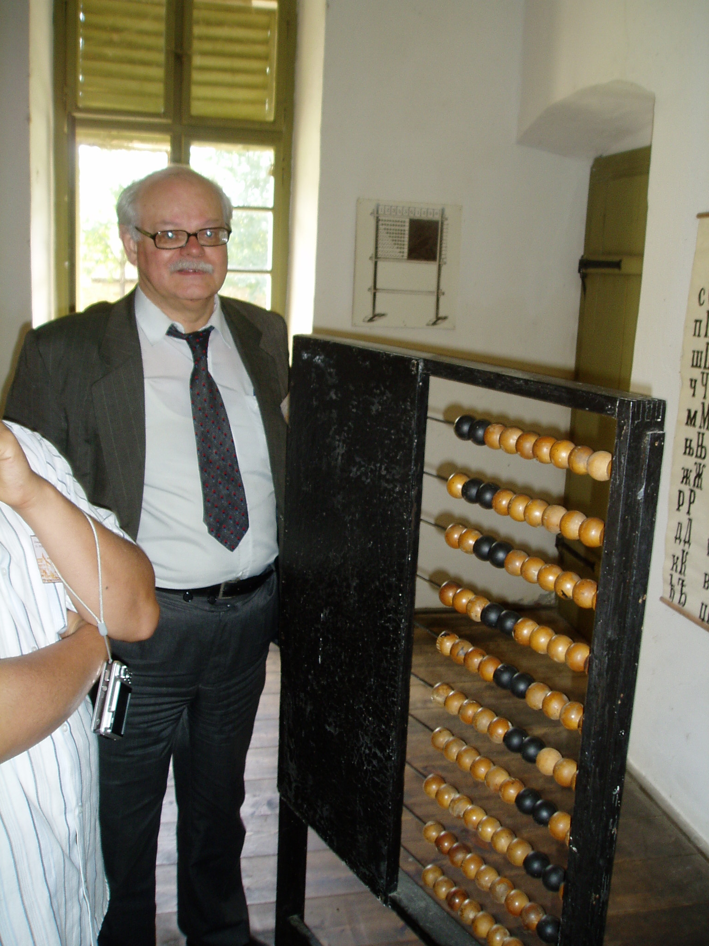
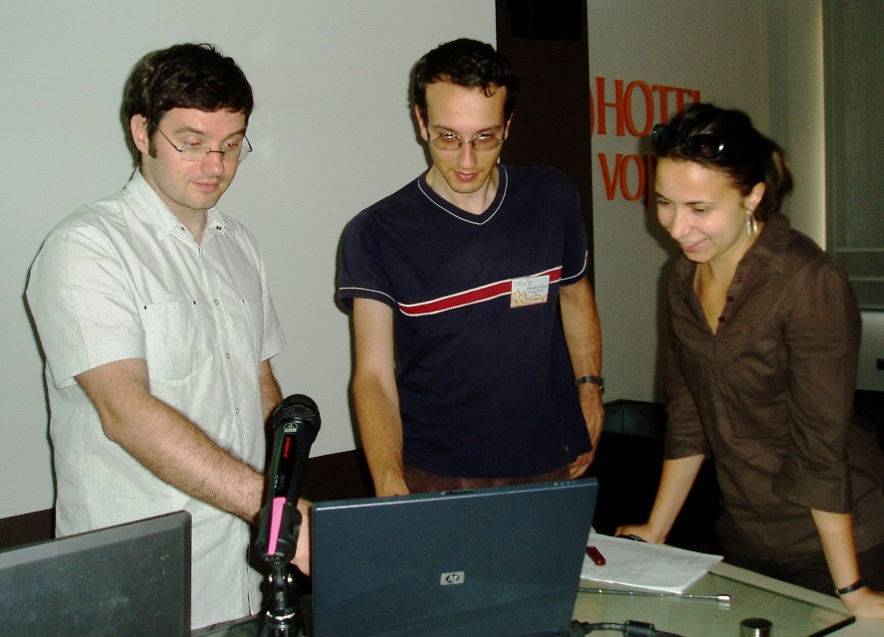
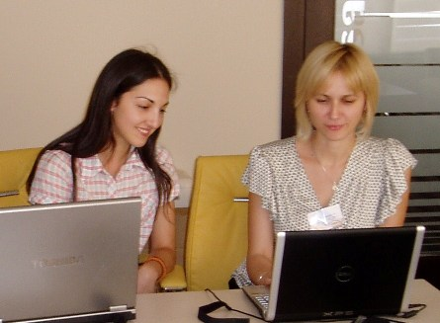
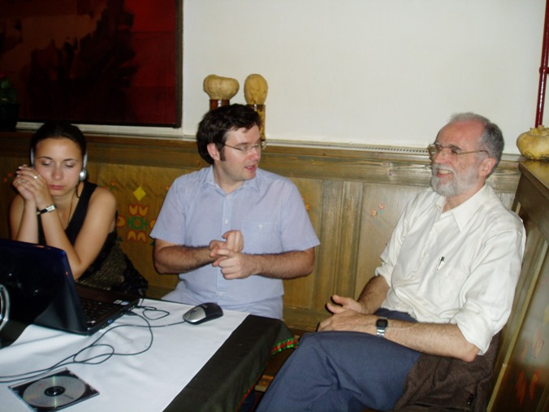
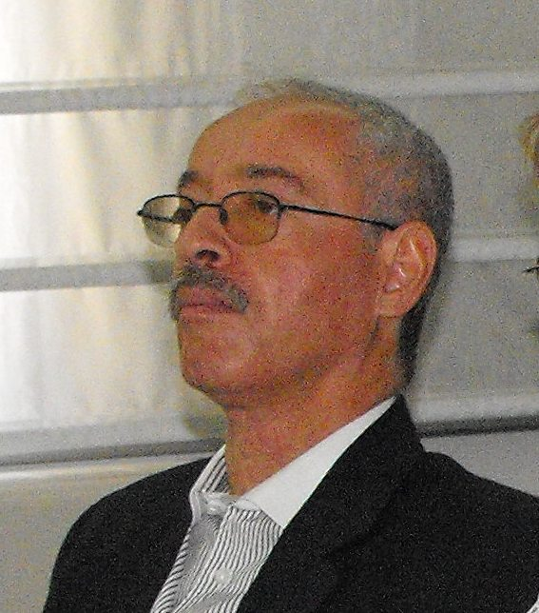
Now, follow the example of popular writers and movie producers:
A sequel!
(The same cast of characters gathers in another exotic location in the Balkans to solve further BLR mysteries!)

Slide 5
WHAT SPECTRAL LINE SHAPES TELL US ABOUT HOW AGNS WORK. PART II
The Serbian Astronomical Society and Belgrade Astronomical Observatory present…
- THE BLR STRIKES BACK!

Slide 6
But first, another idea from network TV:
A re-run!
(a review of some of last year’s talk)

Slide 7
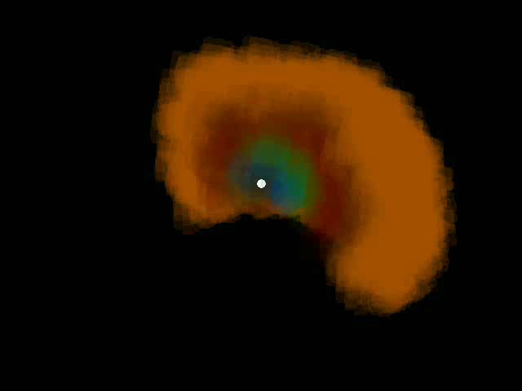
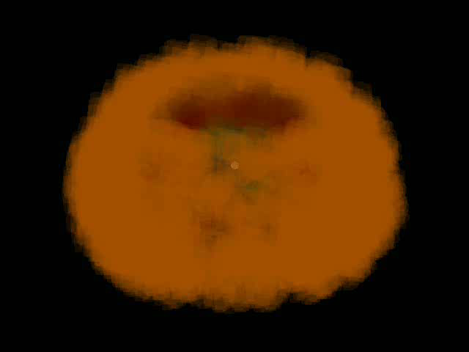
Computer-Generated Images of the Culprit:
(Rendering by Daniel Gaskell)

Slide 8
Sketch of the Culprit

Slide 9
The Description of the Culprit
Outer edge of the BLR is the radius of the torus.
Outer boundary of BLR is dust sublimation radius (Netzer & Laor 1993) (hence R_{BLR} ∝ L^{1/2} from inverse-square law)
Ω_{BLR} = Ω_{dust}
Ω ≈ 50% (actually luminosity dependent)
Flattened BLR
Hole in middle
We see BLR within ≈ 45 deg of face-on
Strong ionization stratification

Slide 10
Ionization structure of a single cloud:

Slide 11
Ionization structure:
SELF-SHIELDING MODEL

Slide 12
Ionization structure:
SELF-SHIELDING MODEL
cf. “filling-factor” model of MacAlpine (1974)

Slide 14
Overall ionization structure like a single cloud!

Slide 15
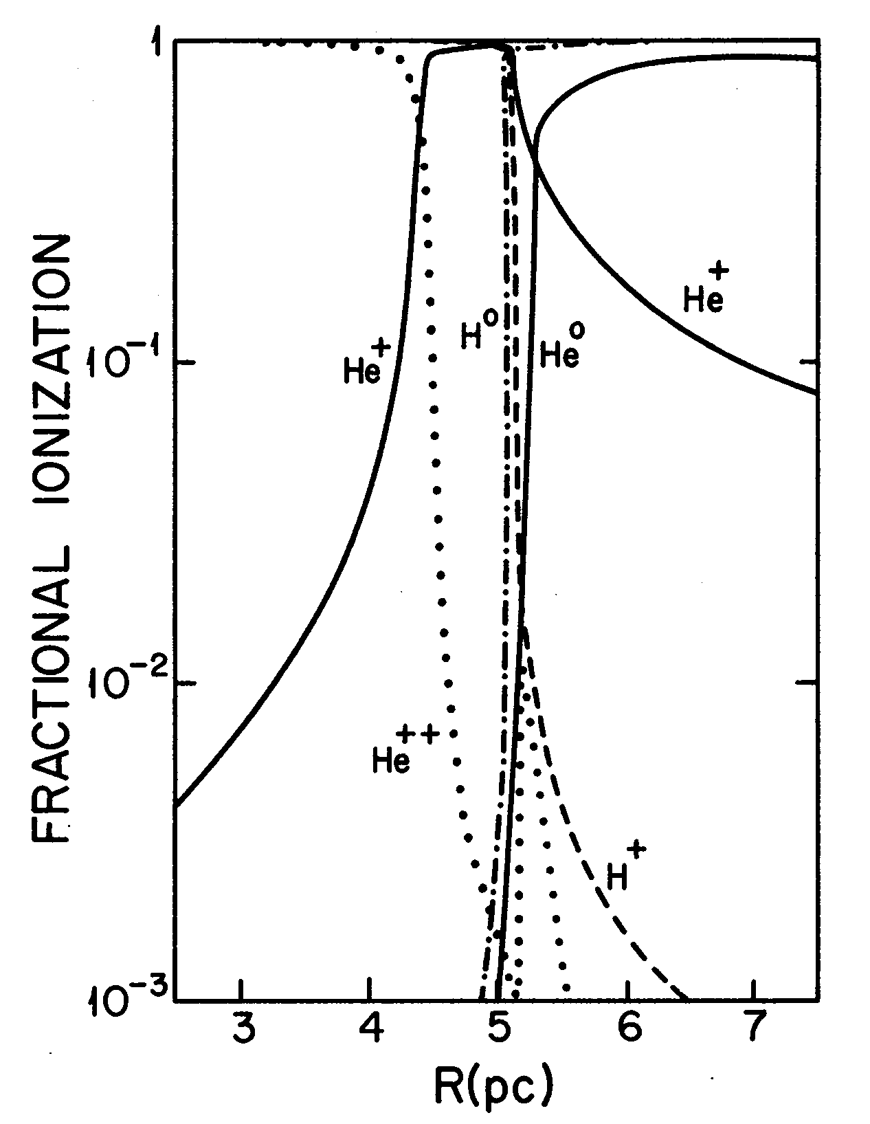
MacAlpine (1972)

Slide 16
Predicts lags for NGC 5548:
(only one free parameter!)

Slide 17
Sketch of the Culprit

Slide 18
How was the crime committed? - motions of the culprit

Slide 19
Overall motion of the gas:
Predominantly Keplerian motion + “turbulence” (random vertical motions) Osterbrock (1978)
Need the vertical motions to get the necessary thickness
(if we didn’t have vertical motions we couldn’t get virial masses since we view AGNs face on!)
Now add inflow:
v_{Keplerian} > v_{turb} > v_{inflow} ~ 0.1 – 0.2 v_{Keplerian}

Slide 20
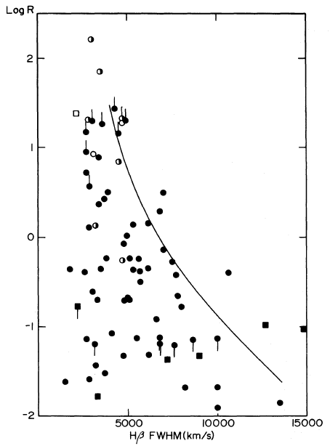
Evidence for disc BLRs in all AGNs
Face-on
Wills & Browne (1986)
Edge-on

Slide 21
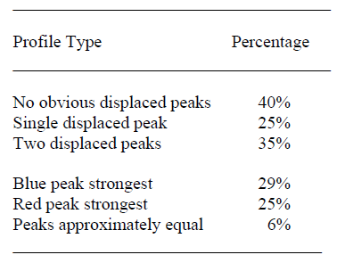
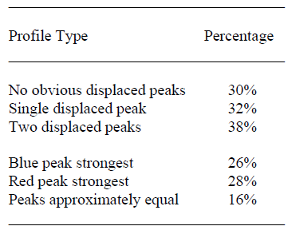
Disc components present in all low-ionization BLR lines
See:
Gaskell & Snedden (1999)
Bon, Popović, Ilić, & Mediavilla (2006)
Popović, Bon, & Gavrilović (2008)
Radio-quiet Radio-loud

Slide 22
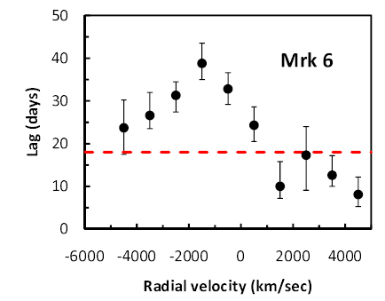
Evidence for inflow: 1. Velocity-resolved reverberation mapping
For inflow, red wing (near side) shows shortest lag (Gaskell 1988).
Gaskell (2010) (Adapted from Sergeev, Pronik, & Sergeeva (1999))

Slide 23
Evidence for inflow: 2. Blueshifting of high-ionization lines because of scattering
High-ionization BLR lines blueshifted relative to low-ionization lines (Gaskell 1982).
[Popular “wind+disc” model with disc blocking wind on far side (Gaskell 1982) ruled out by velocity-resolved reverberation mapping (Gaskell 1988).]
Due instead to scattering off infalling material (Gaskell & Goosmann 2008).

Slide 25
[Modelled using STOKES (Goosmann & Gaskell 2007)]
v_{infall} = 1000 km/s
Solid curves: Shell, (τ = 0, 0.5, 1, 2, 10)
Dots: Torus, τ = 20
(Gaskell & Goosmann 2008)

Slide 26
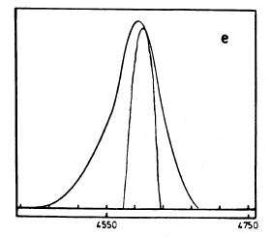
Example:
Gaskell & Goosmann (2008)
Wilkes (1984)

Slide 27
MASS ACCRETION RATE OF BLR (easy calculation!)
Already noted long ago that if BLR motion is radial, mass flow rate ~ accretion rate needed (e.g., Padovani & Rafanelli 1988)
⇒ Mass inflow rate = rate needed to provide observed luminosity! (If efficiency =10% and n_{H} = 10¹⁰ cm⁻³)
THE MASS INFLOW OF THE BLR IS THE ACCRETION ONTO THE AGN!

Slide 28
End of re-run
(on to the sequel… )

Slide 29
What next?
To complete the story we needed to:
Convict the culprit
  (I.e., convince the judge and jury of our peers)
Wrap up the loose ends in the plot of the book/movie.
Next: focus on convincing our peers about our ability to explain line profiles and profile variability.
(Will give us new mysteries for the sequel!)

Slide 30
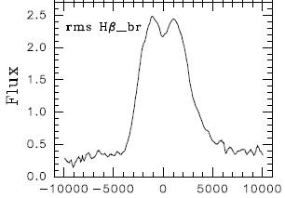
There are disc profiles
NGC 5548 Shapovalova et al. (2004)

Slide 31
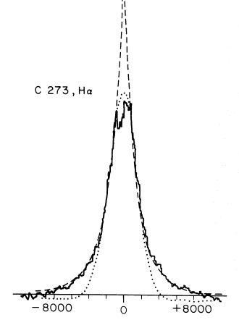
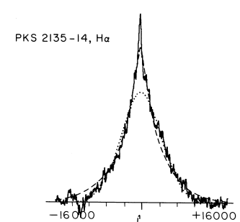
But also “normal” AGN line profiles – “logarithmic” profiles
How do you explain these with the “bird’s nest” BLR?
Obs. – Baldwin (1975) – Lick Observatory (Robinson Wampler IDS)
Models – “logarithmic” profiles from Blumenthal & Mathews (1975)

Slide 32
BL-RESP – a new code for modelling the BLR
[Remark: Not ready for a public release yet, but I’d be delighted to collaborate with anyone who wants to use BL-RESP to model BLR data.]
Takes basic parameters of the GKN (Gaskell, Klimek, & Nazarova) model for each line (or winds, or anything else you want)
What BL-RESP produces:
  movies of the BLR
  BLR profiles for any line
  The reverberation mapping lag
  Reverberation transfer function, Ψ(τ)
  Velocity-resolved lags
  2-D “velocity-delay” maps
  Correction factor (f) for virial black hole mass estimates
What BL-RESP does not do:
  Include scattering (use the STOKES program – publically available )
  Give polarizations (use STOKES instead)

Slide 33
BL-RESP – a few details
BLR modelled as discrete clouds – just for computational convenience (probably really fractal – Bottorff & Ferland 2002)
For GKN model:
Keplerian motion (simple)
Vertical motions (MAJOR THEORETICAL PROBLEM!) modelled as tilted orbits. Known physics and physically consistent (conserves energy and ang. mom.) but vertical motions must really be magnetically driven (else clouds destroyed in collisions).
(Other details – ask questions.)

Slide 34
What is looks like
Face-on
Edge-on
i = 30 deg
[Hit ESC to terminate movie – if that doesn’t work close the command window.
Click on this page when you are done before you move on.]

Slide 35
Typical disc:
NGC 5548 Shapovalova et al. (2004)

Slide 36
i = 20 deg

Slide 37
Face-on
i = 20 deg

Slide 38
Face-on
i = 20 deg
Blumenthal & Mathews (1975) profile!

Slide 39
New results
The same GKN model explains line profiles ranging from the “logarithmic” profile (Blumenthal & Mathews 1975) to “disc-like” emitters!
“Disc-like” emitters not fundamentally different from “normal” AGNs – just seen at a higher inclination.
[What about other claimed differences between disc-like emitters and “normal” AGNs? – differences due to internal reddening (Gaskell et al. 2004)]

Slide 40
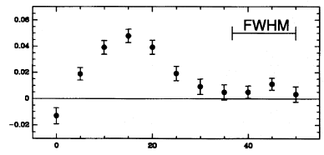
Transfer Functions [Ψ(τ)]
NGC 5548 - Hβ
(Pijpers & Wanders 1994)
1990
(BL-RESP model)
Note: observed Ψ(τ) supports Hβ mostly coming from within a factor of ~ 4 in radius as in GKN.

Slide 41
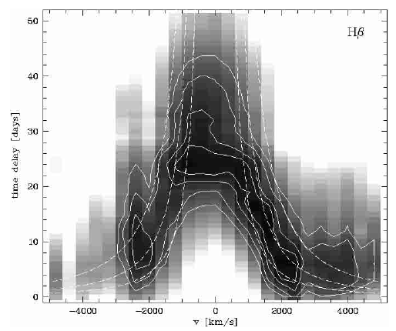
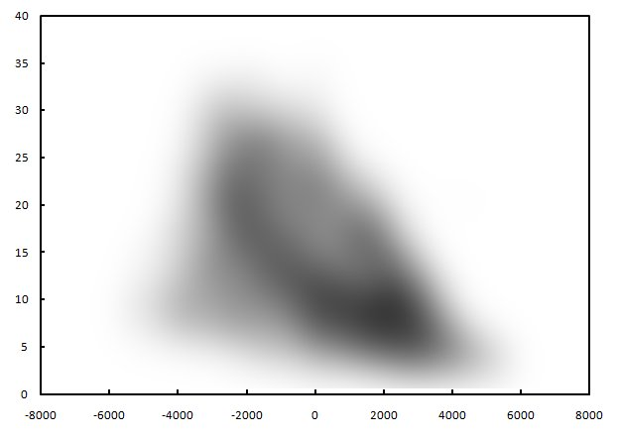
Velocity-delay diagrams
Best example to date: Mrk 110 (Kollatschny 2003)
⇒ Mrk 110 not pure inflow (or outflow)
Sample BL-RESP velocity-delay diagram (pure inflow):

Slide 42
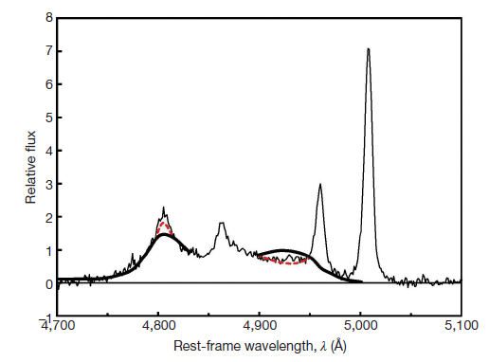
Further mysteries
OK on average, but BLRs are not that simple...
Boroson & Lauer binary BH candidate (Gaskell 2010)

Slide 43
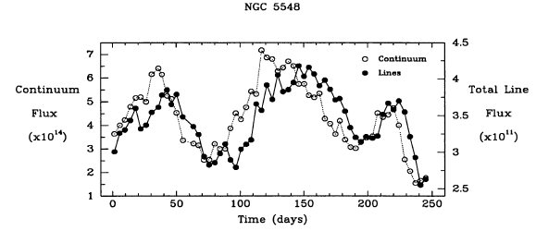
Lag can change in a couple of months!
Maoz (1994)
Lag changes by factor of 1.5!

Slide 44
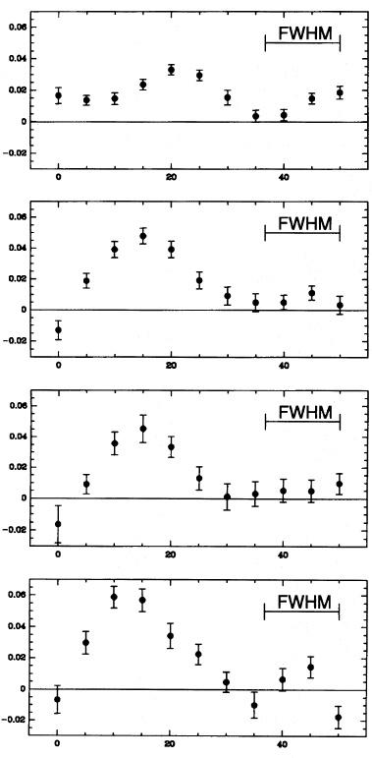
Transfer function can change from year to year!
Pijpers & Wanders (1994)

Slide 45
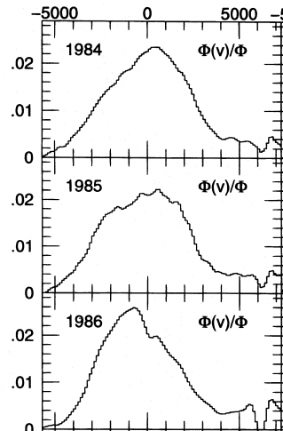
Profiles change with time
Wanders & Peterson (1996)

Slide 46
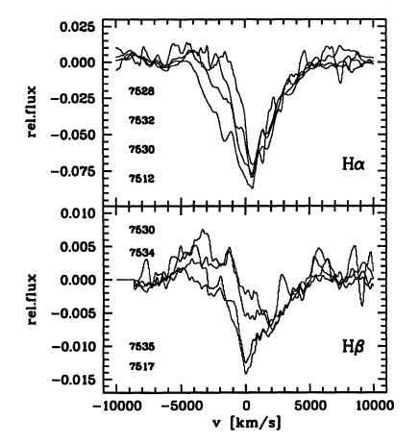
Sometimes only parts of profile vary . . .
Kollatschny & Dietrich (1996)

Slide 47
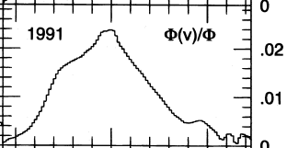
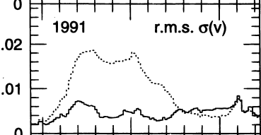
Wanders & Peterson (1996)

Slide 48
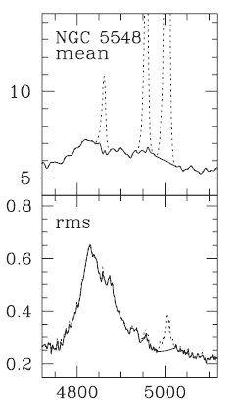
Profiles change in odd ways!
Denney et al. (2009)

Slide 49
Conflicting inflow/outflow kinematic signatures
OK?
(Adapted from Sergeev, Pronik, & Sergeeva (1999))

Slide 50
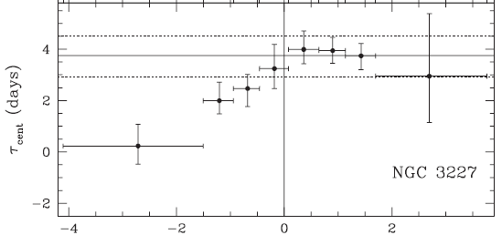
Reverberation mapping signature of outflow??!!
Denney et al. (2009)

Slide 51
What an outflow looks like:
Outflow

Slide 52
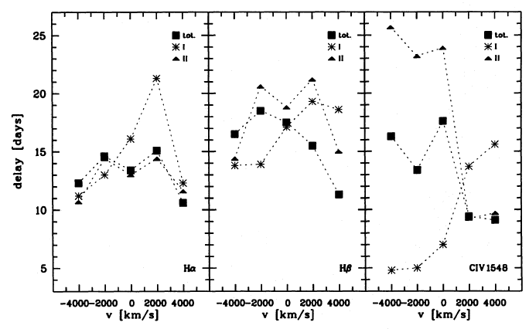
Whole kinemetic signature can change in 2 months!!!
Kollatschny & Dietrich (1996)

Slide 53
How the kinematics appear to change in 2 months
Outflow
Inflow

Slide 54
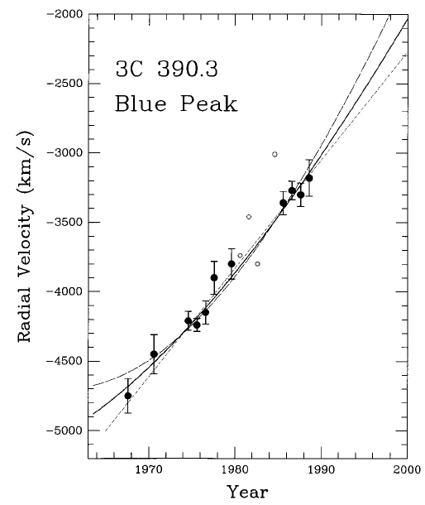
Peaks appear to orbit
Gaskell (1996)

Slide 55
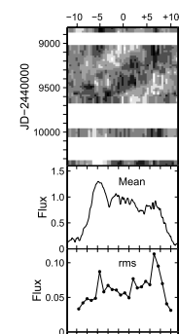
Sergeev et al. (2001)

Slide 56
Can we exlain a profile this extreme?
(The most extreme of ~ 10,000 SDSS spectra in Boroson & Lauer 2010)

Slide 57
A NEW AGN VARIABILITY PARADIGM
Details in Gaskell (2008)

Slide 58
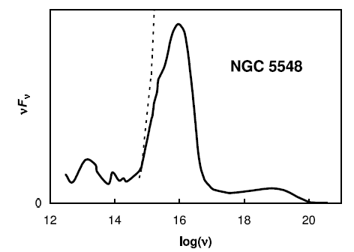
How AGNs are powered
Energy mostly arises from accretion “disc”
Temperature structure well understood (see Gaskell 2008)
SED is the result of summing Planck curves at different temperatures (Pringle & Rees 1972; Shakukra & Sunyaev 1973)
However, steady disc picture totally wrong – variations are VERY strong ⇒ the variability IS the energy generation (Gaskell 2007, 2008)

Slide 59
Photons in each observed spectral region come mostly from where the Plank curve peaks.
∴ each spectral region comes from within an annulus.

Slide 60
Photons in each observed spectral region come mostly from where the Plank curve peaks.
∴ each spectral region comes from within an annulus.
When a spectral varies – the annulus cannot vary simultaneously.
∴ Variations have to be asymmetric

Slide 61
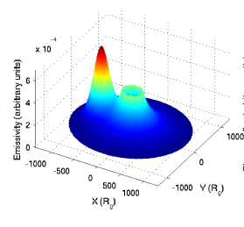
Jovanovic et al. (2010)

Slide 62
Off-axis illumination

Slide 63
Basic profile for central illumination:
i = 20 deg

Slide 67
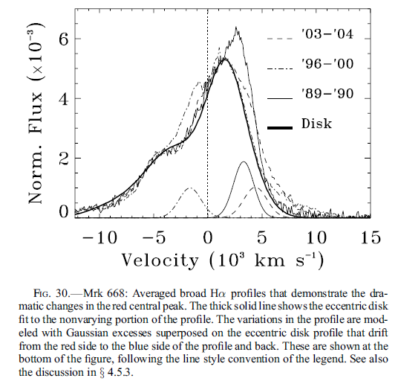
Consistent with profile variability
Gezari et al.

Slide 68
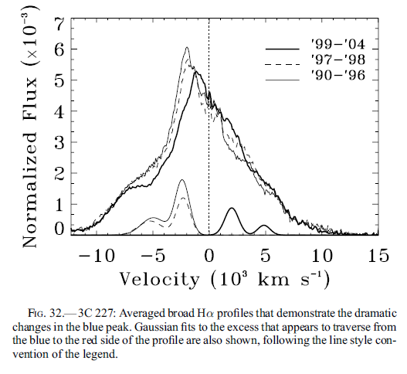
Gezari et al.

Slide 69
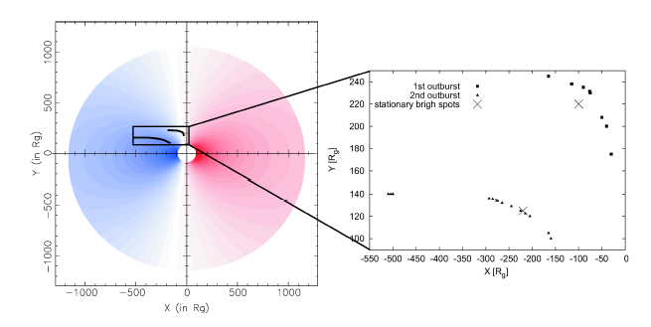
You can model flare motion!
Jovanovic et al. (2010)

Slide 70
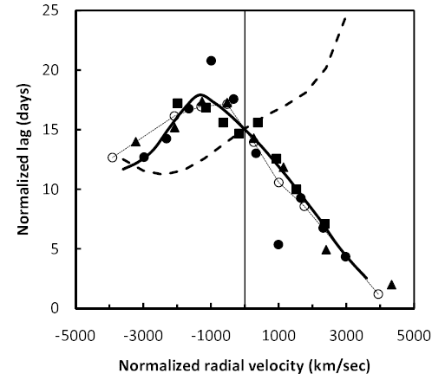
Explains diverse kinematic signatures
Outflow?
Inflow?
Off-axis illumination
OFF-AXIS ILLUMINATION EXPLAINS ALL VELOCITY DEPENDENCE OF LAGS

Slide 71
It’s the continuum flares that are orbiting, not blobs in the BLR.
Solves speed problem
Solves Keplerian shear problem
Sergeev et al. (2001)

Slide 72
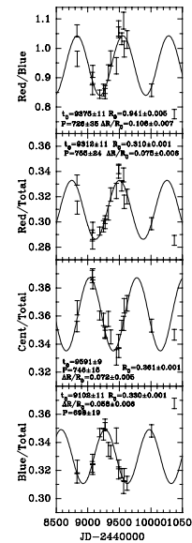
Shapovalova et al.

Slide 73
CONCLUSIONS
The GKN picture works well – AGN BLRs very similar
A new AGN variability paradigm: VARIABILITY IS STRONGLY OFF AXIS
Explains profiles, profile variability, lags, transfer functions, velocity-delay diagrams
Means that we have reached the limits of reverberation mapping (can’t get perfect knowledge with infinite observing).
Makes it hard to find evidence of supermassive BH binaries
Makes modelling more complicated.
We can learn a lot about where flares are happening
Can learn a lot more about BLR structure
STAY TUNED FOR THE NEXT SEQUEL!

