Slide 1


Data analysis on Serbian participation in COST Actions:
Celebrating 50 years of research networks
Dr. Bratislav Marinković, COST Committee of Senior Officials (CSO)
Fruška Gora, 31th May 2022

Slide 2
“COST provides networking opportunities for researchers and innovators in order to strengthen Europe’s capacity to address scientific, technological and societal challenges.”
The three strategic priorities:
– Promoting and spreading excellence (raise the bar for excellence of R&I actors in widening countries in partnership with outstanding European and international institutions)
– Fostering interdisciplinary research for breakthrough science
– Empowering and retaining young researchers and innovators
COST: 1971-2001-2021-2022

Slide 3
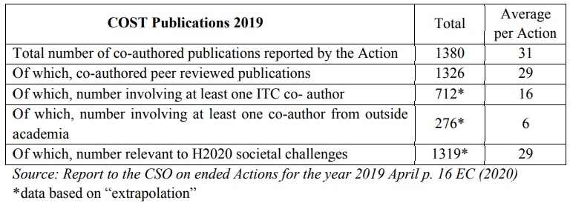
Priority 1. Promoting and spreading excellence
Spreading Excellence and Widening Participation (SEWP)
Under Horizon 2020, from 2014–2020, COST was funded 50% by the SEWP programme and is spending half of the budget to benefit “widening countries. In Horizon Europe, from 2021-2027, COST is funded fully from the WPSE. This means that 80% of the budget will be devoted to widening Actions and 50% of the budget is invested in “widening countries”.

Slide 4
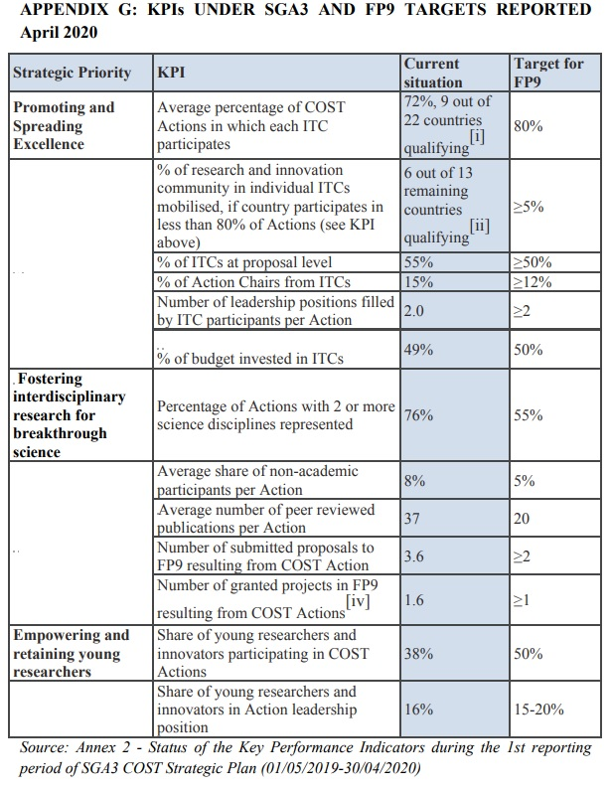

Slide 5
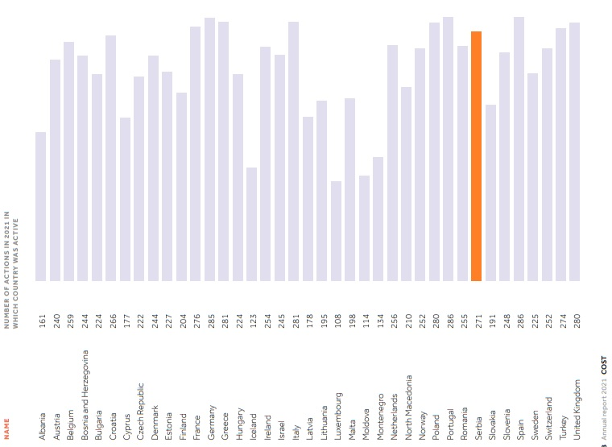
Active participation in COST Actions running in 2021 by country

Slide 6
Priority 2. Fostering interdisciplinary research for breakthrough science

Slide 8
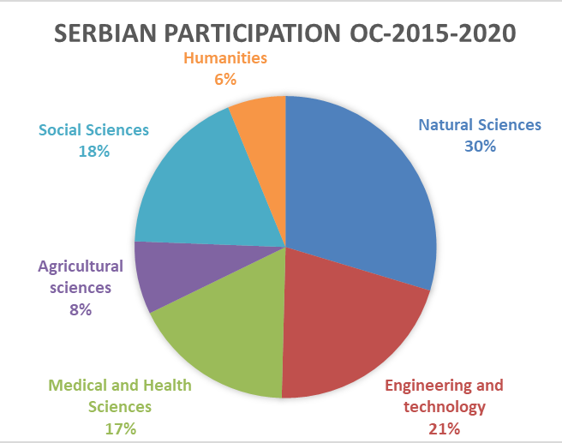

Slide 9
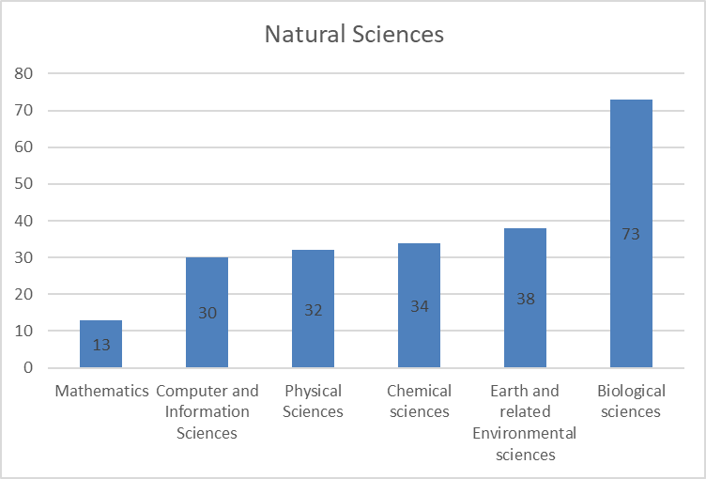
Subfields OECD Fields of Science and Technology
OC 2015 - 2020

Slide 10
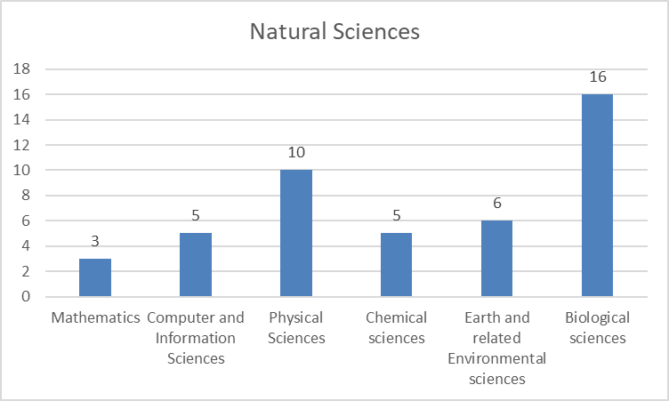
Subfields OECD Fields of Science and Technology
OC 2021-1

Slide 11
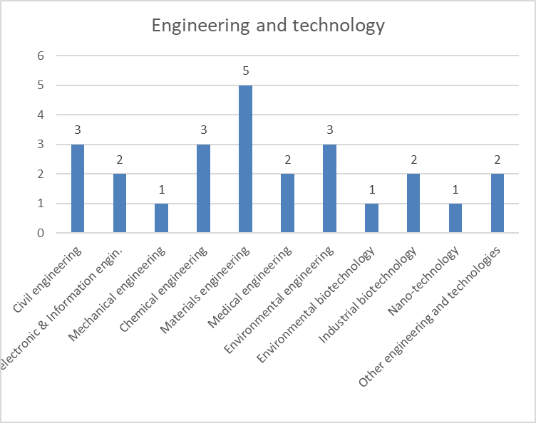
Subfields OECD Fields of Science and Technology
OC 2021-1

Slide 12
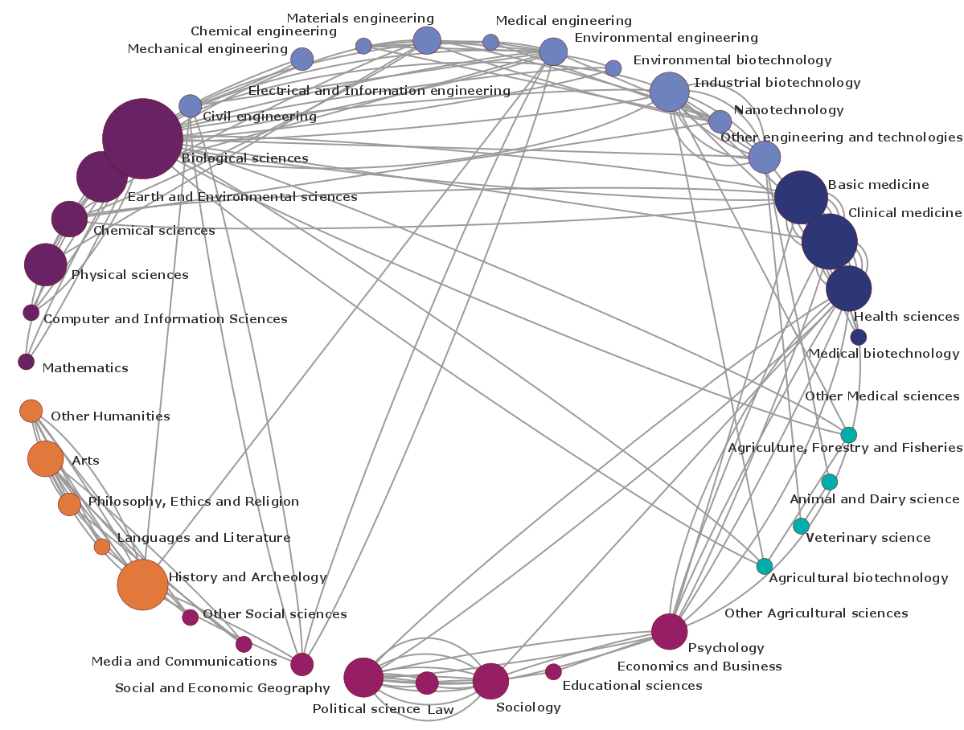
oc-2018-2
oc-2018-2

Slide 13
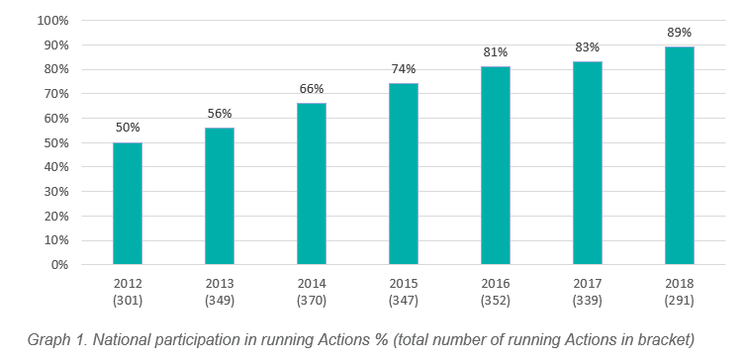
Serbian participation in COST Actions 2012-2018

Slide 14
COST ACTIONS’ BUDGET TRANSFERRED TO SERBIA
COST Actions’ budget transferred to the country
Country share of the total Action budget

Slide 15
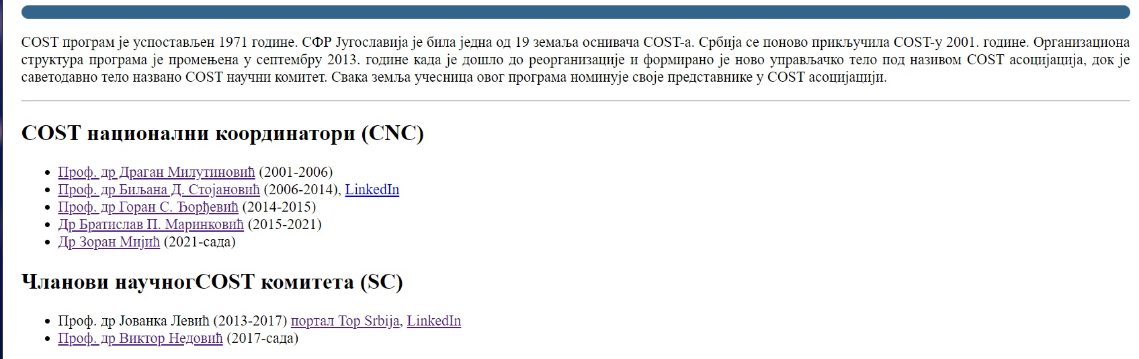
http://mail.ipb.ac.rs/~ncc-serbia/Iz_Istorije.php

Slide 16
National procedures for joining and/or starting a new COST Action
http://www.mpn.gov.rs/cost/
http://mail.ipb.ac.rs/~ncc-serbia/
Dr. Zoran Mijić e-mail: ncc-serbia@ipb.ac.rs

Slide 17
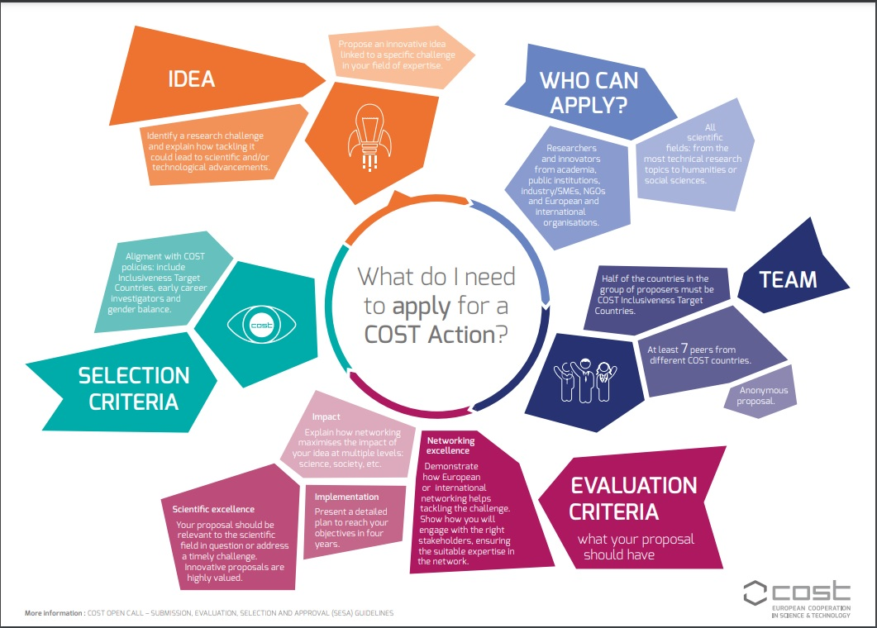
GOALS
INFOGRAPHICS
Acknowledge COST in your publications
Be a WG leader
Be a MC member or substitute
Make your own consortium
Become an Expert
Be a Chair
Enroll in COST pool of experts
Become a Grant Holder
Be a participant of COST Action
Ask for the guide: COST Action Grant Holder - Role and requirements

Slide 18
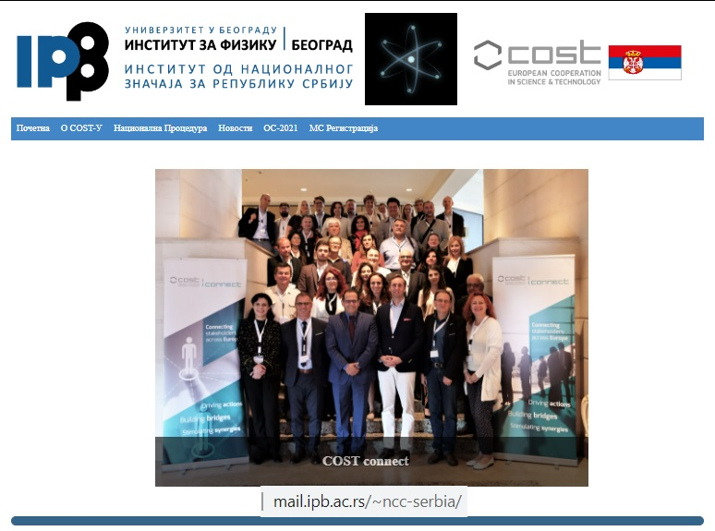
Thank you for your attention
New Info Days:
June+October
COST Connect
October 2022
http://mail.ipb.ac.rs/~ncc-serbia/
ncc-serbia@ipb.ac.rs

