Slide 1


SPECTROSCOPIC METHOD FOR NITROGEN IMPURITY ESTIMATION IN HELIUM ATMOSPHERIC DISCHARGE
N. Cvetanović, S.S. Ivković, B.M. Obradović
Faculty of Physics, University of Belgrade
A&M DATA 2023, Palić

Slide 2

Cold Atmospheric pressure discharges
Non-thermal or cold discharges, are presently most investigated and most promising laboratory plasma sources.
In the last two decades they have been extensively studied both theoretically and experimentally.
Plasma is strongly out of equilibrium with electron temperature of the order 10000 K while ions and atoms are at close to room temperature (therefore cold).
Dielectric barrier discharges (DBDs) operating in noble gases mostly He and Ar.

Slide 3
Why are impurities important in atmospheric discharges?
Gas impurities within the working gas are crucial for barrier discharge operation mostly due to metastable processes.
Numerous models have shown the influence of gas impurity level on discharge parameters.
Impurities originate mostly from the air protruding through the chamber, gas supply system, but also some traces are always in the cylinder
The impurity composition is mostly N₂ but also O₂ and H₂O.
There is a necessity for a spectroscopic measurement of impurity level

Slide 4
Our method is based on the intensity ratio of prominent nitrogen molecular band
and strong helium line.
N₂ (C³Πu–B³Πg, 0-0) at 337 nm, and the
He I (3³S-2³P) at 706 nm .

Slide 5
Collisional-radiative model:
Collisional-radiative model was developed, and a functional dependance of intensity ratio on impurity at a given reduced electric field was numerically obtained.
The ratio is obtained from the number density of exited species:

Slide 6
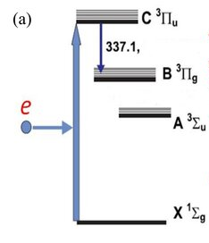
N2(C)
In helium plasma, the nitrogen excited N₂(C) density can be calculated from processes involving electron excitation, N₄⁺ recombination, and pooling from N₂(A) metastable.
When nitrogen is present as an impurity, the metastable pulling is negligible.
e + N₄⁺ → N₂(C) + N₂
e + N₂ → N₂(C)
nm
Steady state equation is valid in our conditions:

Slide 7
He 3³S
System of three time-dependent equations for the interconnected levels 3³D, 3³P and 3³S are:
Electron excitation from the ground level and from the metastable He 2³S
excitation transfer from He 3³D and He 3³P
The electron excitation rate constant from
the ground level He (k_{e}) and metastable Hem (k_{em})
are obtained from the BOLSIG– solver.

Slide 8
Electron collision excitation rates are obtained from Boltzman solver and depend on E/N.
Process |  | Value
deexcitation coefficients
Spontaneous emission He: | 3³S→2³P | A₇₀₆ = 2.75×10⁷ s⁻¹
 | 3³P→2³S | 9.47×10⁶ s⁻¹
 | 3³D→2³S | 6.56×10⁷ s⁻¹
N₂: | N₂(C) → N₂(B) | k₃ = 2.75×10⁷ s⁻¹
 | SPS (0-0) | A₃₃₇ = 1.31×10⁷ s⁻¹
Rate constants
Excitation transfer: | 3¹P→3¹S | k_{ext} = 4.89×10⁻¹⁰ cm³ s⁻¹
 | 3¹D→3¹P | k_{ext} = 1.81×10⁻¹⁰ cm³ s⁻¹
Collisional quenching: | He(3³S) + He | k_{q}=0.53×10⁻¹¹ cm³ s⁻¹
 | He(3³P) + He | 9.8×10⁻¹¹ cm³ s⁻¹
 | He(3³D) + He | 2.4×10⁻¹¹ cm³ s⁻¹
 | N₂(C) + N₂ | k₄ = 1.14×10⁻¹¹ cm³ s⁻¹
 | N₂(C) + He | k₅ = 1×10⁻¹² cm³ s⁻¹
Electron recombinaton: | e + N₄⁺→ N₂(C) | k₂ = 4.6×10⁻⁶ cm³ s⁻¹

Slide 9
Resulting equation:
Because of metastable excitaion it is is valid only E/N > 8 Td
Linear, but field sensitive!

Slide 10
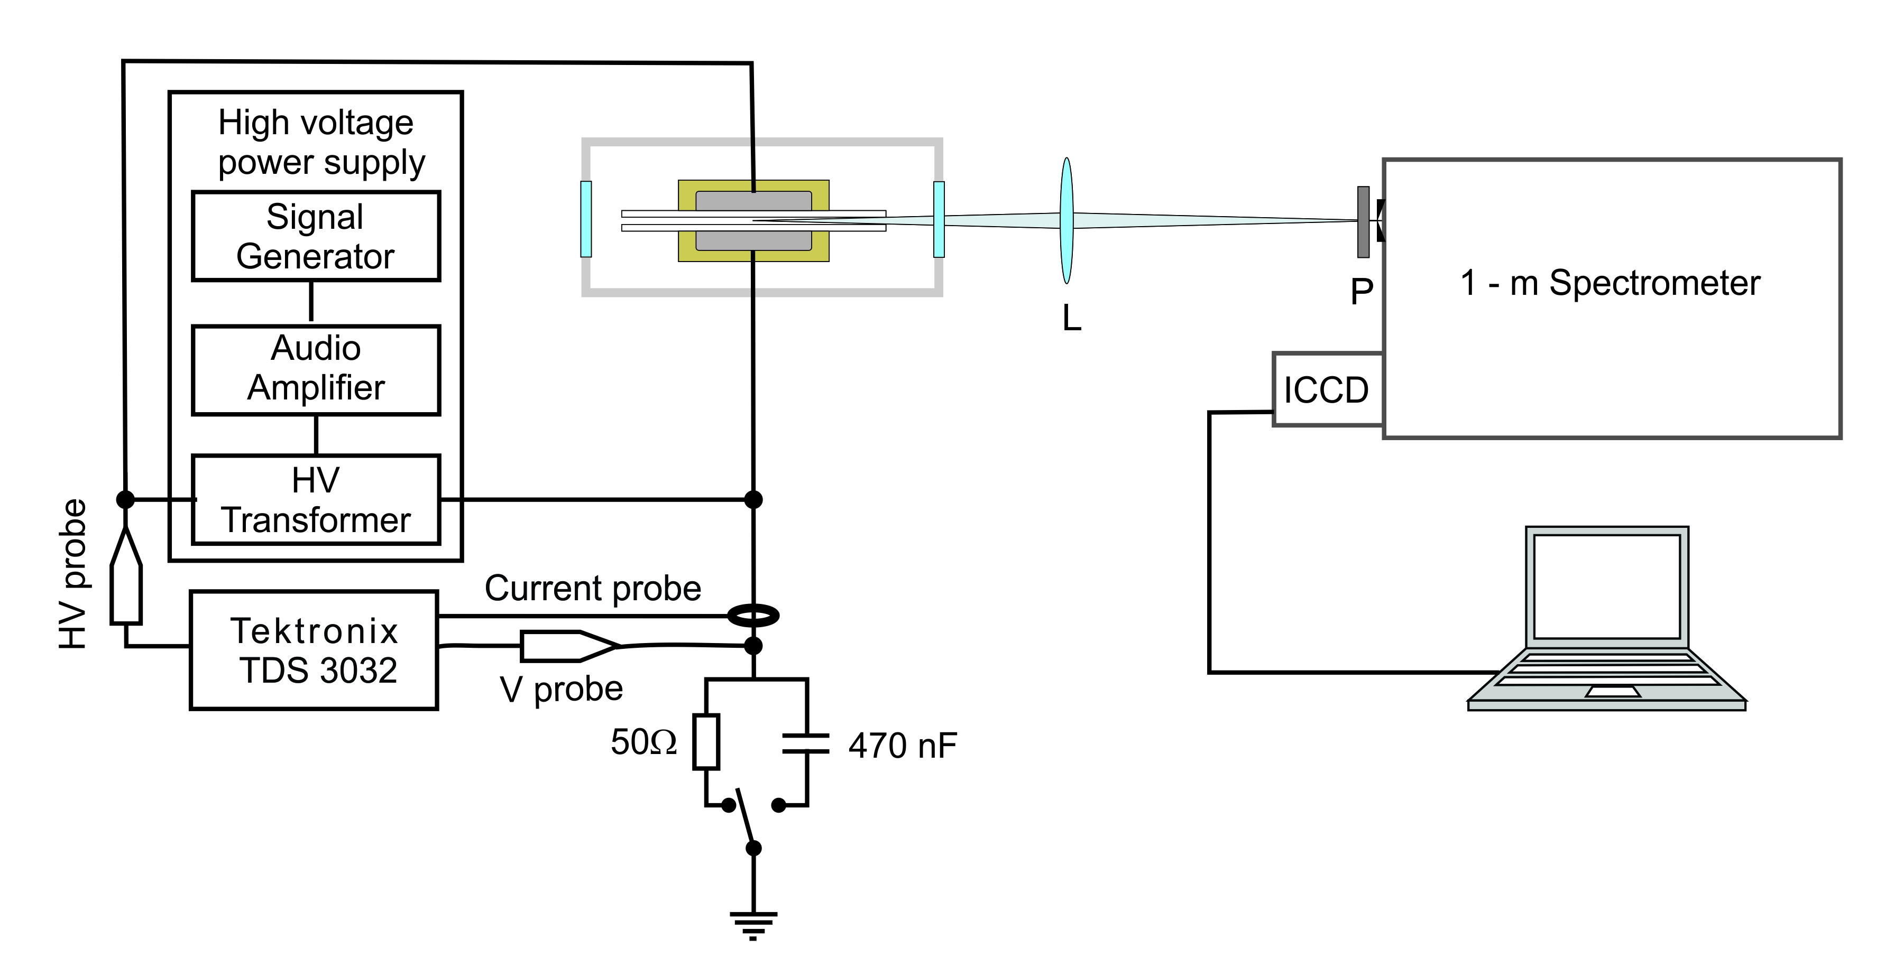
Experiment: DBD with varying helium flow
Investigation of discharge behavior with change of helium gas flow
Electrical and spectroscopic measurements where performed
Strong change of electric properties and line intensities can be attributed to different causes
One possible explanation was the decrease of impurities with stronger gas flow

Slide 11
Experiment
Electric field was measured using Stark spectroscopy
E
-
He

Slide 12
Uncertainty is high at high N2 levels
Minimum value corresponds to the level from the gas cylinder
The obtained values corresponds well with discharge behavior via models
It is evident that increase of gas flow reduces the impurity level

Slide 13
The model needs further detailed verification
This will probably be possible only for high ppm values
Ivković S.S., Cvetanović N. and Obradović B.M. Plasma Sources Sci. Technol. 31 095017 2022

Slide 14
Thank you for your attention!

