Slide 1


Aerosol vertical profiles in Belgrade, Serbia, associated with different surface PM10 concentrations
Maja Kuzmanoski¹, Zorica Podraščanin², Ana Ćirišan³ and Zoran Mijić¹
¹Institute of Physics Belgrade, University of Belgrade, Belgrade, Serbia
²Department of Physics, Faculty of Sciences, University of Novi Sad,
Novi Sad, Serbia
³Faculty of Ecology and Environmental Protection,
Union-Nikola Tesla University,
Belgrade, Serbia

Slide 2
Introduction
Observation of aerosol vertical profile is important in air pollution studies:
vertical structure of the atmospheric boundary layer (ABL)
temporal changes of the ABL height (ABLH)
to understand the development of air pollution
to estimate the contribution of long-range transport to air pollution

Slide 3
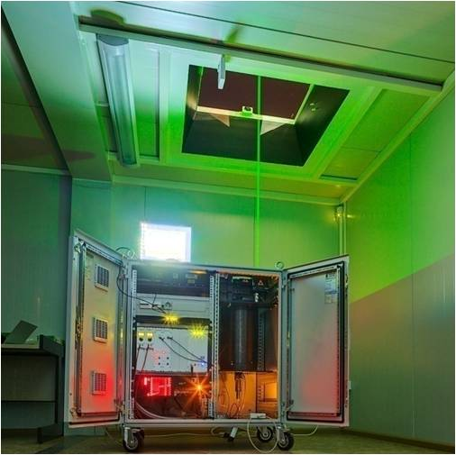
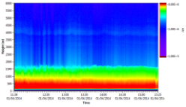
Lidar measurements of aerosol vertical distribution
Atmospheric aerosols
and molecules
Complete overlap
Backscattered signal:
355, 387 nm
Emitted radiation:
355, 532, 1064 nm
Real-time data display
Temporal resolution: 1 min
Pulsed
laser
Blind zone
Vertical resolution:
7.5 m
Telescope
Data acquisition
Detection
system

Slide 4
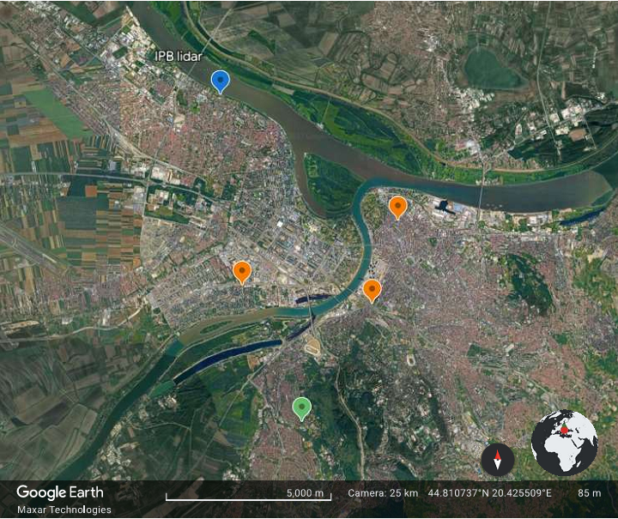
Measurements (period: 2018-2020)
Lidar measurements at 355 nm
30-min averaged vertical profiles of aerosol backscatter coefficient
(Klett-Fernald method, LR=50 sr)
ABLH derived using the gradient method
Radiosounding (00 and 12 UTC)
Stability of ABL based on vertical profile potential temperature
SEPA - automatic monitoring stations:
1-hour PM10 mass concentrations

Slide 5
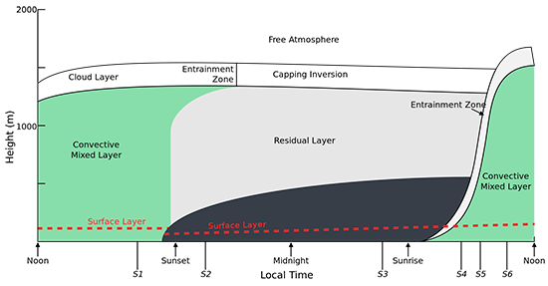
Atmospheric boundary layer (ABL)
(Stull, 1988)

Slide 6
ABLH – typical diurnal variation
GDAS
GDAS

Slide 7
ABLH: lidar and GDAS, 12 UTC
26 lidar profiles around 12 UTC for different stability conditions of ABL:
2 stable
12 unstable
14 neutral
1:1

Slide 8
Lidar ABLH

Slide 9
Lidar measurements and PM10
Average backscatter coefficient in the ABL for different PM10 concentrations

Slide 12
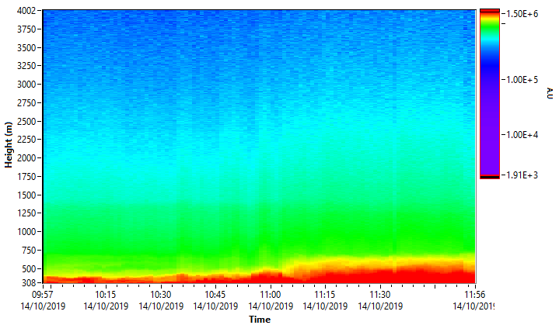
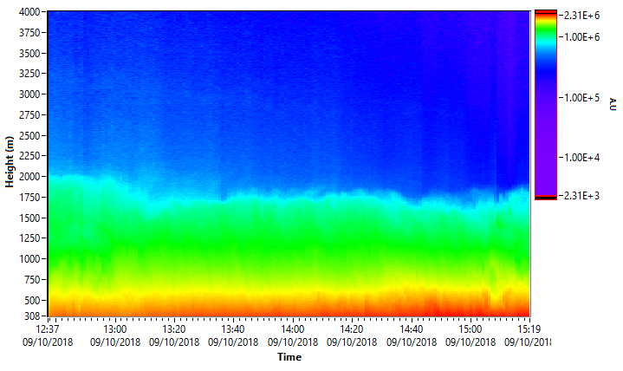

Slide 13
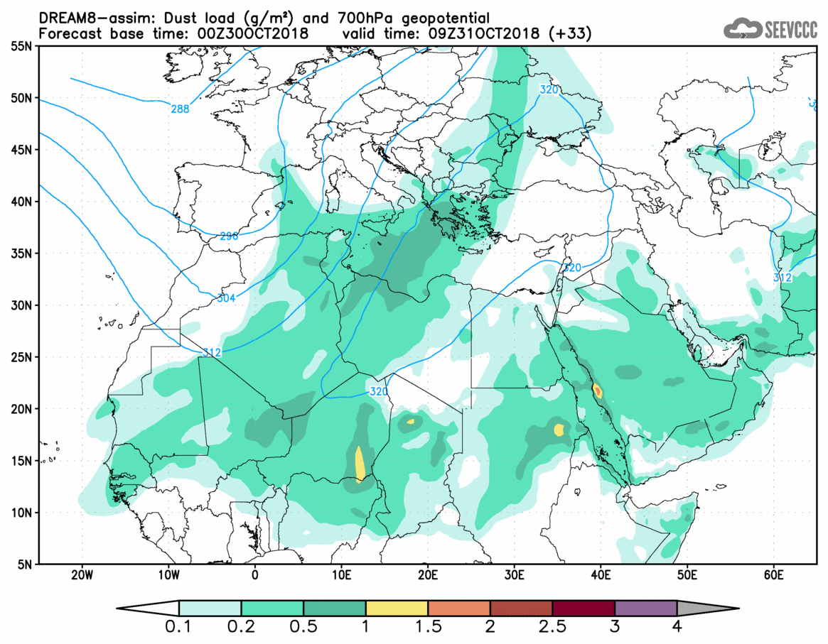
Saharan dust case, 31/10/2018

Slide 14
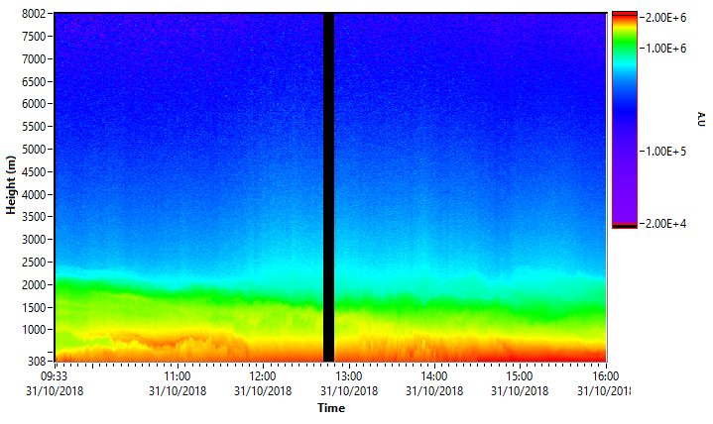
Saharan dust, 31/10/2018
PM10:
30.65 μg m⁻³
40.73 μg m⁻³
62.67 μg m⁻³
71.00 μg m⁻³
122.97 μg m⁻³
IBSC_{ABL} (sr⁻¹):
BSC_{ABL} (km⁻¹ sr⁻¹):
CoM_{ABL}(km):
4.1E-03
2.2E-03
1.2
4.1E-03
2.1E-03
1.2
3.2E-03
1.9E-03
1.1
3.4E-03
2.0E-03
1.0
3.2E-03
2.0E-03
0.9

Slide 15
Conclusion
Initial analysis of relationship between PM10 concentrations and lidar-derived aerosol optical properties within ABL is performed
Lidar measurements can be used to identify intrusion of long-range transported aerosol into ABL
Further work will include WRF-Chem model simulations

